Slide 1

Puzzle | Upside-Down Glasses
There are n glasses on the table, all standing upside down.
In one move, you are allowed to turn over exactly n – 1 of them.
Determine one method to turn up all the glasses.

Slide 2
Puzzle | Upside-Down Glasses
If n is odd :
As in one move, we are allowed to turn over exactly n – 1 of them.
If n is odd then n – 1 i.e, the number of glasses turned over in one move, is even.
Therefore, we can only turn up(or turn down) even number of glasses for each move.
However, there is odd number of glasses to be turned up.
No solution to turn up all glasses!

Slide 3
Puzzle | Upside-Down Glasses
If n is even :
Let us assume that the glasses are numbered from 1 to n.
If n is even, the problem can be solved by making the following move n times: turn over all the glasses except the ith glass, where i = 1, 2, . . . , n.
For example: 1 -> up, 0 ->down, n=4
0000 -> 0111 -> 1100 -> 0001 -> 1111

Slide 4
Learning to Ask: Neural Question Generation for Reading Comprehension [ACL17]
Xinya Du, Junru Shao, Claire Cardie

Slide 5
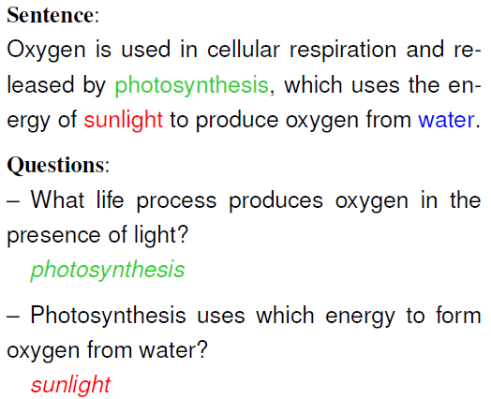
What is Question Generation and why QG?
A New Task: Automatic natural question generation for sentences from text passages in reading comprehension.
Example: From Wikipedia article Oxygen
Real Applications:
Education: Generating questions for testing understanding.
Chat bot: Asking questions to start a conversation or to request feedback.
Improving question answering (QA)
Notes:
193 230 198

Slide 6
QG: Different from many NLG Problems
Unlike Machine Translation:
The input and output are in the same language
Length ratio is often far from one to one
Unlike Summarization:
QG may involve substantial changes to words and their ordering
Summarization usually removes words.

Slide 7

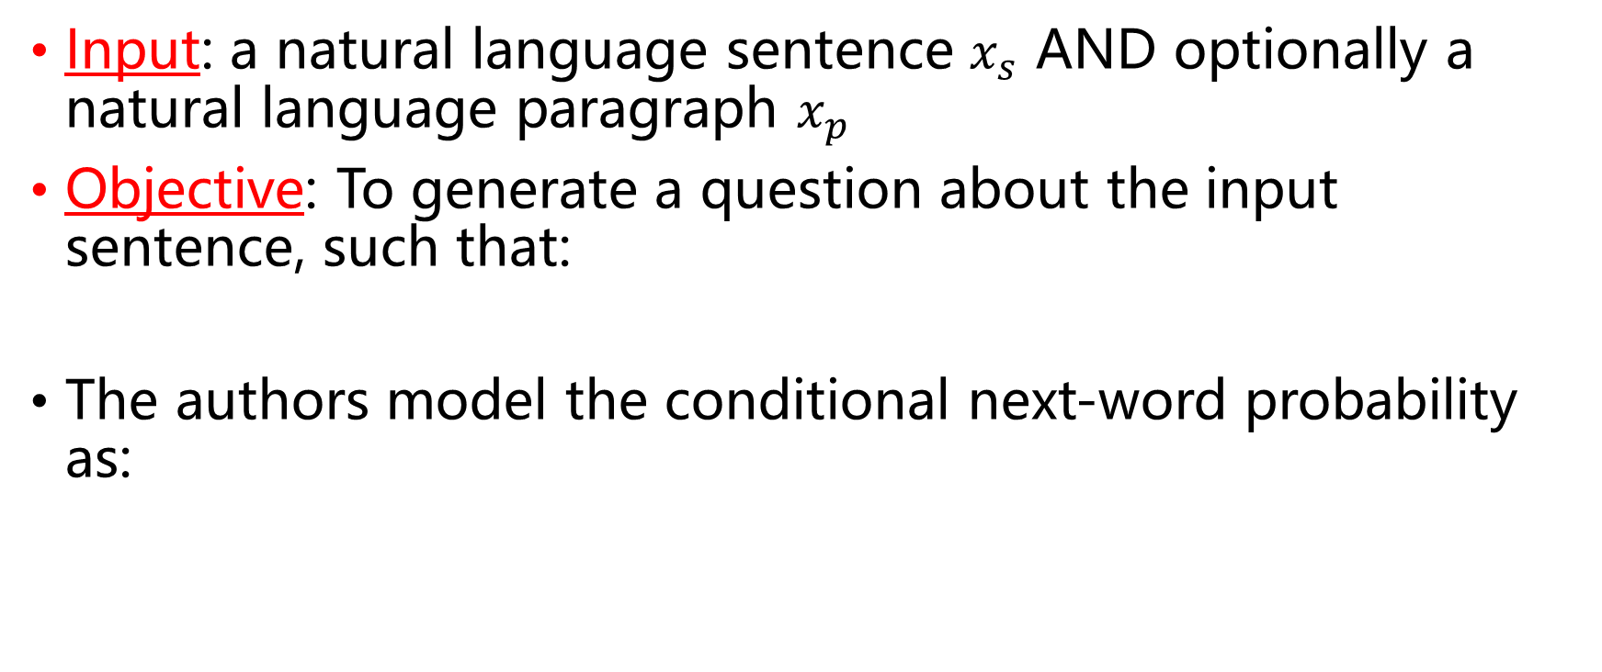
Task Objective
Input: a natural language sentence $x_{s}$ AND optionally a natural language paragraph $x_{p}$
Objective: To generate a question about the input sentence, such that:
The authors model the conditional next-word probability as:

Slide 8
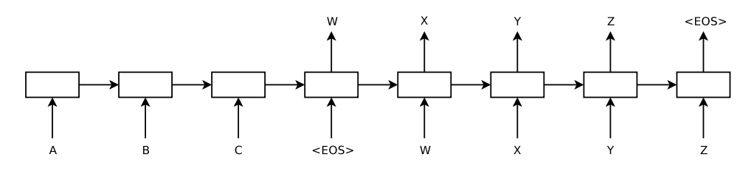
Sequence to Sequence Learning
Deep Learning which maps sequence to sequence
Use multi-layered LSTMs to map the input sequence to a fixed dimensionality
Use another LSTMs to decode the target sequence from the vector
Sutskever, Ilya, Oriol Vinyals, and Quoc V. Le. "Sequence to sequence learning with neural networks." NIPS. 2014.

Slide 9
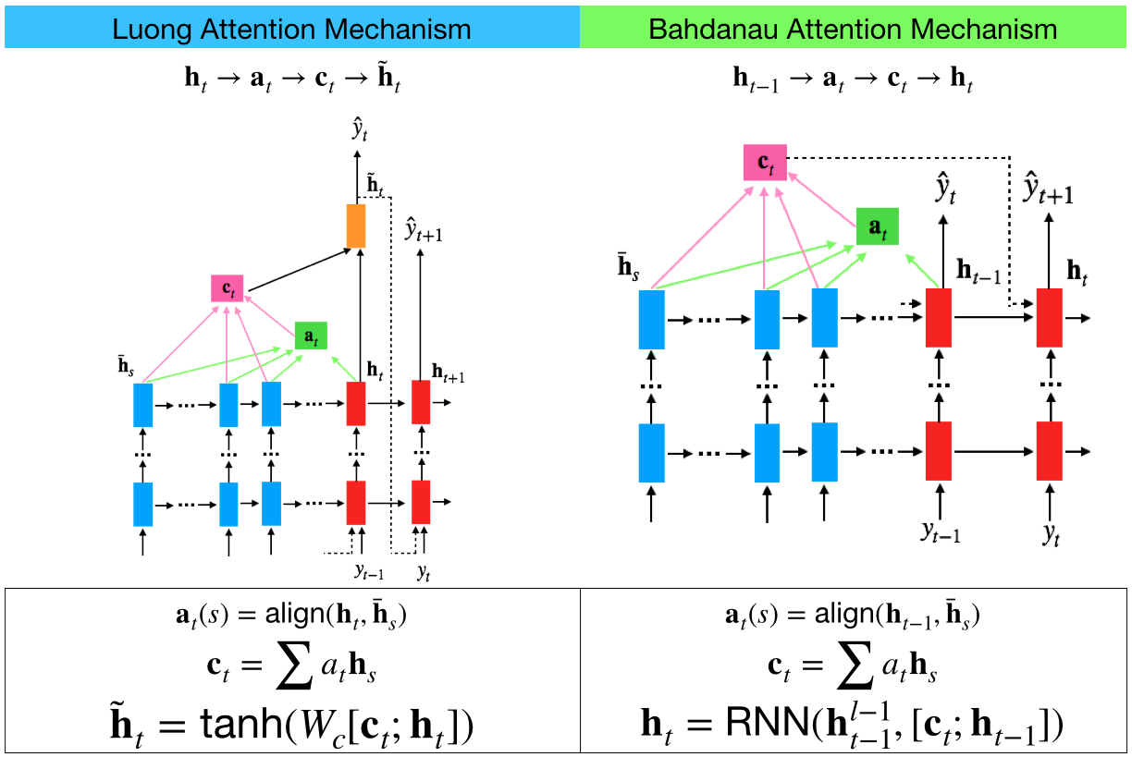
Attention Mechanism
Bahdanau, Dzmitry, et al. “Neural Machine Translation by Jointly Learning to Align and Translate.” ICLR, 2015.
Luong, Thang, et al. “Effective Approaches to Attention-Based Neural Machine Translation.” EMNLP, 2015.

Slide 10
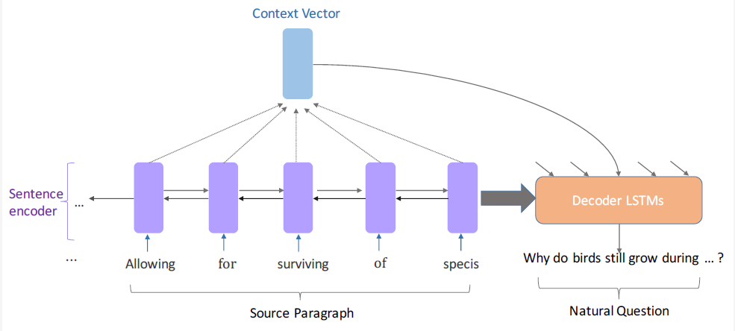
Sentence Level Seq2Seq Model
Encoding only sentence as input, do not consider paragraph/context-level information.

Slide 11
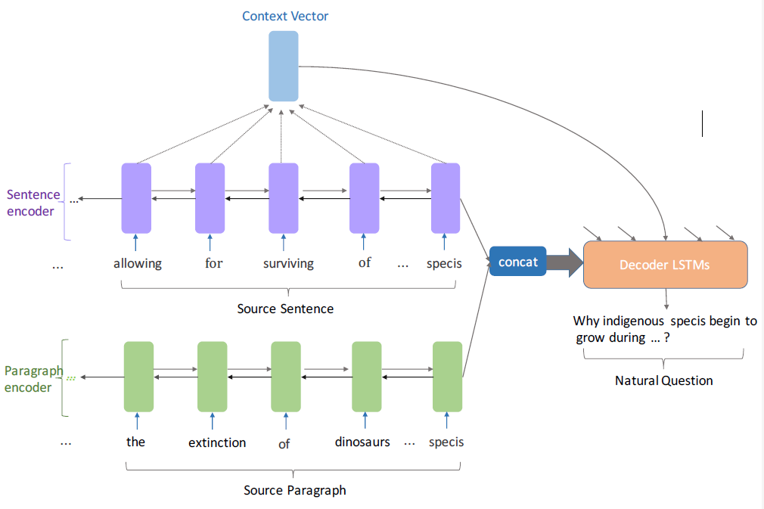
Paragraph Level Seq2Seq Model
Encoding both sentence and paragraph (that contains the sentence) as input, but only attending source sentence hidden states.
Also tried encoding title/
passage-level information,
but performance drops.

Slide 12
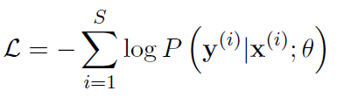

Training and Inference
Training: Minimize the negative log-likelihood with respect to θ:
Inference: Beam search and UNK replacement
For the UNK token at time step t, we replace it with the token in the input sentence with the highest attention score, the index of which is:

Slide 13

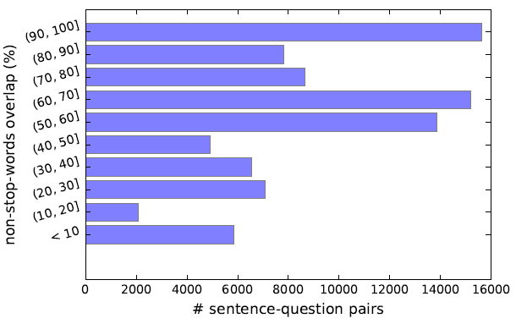
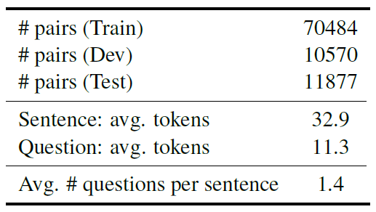
Dataset
The authors build their QG dataset on SQuAD corpus
Pruning constraint: the sentence-question pair have at least one non-stop-word in common
They pair up the questions with the sentence(s) which contain the answer span, and paragraph with contain the sentence

Slide 14
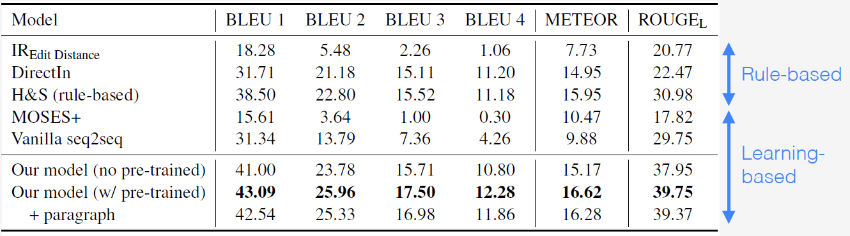
Experiments
Automatic Evaluation:
Beat strong rule-based system
Directly copy (DirectIn) forms a very strong baseline
Adding paragraph lowers the performance

Slide 15
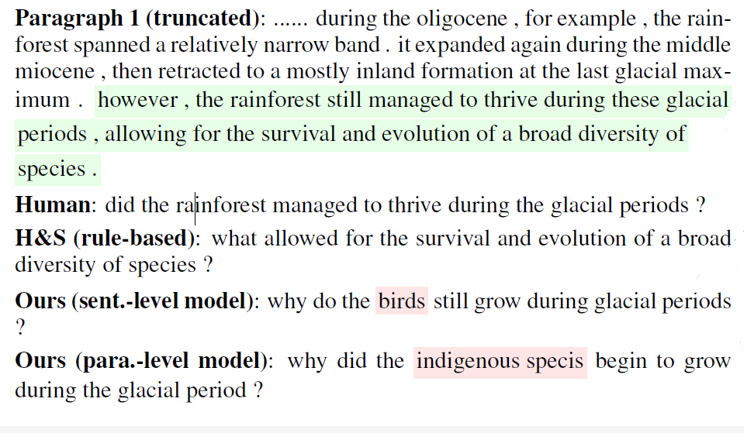
Output Analysis
Rule-based model copies nearly word for word the input sentence with minor syntactic change.
• redundant info.
• sometimes ungrammatical
Sentence-level model and paragraph-level both:
• learns to select an important aspect of the sentence
• Questions are more natural sounding and vary more in terms of type.
Para.-level model takes into account context info. beyond sentence.

Slide 16
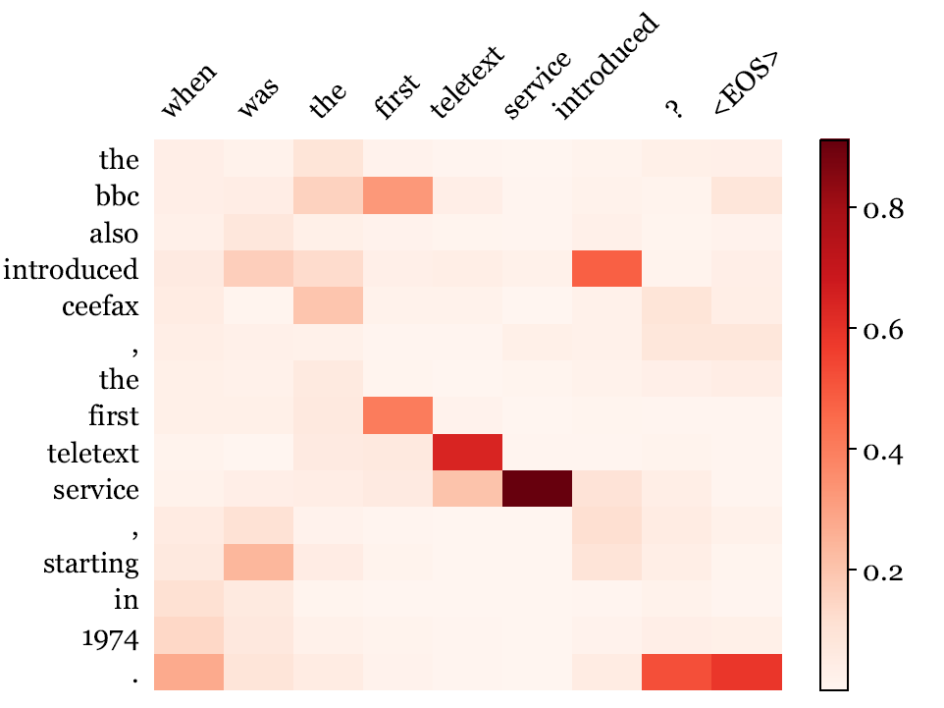
Interpretability
Attention weight matrix shows the soft alignment between the sentence(left) and the generated question (top).

Slide 17
Conclusion
The first fully data-driven neural network approach for question generation in the reading comprehension setting.
They investigated encoding sentence- and paragraph-level information for this task.

Slide 18
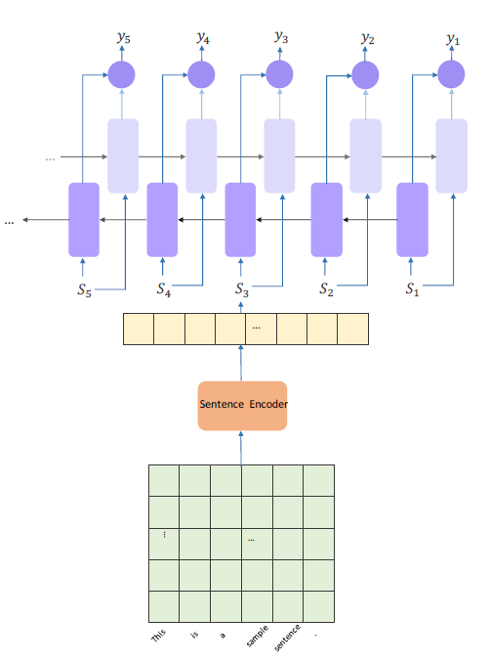
Follow-up Work^{[1]}
BiLSTM
Aim to select a subset of k question-worthy sentences (k < m).
y=1: the sentence is question-worthy.
y=0: the sentence may not contain question-worthy point.
Sum/Conv+pool
[1] Du, Xinya and Claire Cardie. “Identifying Where to Focus in Reading Comprehension for Neural Question Generation.” EMNLP (2017).

Slide 19
Thanks Q&A

