Slide 1


One Theme in All Views: Modeling Consensus Topics in Multiple Contexts
Jian Tang ¹, Ming Zhang ¹, Qiaozhu Mei ²
¹ School of EECS, Peking University
² School of Information, University of Michigan
Notes:
Good morning, everyone! My name is Jian Tang. I’m a PhD student from Peking University. The title of our paper is “One Theme in All Views: Modeling Consensus Topics in Multiple Contexts”. This is a joint work with Dr. Ming Zhang of Peking University and Dr. Qiaozhu Mei of the University of Michigan. This work is done when I am visiting University of Michigan.

Slide 2
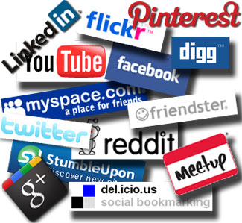
User-Generated Content (UGC)
A huge amount of user-generated content
170 billion tweets + 400 million/day¹
Applications:
online advertising
recommendation
policy making
Profit from user-generated content
$1.8 billion for facebook²
$0.9 billion for youtube²
¹http://expandedramblings.com/index.php/march-2013-by-the-numbers-a-few-amazing-twitter-stats/
²http://socialtimes.com/user-generated-content-infographic_b68911
Notes:
Our work is motivated by the overload of user-generated content. We are living in the era of social media. There are plenty of social media websites such as Facebook, Twitter, Google++. In these websites, users can post messages, share the messages with their friends and comment the messages. As a result, a huge amount of content is generated, usually referred to as the user-generated content. For instance, over 400 million tweets are being posted on Twitter everyday, accumulating 170 billion tweets in total. User-generated content has introduced many important applications to many fields such as online advertising, recommender systems, and policy making. By analyzing user-generated content, business providers can better understand users’ interests and then deliver better service to the users. A huge profit has been made in this context.
Since user-generated content is *so* valuable, how can we explore and analyze this big data?

Slide 3


Topic Modeling for Data Exploration
Infer the hidden themes (topics) within the data collection.
Annotate the data through the discovered themes
Explore and search the entire data with the annotations
Key Idea: document-level word co-occurrences
  -words appearing in the same document tend to take on the same topics
Notes:
A powerful tool to explore and analyze content data is topic modeling. Topic models have been proved to be quite effective in analyzing traditional media such as news article and scientific papers.
Topic models can discover the hidden themes or topics pervading the data collection. Each of the topics is defined as a multinomial distribution of words. Users can then explore and navigate the topics to understand the data collection. These topics can also be used for many data mining tasks such as clustering, classification, and information retrieval.
The essential idea of topic models is to make use of document-level word co-occurrences. The basic assumption is that words appearing in the same document tend to take on the same topics.

Slide 4
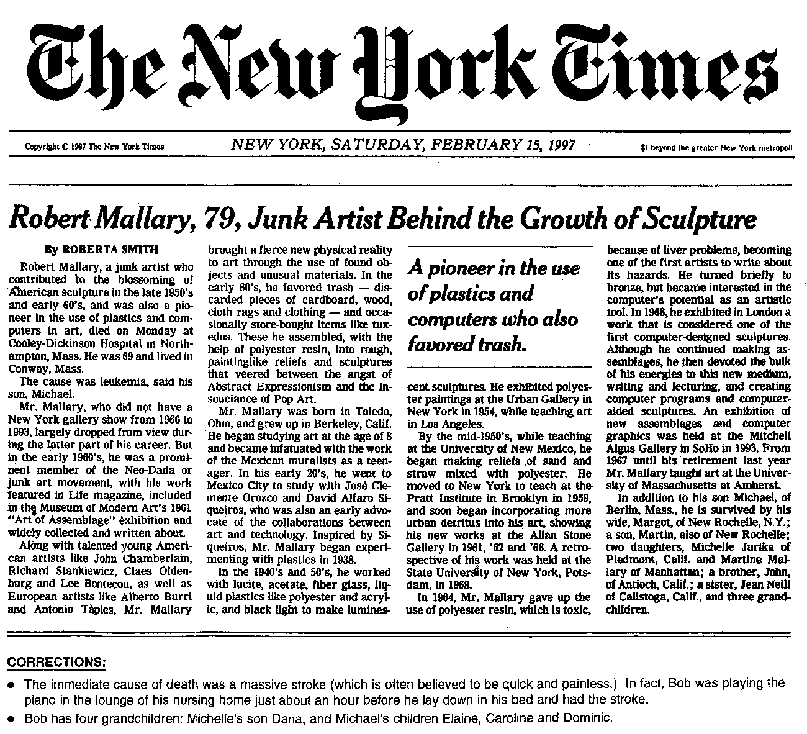
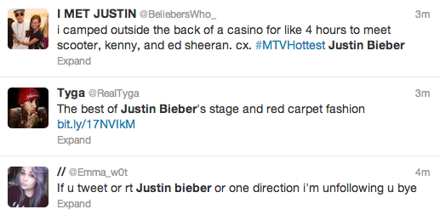


Challenges of Topic Modeling on User-Generated Content
Tradition media
Social media
v.s.
Benign document length
Controlled vocabulary size
Refined language
Short document length
Large vocabulary size
Noisy language
document-level word co-occurrences in UGC are sparse and noisy!
Notes:
However, the application of topic modeling to user-generated content is not as trivial as we think. Existing work on user-generated content found that the quality of the discovered topics is compromised. This observation is probably not surprising because as we said, the central idea in topic models is to make use of document-level word co-occurrences. Comparing with traditional media, the document length in user-generated content is much shorter. For instance, in Twitter each tweet contains at most 140 characters. The vocabulary size is usually much larger and not controlled. Users frequently invent new words such as hashtags. The language in user-generated content is very noisy. As a result, we can see that the document-level word occurrences in user-generated content are quite sparse and noisy.

Slide 5
Rich Context Information
Notes:
Does this mean topic models cannot be applied to user-generated content? Luckily, a rich set of context information is introduced in social media as a compensation of the sparse content. For instance, when a tweet is posted, we know the user who posted the tweet, the time and location at which it was posted, and many other metadata variables associated with the tweets. These types of context information can actually complement the data sparseness in user-generated content, and it is a common practice to make use of context information to improve the performance of topic modeling.

Slide 6
Why Context Helps?
Document-level word co-occurrences
  words appearing in the same document tend to take on the same topic;
  sparse and noisy
Context-level word co-occurrences
  Much richer
  E.g., words written by the same user tend to take on the same topics;
  E.g., words surrounding the same hashtag tend to take on the same topic;
  Note that it may not hold for all that contexts!
Notes:
So why can context help topic modeling on user-generated content? In user generated content, although the document-level word co-occurrences are quite sparse and noisy, the context-level word co-ocurrences are usually much richer. For instance, the words written by the same user are likely to take on the same topics; words surrounding the same hashtag ten to take on the same topic. Well, note that this may not hold for all the contexts! For example, tweets posted in the same hour of a day doesn’t necessarily talk about the same topic.

Slide 7
Existing Ways to Utilize Contexts
Concatenate documents in particular context into a longer pseudo-document.
Introduce particular context variables into the generative process, e.g.,
  Rosen-Zvi et al. 2004 (author context)
  Wang et al. 2009 (time context)
  Yin et al. 2011 (location context)
A coin-flipping process to select among multiple contexts
  e.g., Ahmed et al. 2010 (ideology context, document context)
Cons:
  Complicated graphical structure and inference procedure
  Cannot generalize to arbitrary contexts
  Coin-flipping approach makes data sparser
Notes:
Indeed, there are several approaches to utilize contexts to improve the performance of topic modeling. The simplest approach is to concatenate the documents in particular context into a longer pseudo-document. For instance, one can concatenate all tweets written by the same users, and thus apply topic modeling on documents of users. Another common approach is to introduce particular context variables into the generative process. For instance, the author-topic model put the author variable into LDA. Similar approach is used to model time and location context. However, these models are all designed for specific type of context and cannot generalize to arbitrary contexts. Besides, they are not designed to model multiple types of contexts.
To handle multiple types of contexts, a coin-flipping process is usually used, in which a coin is flipped to decide which word is generated by which context. However, the coin-flipping approach actually makes data sparser, and the quality of topics is compromised.

Slide 8
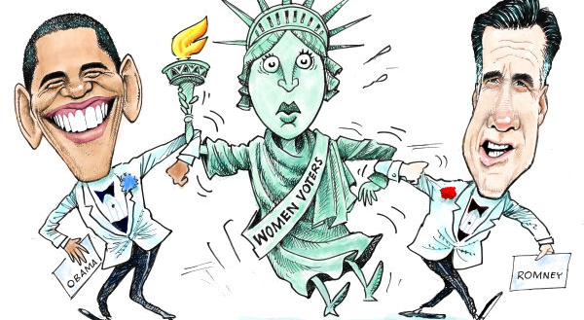
Coin-Flipping: Competition among Contexts
Word Token
Context
Competition makes data even sparser!
Context
Notes:
A typical way to incorporate multiple contexts into the graphical structure of topic models with coin-flipping is like this. It looks complicated. But the basic idea is to flip a coin, or a dice, to decide which token belongs to which context. We can see that different contexts are actually competing for the tokens. The competition among the contexts makes the sparse data even sparser. As a result, such a coin-flipping process generally don’t work very well in practice.
Instead of competition among the contexts, a more principled approach is to let different types of contexts collaborate with each other. To do this, we need a more general definition of context.

Slide 9
Type of Context, Context, View
#kdd2013
Time:
2008
…
2009
…
Hashtag
…
……
……
…
……
2012
…
#jobs
User:
U₁
U₂
U₃
……
U_{N}
Type of Context: a metadata variable, e.g. user, time, hashtag, tweet
Context : a subset of the corpus, or a pseudo document, defined by
a value of a type of context (e.g., tweets by a user)
View: a partition of the corpus according to a type of context
Notes:
We define a type of context as a metadata variable associated with user-generated content. For instances, the user of a tweet defines a type of context ((point to the x-axis)) and the time defines another ((point to y-axis)). Note that the organic document boundary is also considered as a special type of context ((point to a particular tweet)). Here a tweet itself is also a type of context.
A context is defined as a subset of the corpus or a pseudo document, which is defined by a particular value of a type of context. For instance, the tweets posted by a particular user ((play annimation)) defines a pseudo-document or a context of that user, tweets posted at a particular year ((play annimation)) defines a pseudo-document or a context of that year, 、the tweets containing the hashtag #KDD2013 ((play annimation)) defines a context of that hashtag.
We can see that each type of context defines a partition of the corpus, we called this partition a view of the corpus. When multiple types of contexts exist, there are multiple views of the data.

Slide 10
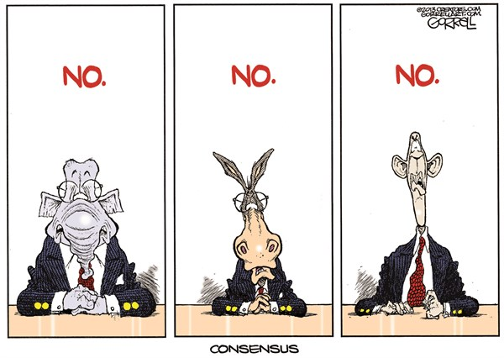
Competition → Collaboration
Let different types of contexts vote for topics in common (topics that stand out from multiple views are more robust)
Allow each type (view) to keep its own version of (view-specific) topics
Collaboration utilizes different views of the data
Notes:
With this general definition, we can enhance the collaboration among the contexts. The basic idea is to let different views vote for topics in common, which are called the consensus topics. Usually, topics that stand out from multiple views of the corpus are more robust.
Although we assume that there are consensus topics that all views agree on, different views can interpret these topics differently. Therefore, we also allow each view to have the specific instantiation of the consensus topics, which are called the view-specific topics.
Instead of making the data sparser, the collaboration among different views enriches the data.

Slide 11
How? A Co-regularization Framework
View 1
View-specific topics
View-specific topics
View 2
(View: partition of corpus into pseudo-documents)
Objective: Minimize the disagreements between individual opinions (view-specific topics) and the consensus (topics)
Consensus topics
Objective: Minimize the disagreements between individual opinions (view-specific topics) and the consensus (topics)
View-specific
topics
View 3
Notes:
How can we let different views collaborate with each other? (These are different views of the data. Remember that each view is a partition of the corpus according to a type of context. Topics can be generated through classical LDA model on any view. Therefore, we associate each view with a set of view-specific topics. We assume that there are also the same number of consensus topics voted by different views.) We proposed a co-regularization framework to let different views collaborate. The essential idea is to minimize the disagreements between view-specific topics and the consensus topics. By doing this, we don’t need to manipulate the structure of the classical topic models at all.( The generation of view specific topics is simply done by applying LDA on the pseudo-documents partitioned in this view.) of course, besides minimizing the disagreement, we also want the data likelihood of each view to be maximized.

Slide 12
The General Co-regularization Framework
View 1
View-specific topics
View-specific topics
View 2
Objective: Minimize the disagreements between individual opinions (view-specific topics) and the consensus (topics)
Consensus topics
KL-divergence
View 3
View-specific topics
Notes:
Specifically, we denote the view-specific topics as \beta_c and the consensus topics as \beta. The disagreement between view specific topics and consensus topics is the sum of kl-divergence between the corresponding topic distributions. Note that in topic modeling, the likelihood of the data has to be maximized. This motivated the unified objective function, which is the summation of the data likelihood of each view penalized by the disagreement between the view-specific topics and the consensus topics. This is the so-called co-regularization.

Slide 13
Learning Procedure: Variational EM
Variational E-step: mean-field algorithm
  Update the topic assignments of each token in each view.
M-step:
  Update the view-specific topics
  Update the consensus topics
Topic-word count from view c
Topic-word probability from consensus topics
Geometric mean
Notes:
For the learning procedure of the co-regularization framework, the variational EM algorithm is used, which approximates the posterior distribution with a variational distribution. In this step, the topic assignments of each token in each view are updated. Because we did not manipulate the structure of LDA, the updating equation is exactly the same as LDA. In the M-step, we update both the view-specific topics and the consensus topics. The view-specific topics are updated based on topic-word count in the view and the consensus topics. Each of the consensus topic is calculated as the geometric mean of the corresponding view-specific topics. Both updating equations turn out to be simple and intuitive.

Slide 14
Experiments
Datasets
  Twitter: user, hashtag, tweet
  DBLP: author, conference, title
Metric: Topic semantic coherence
  The average point-wise mutual information of word pairs among the top-ranked words (D. Newman et al. 2010)
External task: User/Author clustering
  Partition users/authors by assigning each user/author to the most probable topic
  Evaluate the partition on the social networks with modularity (M. Newman, 2006)
  Intuition: Better topics should correspond to better communities on the social network
Notes:
We use two datasets in our experiments: Twitter and DBLP. In Twitter, three types of contexts are used: user, hashtag and the organic document boundary, tweet. We select the DBLP dataset because the titles of the papers are very short so they can well simulate the user-generated content. Three types of contexts, author, conference, and title are studied.
We evaluate the quality of each topic based on the semantic coherence of the topic, which is the average point-wise mutual information of word pairs among the top-ranked words. Another way to evaluate the topics is to utilize the topics for an external task. Here we use the task of user clustering in Twitter or Author clustering in DBLP. We partition users by assigning each of them to his most probable topic and then evaluate the partition using the metric of modularity on a corresponding social network structure. The intuition of this evaluation is that better topics should correspond to better communities on the social network. For both metrics, the higher the better.

Slide 15
Topic Coherence (Twitter)
Algorithm | Topic coherence
LDA (User) | 1.94
LDA (Hashtag) | 2.54
LDA (Tweet) | -0.016
Single type of context:
LDA(Hashtag) > LDA(User) >> LDA(Tweet)
Algorithm | Topic coherence
 | Hashtag | Consensus
ATM (User+Hashtag) | - | 2.15
Coin-Flipping (User+Hashtag) | - | 2.01
CR (User+Tweet) | - | 1.67
CR (User+Hashtag) | 2.69 | 2.32
CR (Hashtag+Tweet) | 2.20 | 1.56
CR (User+Hashtag+Tweet) | 2.50 | 1.78
Multiple types of contexts:
CR(User+Hashtag) >ATM>Coin-Flipping
CR(User+Hashtag) > CR(User+Hashtag+Tweet)
Notes:
Let’s first look at the results of topic coherence in Twitter dataset. For individual types of context, LDA with hashtag context outperforms LDA with user context and well outperforms LDA with the organic tweet context. We can see that the performance of LDA with tweet context is so bad, which verifies that topic models do not work so well in short documents.
For multiple types of contexts, using co-regularization framework with user and hashtag outperforms a classical contextual topic model, the author-topic model, and the coin-flipping method. This is because in both the author-topic model and the coin-flipping method, different types of contexts are competing with each other and make the data sparser while our co-regularization framework let different views collaborate. Although the hashtag view is already strong as you can see from here (pointer), collaborating with the user view also improved the view-specific topics in the hashtag view. After further incorporating tweet context in the co-regularization framework, the performance actually drops. This suggests that the introduction of a very weak view may hurt the performance of strong views.

Slide 16
User Clustering (Twitter)
Type | Algorithm | Modularity
Single context | LDA (User) | 0.445
Multiple contexts | CR (User+Hashtag) | 0.491
 | CR (User+Tweet) | 0.457
 | CR (User+Hashtag+Tweet) | 0.480
CR(User+Hashtag)> LDA(User)
CR(User+Hashtag)> CR(User+Hashtag+Tweet)
Notes:
Now let’s look at the performance of user clustering measured with modularity metric. Given a social network, a good community partition will yield a higher modularity score. We similuate the social network among users with the re-tweet neetwork, and we assume that better topics correspond to better communities on the social network. Therefore, a larger modular score indicates better topics.
We can see that using co-regularization framework with the user and hashatag contexts outperforms LDA with individual user context. After further incorporating tweet context, the performance also decreases.

Slide 17
Topic Coherence (DBLP)
Algorithm | Topic coherence
LDA (Author) | 0.613
LDA (Conference) | 0.569
LDA (Title) | -0.002
Single type of context:
LDA(Author)> LDA(Conference) >> LDA(Title)
Algorithm | Topic coherence
 | Author | Consensus
ATM (Author+Conference) | - | 0.578
Coin-flipping (Author+Conference) | - | 0.577
CR (Author+Conference) | 0.624 | 0.598
CR (Conference+Title) | - | 0.606
CR (Author+Conference+Title) | 0.642 | 0.634
Multiple types of contexts:
CR(Author+Conference) >ATM>Coin-flipping
CR(Author+Conference+Title)>
CR(Author+Conference)
Notes:
Similar behaviors of the models can be observed in DBLP dataset. The most informative view for topic modeling in this dataset is author view, closed followed by the conference view. The performance of LDA with titles is also quite bad.
Using co-regularization framework also outperformance author-topic model and coin-flipping method

Slide 18
Author Clustering (DBLP)
Type | Algorithm | Modularity
Single context | LDA (Author) | 0.289
Multiple contexts | CR (Author+Title) | 0.288
 | CR (Author+Conference) | 0.298
 | CR (Author+Conference+Title) | 0.295
CR(Author+Conference)> LDA(Author)
CR(Author+Conference)> CR(Author+Conference+Title)
Notes:
For the author clustering on DBLP, using co-regularization framework with author and conference contexts outperforms LDA with individual author context. After further incorporating the title view, the performance decreases.

Slide 19
Summary
Utilizing multiple types of contexts enhances topic modeling in user-generated content.
Each type of contexts define a partition (view) of the whole corpus
A co-regularization framework to let multiple views collaborate with each other
Future work :
  how to select contexts
  weight the contexts differently
Notes:
Finally, we give a summary of this work. We investigated the problem of exploiting multiple types of contexts to enhance topics modeling in use-generated content. We formulate each type of context as a partition or a view of the whole corpus. We proposed a co-regularization framework to let multiple views collaborate with each other and vote for the consensus topics. The future work would be how to select contexts and weight the contexts differently in the co-regularization framework.
----- 会议笔记(8/9/13 17:30) -----
Rewrite the scripts
Memorize it...
Questions:
(1) Modularity…. better score
(2) What is difference between view-specific topics and consensus-specific topics. view-specific topics are more effective for distingusish users/hashtags(the contexts in these views)
(3) Why not use perplexity metric?
(4) Given an example of the view-specific topics and the consensus topics.
more effecitvie in distinguishing in arbitrary partitions
Be precise in question answering.
Be conservative…
topic modeling does not work as well in user-generated content…
That's a great question! this do realize...

Slide 20

Thanks!
Acknowledgements: NSF IIS-1054199, IIS-0968489, CCF-1048168;
NSFC 61272343, China Scholarship Council (CSC, 2011601194);
Twitter.com

Slide 21
Multi-contextual LDA
: context type proportion
c: context type
x: context value
z: topic assignment
: the context values of type i
: the topic proportion of contexts
: the word distribution of topics
To sample a word,
(1) sample a context type c according to the context type proportion
(2) Uniformly sample a context value x from
(3) sample a topic assignment z from the distribution over topics associated with x
(4) sample a word w from the distribution over words associated with z

Slide 22
Parameter Sensitivity

