Slide 1

Recurrent Neural Network
Deep Learning Tutorial
Wang Yue 2016.09.27

Slide 2

Outline
1
Overview
2
RNN
3
An example of RNN
4
LSTM

Slide 3
Part 1
Overview
Humans don’t start their thinking from scratch every second. As you read this essay, you understand each word based on your understanding of previous words. You don’t throw everything away and start thinking from scratch again.
Sequential data

Slide 4
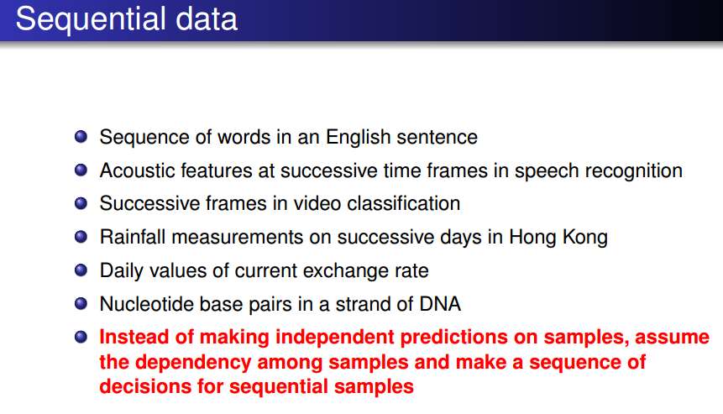
Part 1
Overview

Slide 5
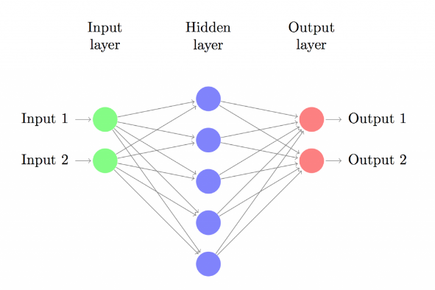
Part 1
Overview
Traditional neural networks can’t do this, and it seems like a major shortcoming. For example, imagine you want to classify what kind of event is happening at every point in a movie. It’s unclear how a traditional neural network could use its reasoning about previous events in the film to inform later ones.
Traditional neural network

Slide 6
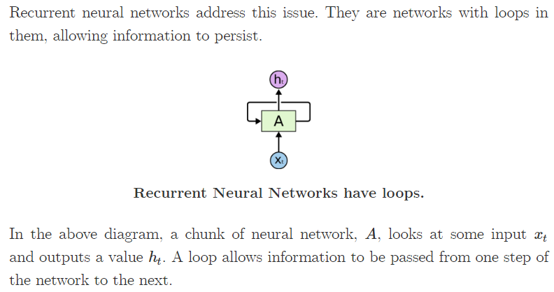
Part 1
Overview

Slide 7
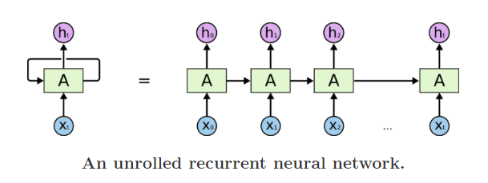
Part 1
Overview
A recurrent neural network can be thought of as multiple copies of the same network, each passing a message to a successor. Consider what happens if we unroll the loop:

Slide 8
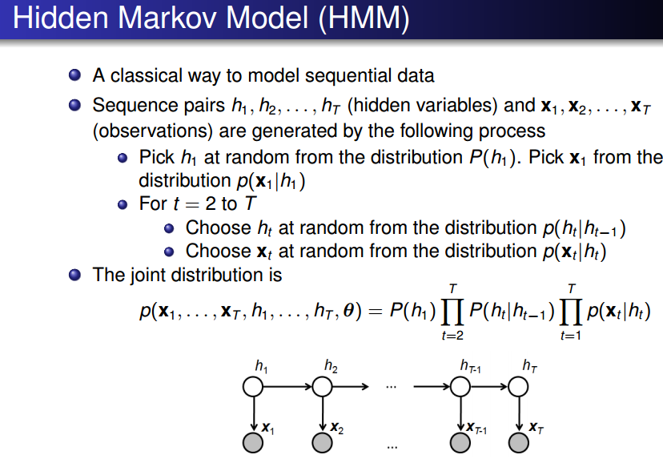
Part 2
RNN

Slide 9
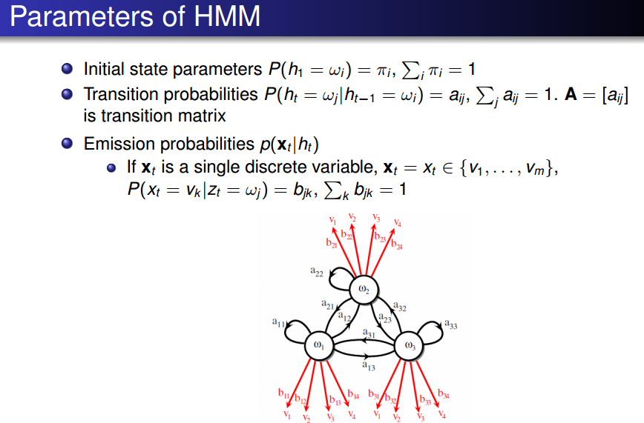
Part 2
RNN

Slide 10
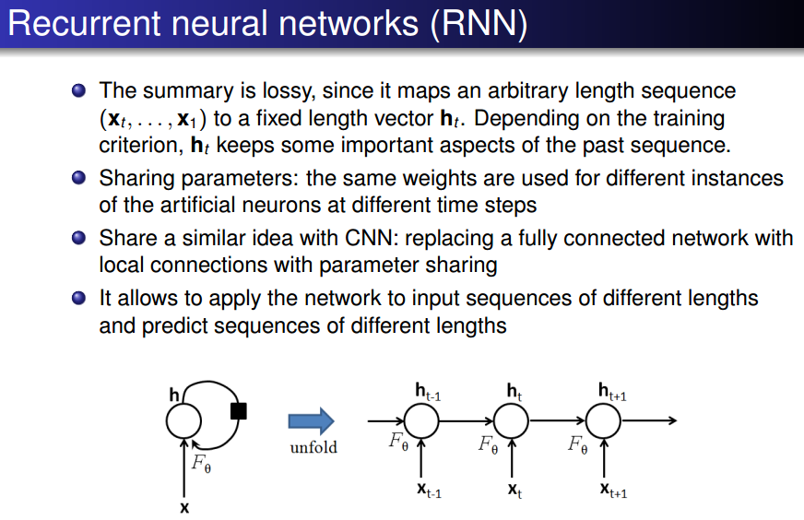
Part 2
RNN

Slide 11
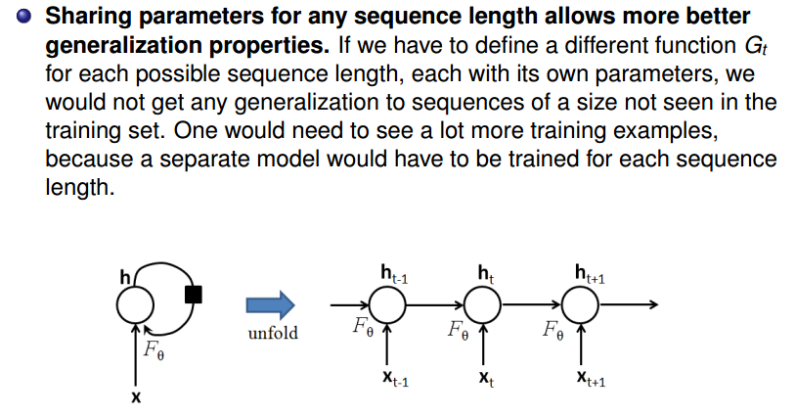
Part 2
RNN

Slide 12
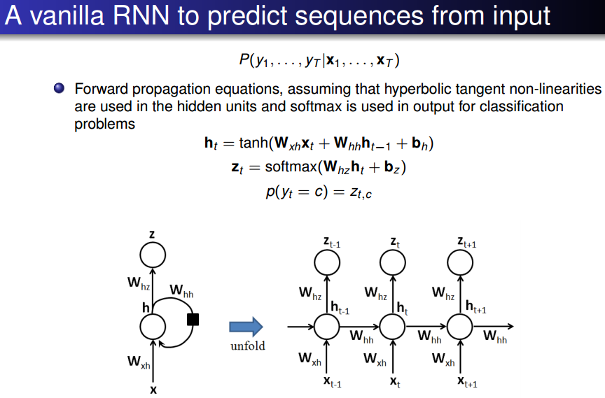
Part 2
RNN

Slide 13
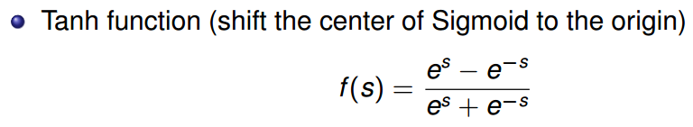
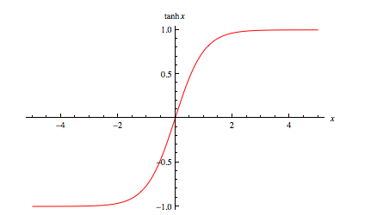
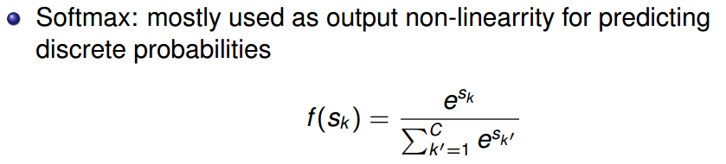
Part 2
RNN

Slide 14
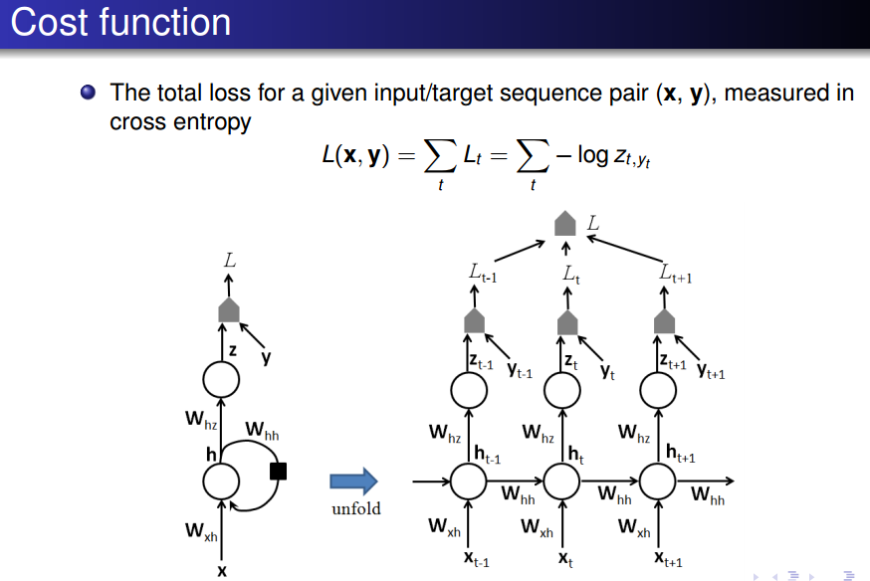
Part 2
RNN

Slide 15
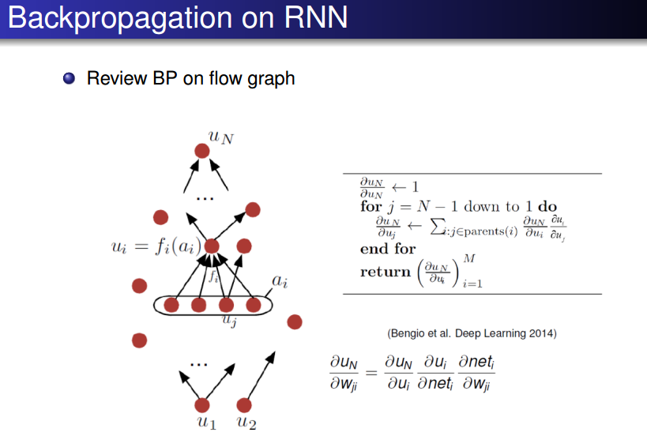
Part 2
RNN

Slide 16
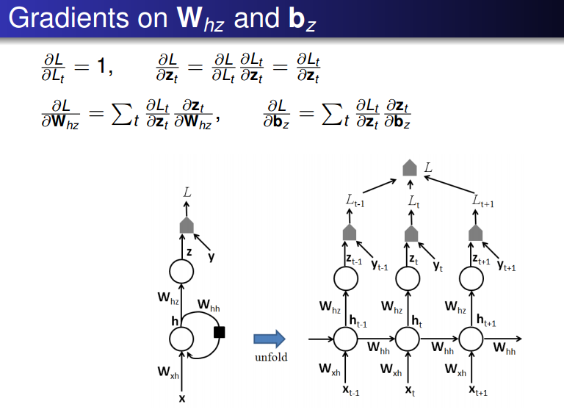
Part 2
RNN

Slide 17
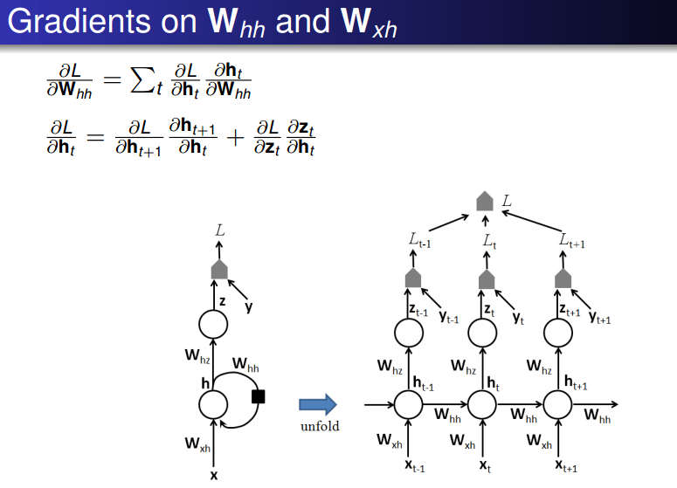
Part 2
RNN

Slide 18
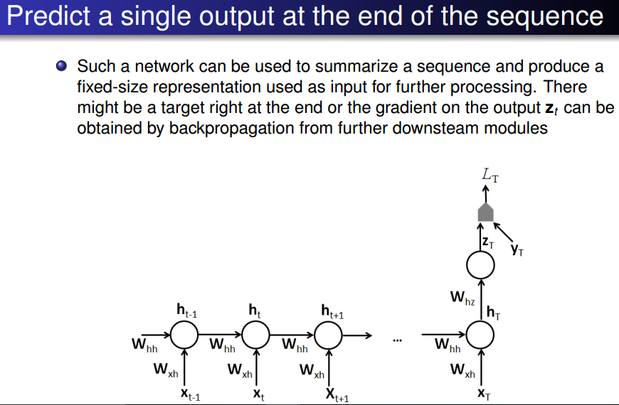
Part 2
RNN

Slide 19
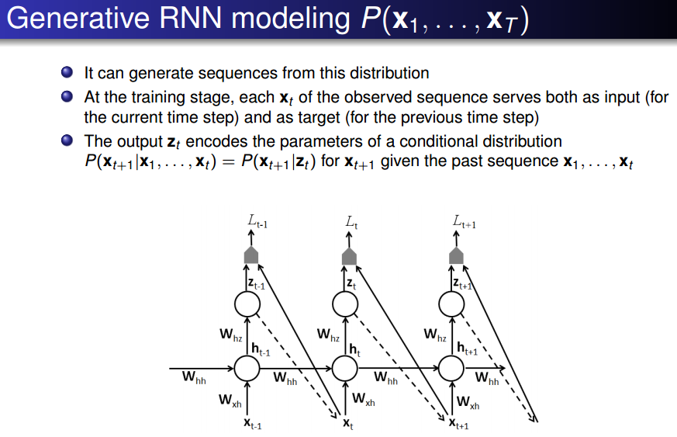
Part 2
RNN

Slide 20
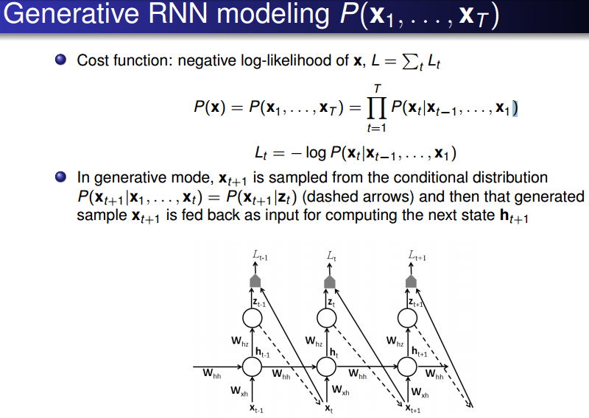
Part 2
RNN

Slide 21
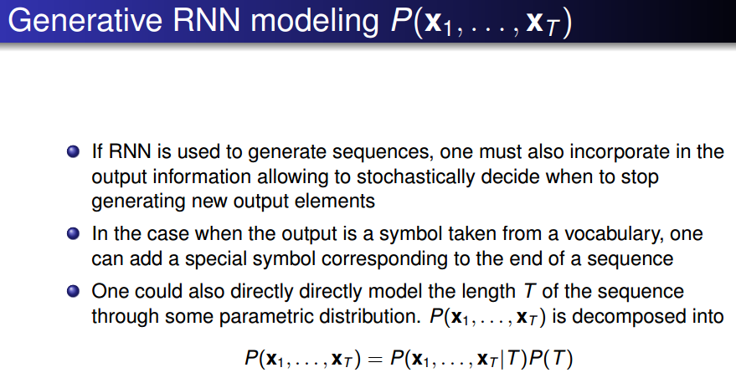
Part 2
RNN

Slide 22

Part 3
An example of RNN
LANGUAGE MODELING
Our goal is to build a Language Model using a Recurrent Neural Network. Let’s say we have sentence of m words. A language model allows us to predict the probability of observing the sentence (in a given dataset) as:
“He went to buy some chocolate”

Slide 23
Part 3
An example of RNN
Two usages
First, such a model can be used as a scoring mechanism. For example, a Machine Translation system typically generates multiple candidates for an input sentence. You could use a language model to pick the most probable sentence.
Because we can predict the probability of a word given the preceding words, we are able to generate new text by using it as a generative model. Given an existing sequence of words we sample a next word from the predicted probabilities, and repeat the process until we have a full sentence.

Slide 24
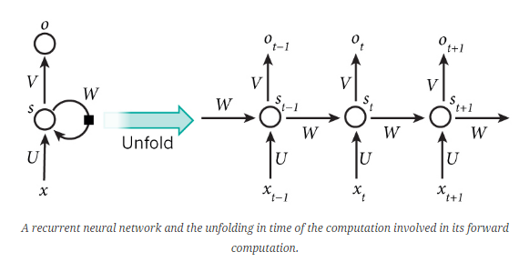

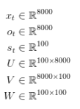
Part 3
An example of RNN
We pick a vocabulary size C = 8000 and a hidden layer size H = 100
Each word x as a one-hot vector of the vocabulary’s size. For example, the word with index 36 would be the vector of all 0’s and a 1 at position 36.

Slide 25
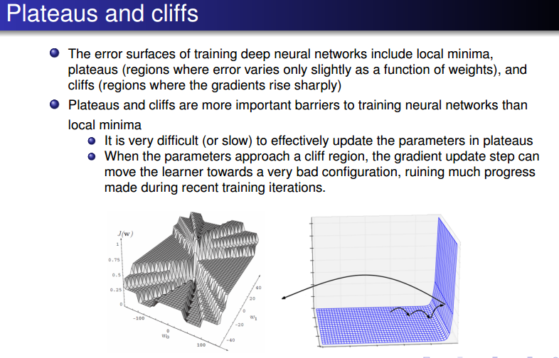
Part 4
LSTM

Slide 26
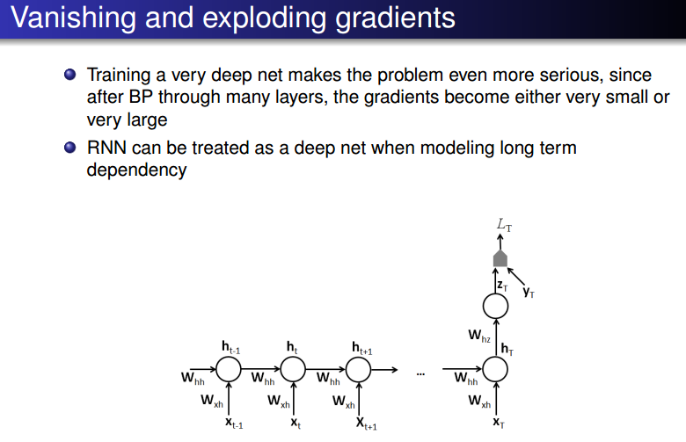
Part 4
LSTM

Slide 27
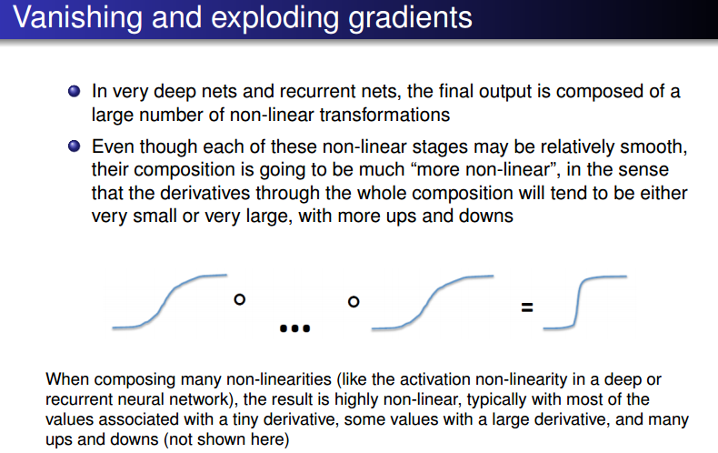
Part 4
LSTM

Slide 28
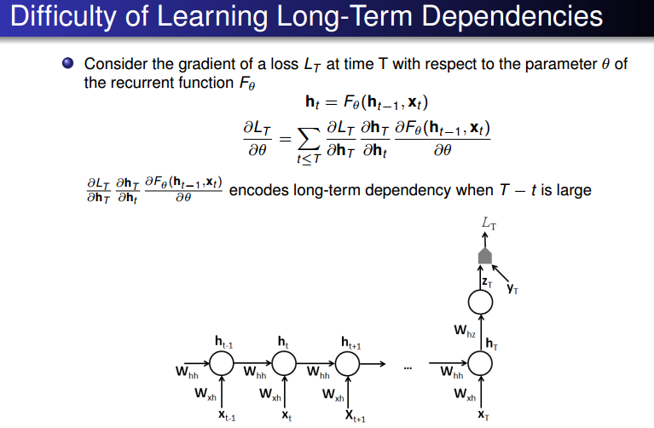
Part 4
LSTM

Slide 29
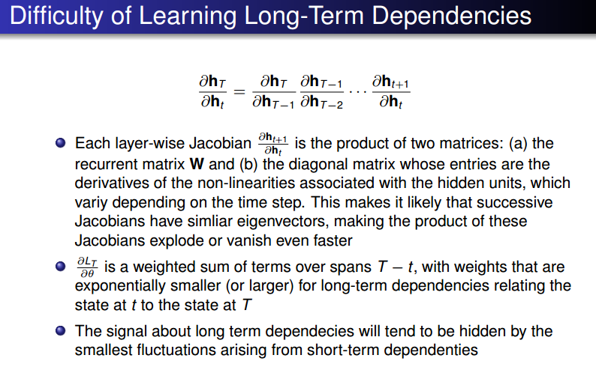
Part 4
LSTM

Slide 30
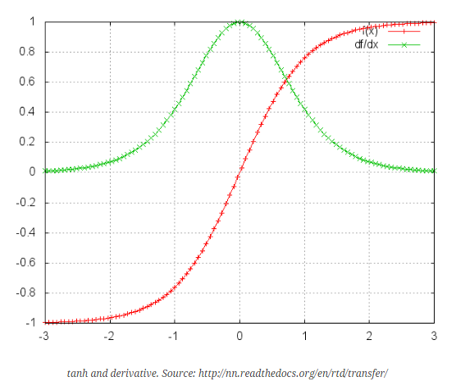
Part 4
LSTM

Slide 31
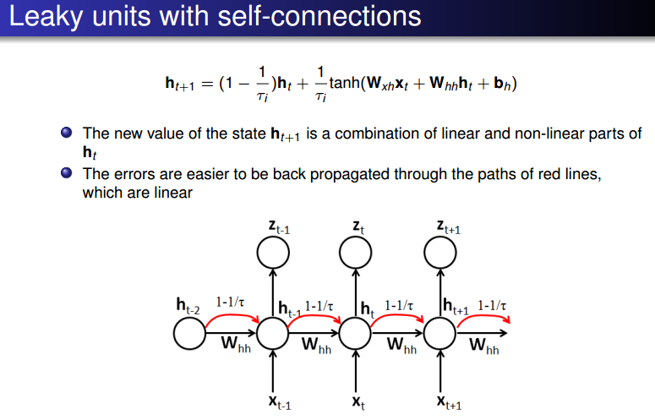
Part 4
LSTM

Slide 32
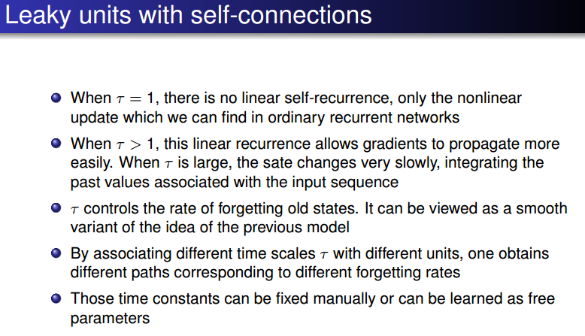
Part 4
LSTM

Slide 33
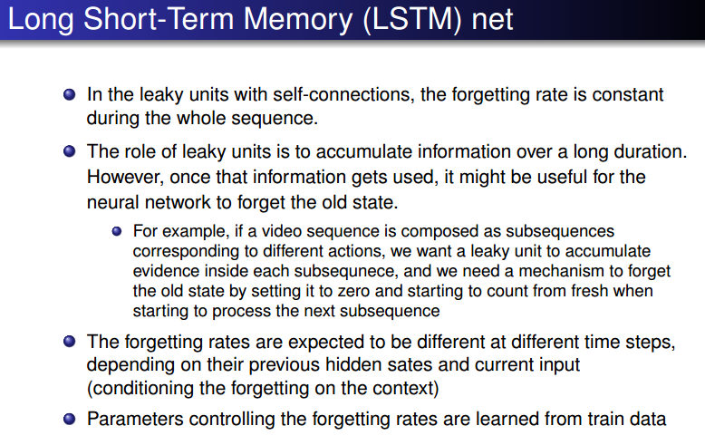
Part 4
LSTM

Slide 34
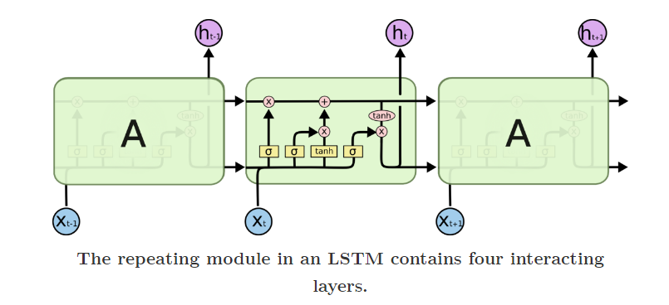
Part 4
LSTM

Slide 35
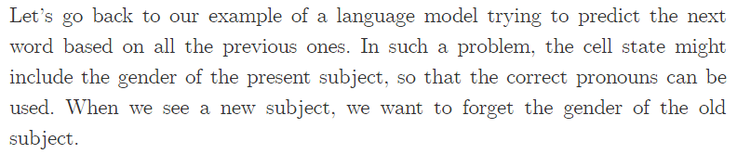
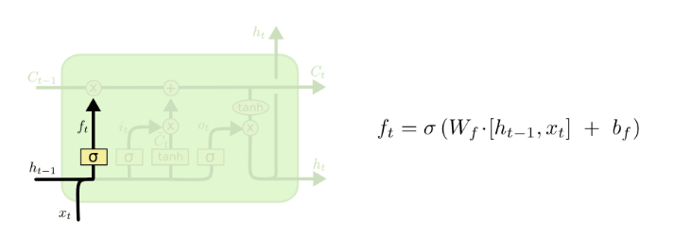
Part 4
LSTM

Slide 36
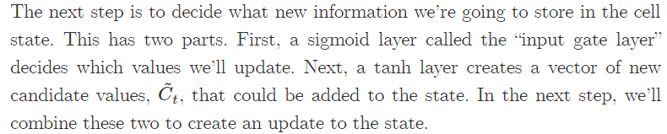
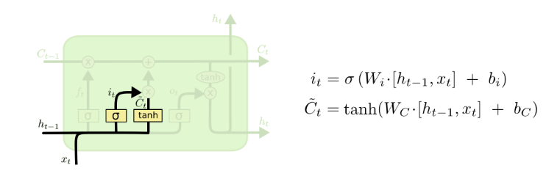
Part 4
LSTM

Slide 37
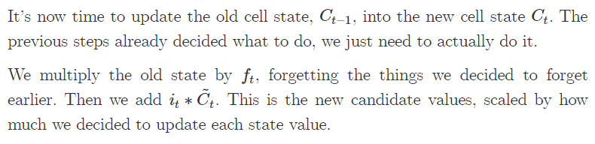
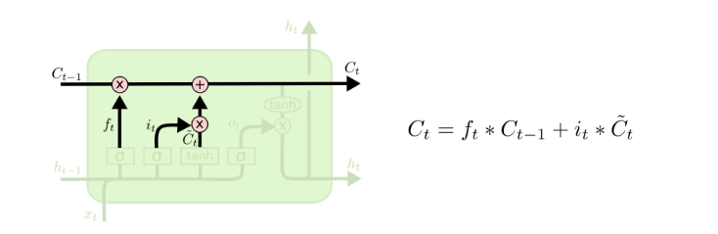
Part 4
LSTM

Slide 38
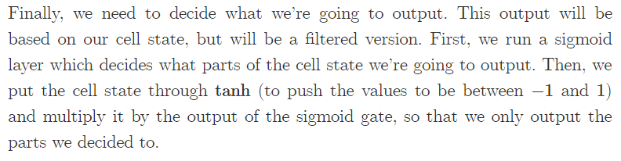
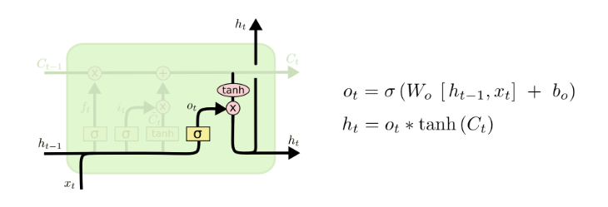
Part 4
LSTM

Slide 39
Recurrent Neural Network
Yue Wang, 1155085636, CSE, CUHK
Thank you!

