Slide 1

Deep Knowledge Tracing
Chris Piech∗ , Jonathan Spencer∗ , Jonathan Huang∗‡, Surya Ganguli∗ , Mehran Sahami∗ , Leonidas Guibas∗ , Jascha Sohl-Dickstein∗†
∗Stanford University, †Khan Academy, ‡Google

Slide 2
Contributions
A novel application of recurrent neural networks (RNN) to tracing student knowledge. (Model Introduction)
Demonstration that our model does not need expert annotations. (Previous Work)
A 25% gain in AUC over the best previous result. (Experimental results)
Power a number of other applications. (Other Applications)

Slide 3
Thanks!

Slide 4
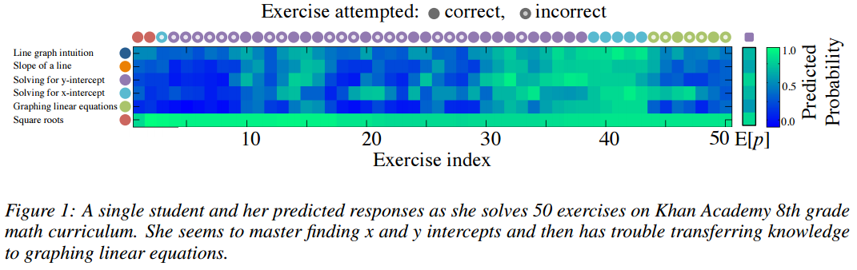
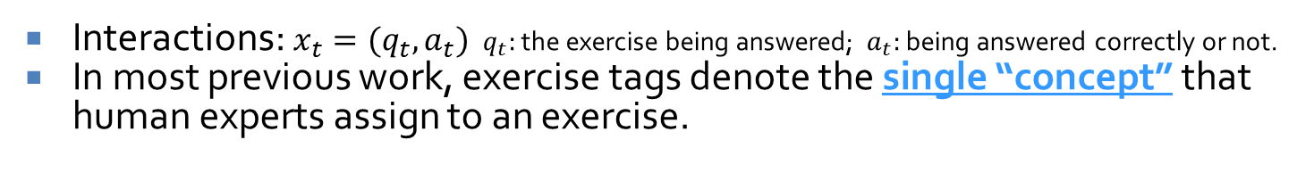
Knowledge Tracing
Def: The task of modeling student knowledge over time.
Usually by observing the correctness of doing exercises.
Exercises
Concept/skills
Interactions: $x_{t}=(q_{t},a_{t})$ $q_{t}:$ the exercise being answered; $a_{t}:$ being answered correctly or not.
In most previous work, exercise tags denote the single “concept” that human experts assign to an exercise.
Notes:
so that we can accurately predict how students will perform on future interactions
attempt to monitor the student’s changing knowledge state during practice

Slide 5
Motivation
Develop computer-assisted education by building models of large scale student trace data on MOOCs.
Resources can be suggested to students based on their individual needs.
Content which is predicted to be too easy or too hard can be skipped or delayed.
Formal testing is no longer necessary if a student’s ability undergoes continuous assessment
The knowledge tracing problem is inherently difficult. Most previous work in education relies on first order Markov models with restricted functional forms.
Notes:
The knowledge tracing problem is inherently difficult.
as human learning is grounded in the complexity of both the human brain and human knowledge.

Slide 6
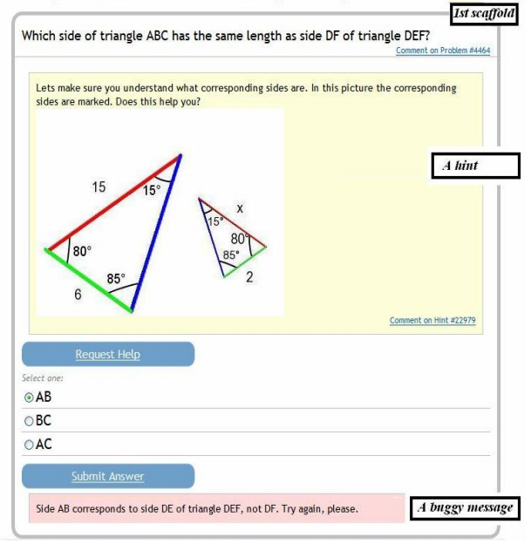
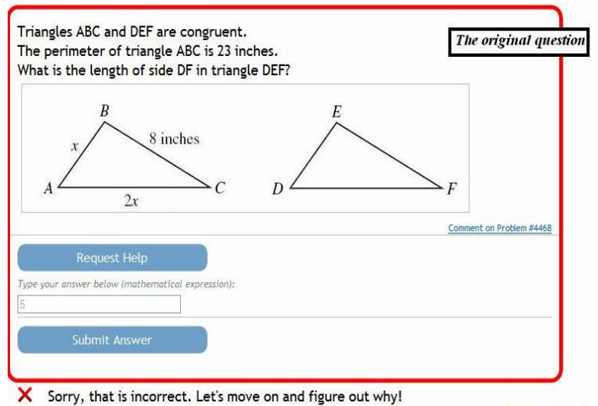
Dataset (1) : ASSISTment
An online tutor that simultaneously teaches and assesses students in grade school mathematics.
Notes:
ASSISTment: an online tutor that simultaneously teaches and assesses students in grade school mathematics.
An example of an ASSISTments item where the student answers incorrectly and is given tutorial help.
Tutorial help will be given if the student answers the question wrong or asks for help.
The tutorial help assists the student in learning the required knowledge by breaking each problem into sub questions called scaffolding or giving the student hints on how to solve the question.
A question is only marked as correct if the student answers it correctly on the first attempt without requesting help.

Slide 7

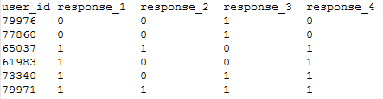
Dataset (1)
The items in the problem set all have the exact same skill tagging
0 corresponds to incorrect, 1 is a correct
Each student completed an average of 3 of the 42 problem sets in this dataset
Each problem set has on average of 312 students

Slide 8
Dataset(2) KDD Cup 2010
Task: Predicting the value (between 0 and 1) that indicates the probability of a correct first attempt for this student-step.
The data matrix is sparse.
There is a strong temporal dimension to the data.
The whole collection of steps comprises the solution.
Every knowledge skill/concept is associated with one or more exercises.
A single exercise can be associated with one or more knowledge skill/concept.
Notes:
not all students are given every problem, and some problems have only 1 or 2 students who completed each item.
students improve over the course of the school year, students must master some skills before moving on to others, and incorrect responses to some items lead to incorrect assumptions in other items. So, contestants must pay attention to temporal relationships as well as conceptual relationships among items.
The last step can be considered the "answer", and the others are "intermediate" steps.

Slide 9
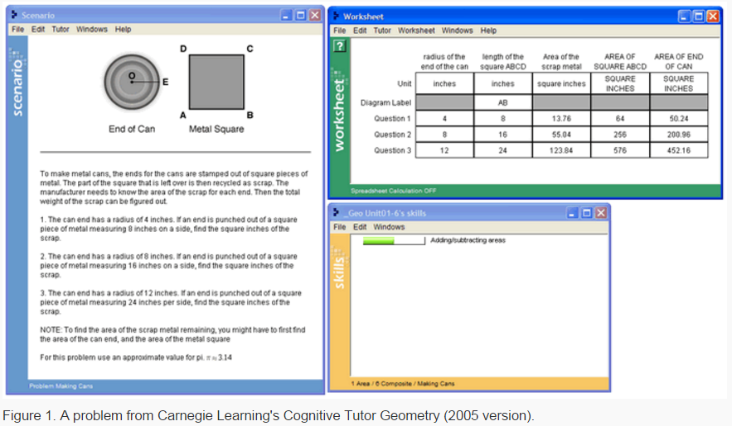
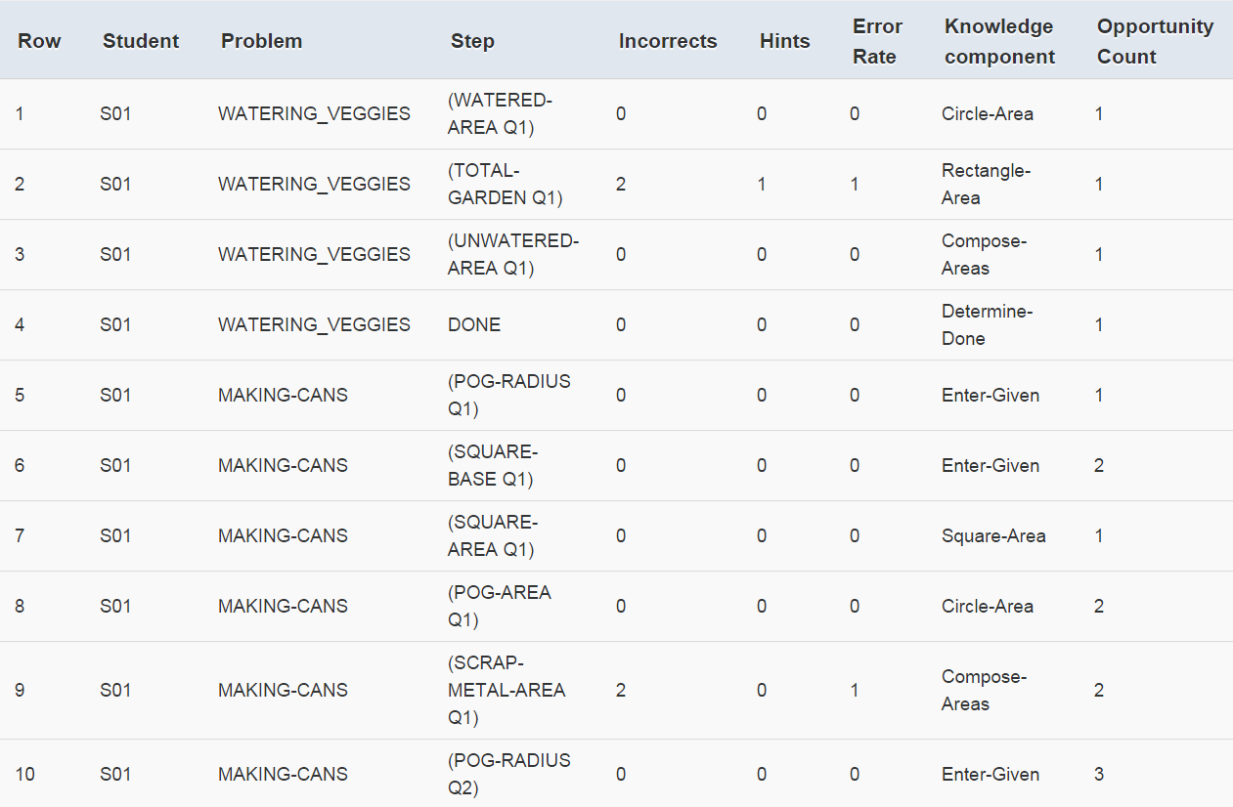
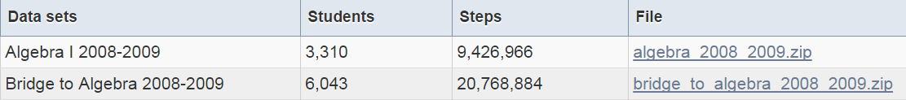
Dataset(2) KDD Cup 2010

Slide 10
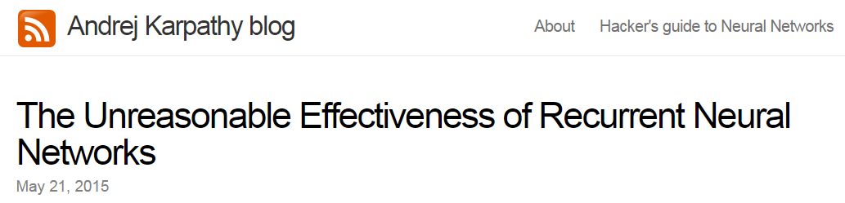
Recurrent Neural Networks(RNN)

Slide 11
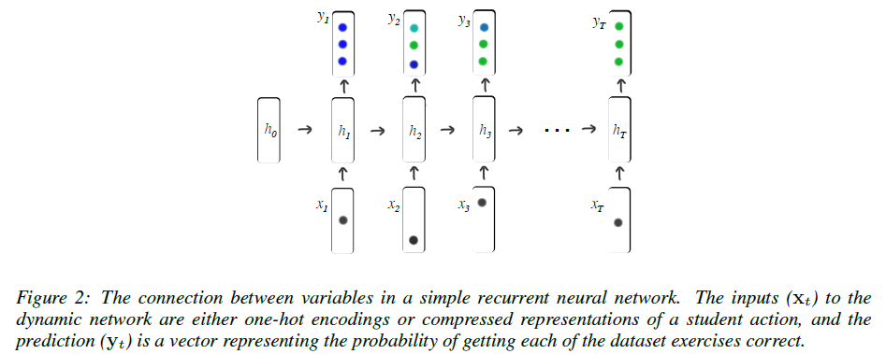
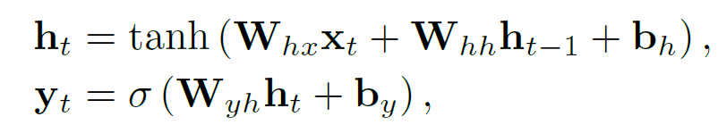






Recurrent Neural Networks(RNN)
$$W_{yh}$$
$$W_{yh}$$
$$W_{hh}$$
$$W_{hh}$$
$$W_{hx}$$
$$W_{hx}$$
Notes:
Traditional Recurrent Neural Networks (RNNs) map an input sequence of vectors x1; : : : ; xT , to an output sequence of vectors y1; : : : ; yT .
This is achieved by computing a sequence of ‘hidden’ states h1; : : : ; hT which can be viewed as successive encodings of
relevant information from past observations that will be useful for future predictions.
where both tanh and the sigmoid function () are applied to each dimension of the input. The
model is parameterized by an input weight matrixWhx, recurrent weight matrixWhh, initial state
h0, and readout weight matrixWyh. Biases for latent and readout units are given by bh and by.

Slide 12
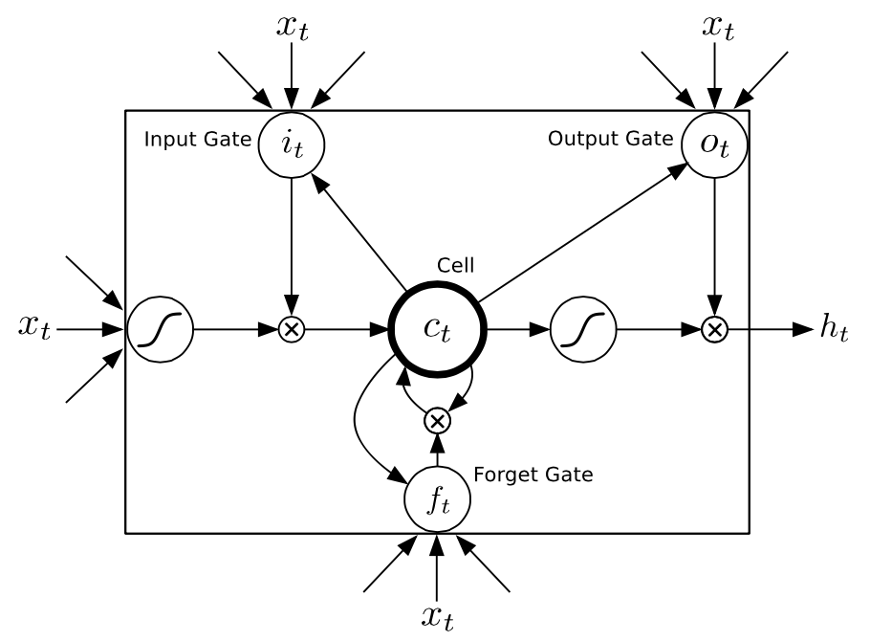
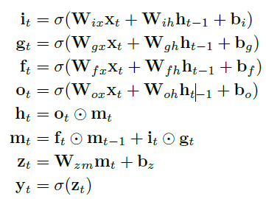
Long Short Term Memory (LSTM)
Notes:
a more complex variant of RNNs that often prove more powerful
In the variant of LSTMs we use, latent units retain their values until explicitly
cleared by the action of a ‘forget gate’. They thus more naturally retain information for many time
steps, which is believed to make them easier to train. Additionally, hidden units are updated using
multiplicative interactions, and they can thus perform more complicated transformations for the
same number of latent units. The update equations for an LSTM are significantly more complicated
than for an RNN

Slide 13
Previous Work
Bayesian Knowledge Tracing (BKT)
Learning Factors Analysis (LFA)
Performance Factors Analysis (PFA)
SPARse Factor Analysis (SPARFA)

Slide 14
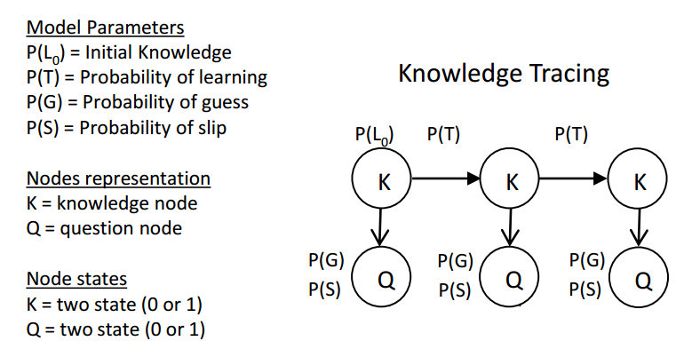
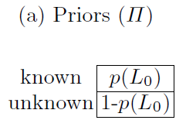
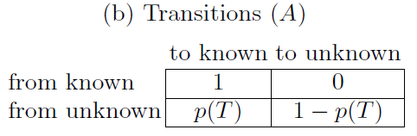
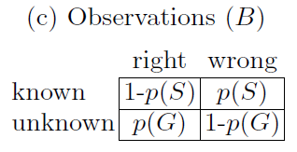
Standard Bayesian Knowledge Tracing (BKT) (1995)
State:
{unlearned, learned}
Observation:
{incorrect, correct}
Notes:
Bayesian Knowledge Tracing (BKT) is the most popular approach for building temporal models of
student learning.
BKT models a learner’s latent knowledge state as a set of binary variables
Bayesian Knowledge Tracing (BKT) is a user modeling method extensively used in the area of Intelligent Tutoring Systems
Assumes a two-state learning model {learned, unlearned}
Unlearned → learned | practice through reading the text/ at each opportunity to apply the rule in practice
No forgetting: Learned → unlearned (NO)
If learned , may make a mistake
If unlearned, maybe guess correctly
[2008]
Using four parameters per skill, fit using student performance data, to relate performance to learning
Statistically, equivalent to the two-node dynamic Bayesian network
At the beginning of using the tutor, each student has an initial probability (L0) of knowing each skill, and at each opportunity
to practice a skill the student does not know, the student has a certain probability (T)
of learning the skill, regardless of whether their answer is correct.
The system’s estimate that a student knows a skill is continually updated, every
time the student gives a first response (correct, incorrect, or a help request) to a problem
step. First, the system re-calculates the probability that the student knew the skill
before the response, using the evidence from the response (help requests are treated as
evidence that the student does not know the skill), using the first two equations of

Slide 15
Extensions and Drawbacks
Extensions:
Contextualization of guessing and slipping estimates
Estimating prior knowledge for individual Learners
Estimating problem difficulty
Drawbacks:
The binary representation of student understanding may be unrealistic.
The meaning of the hidden variables and their mappings onto exercises can be ambiguous, rarely meeting the model’s expectation of a single concept per exercise.
The binary response data used to model transitions imposes a limit on the kinds of exercises that can be modeled.

Slide 16
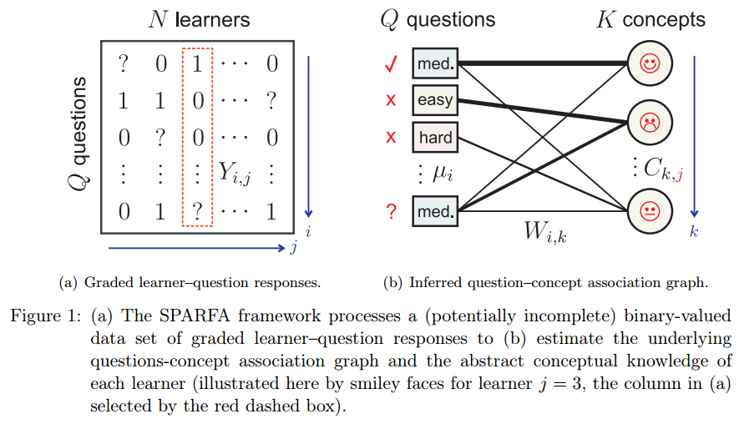
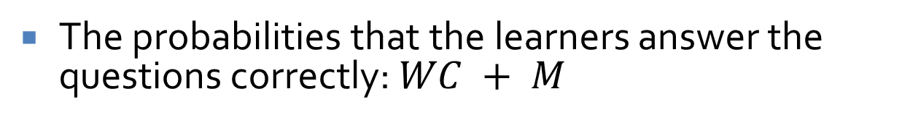
SPARse Factor Analysis (SPARFA) (JMLR 2014)
The probabilities that the learners answer the questions correctly: $WC + M$

Slide 17
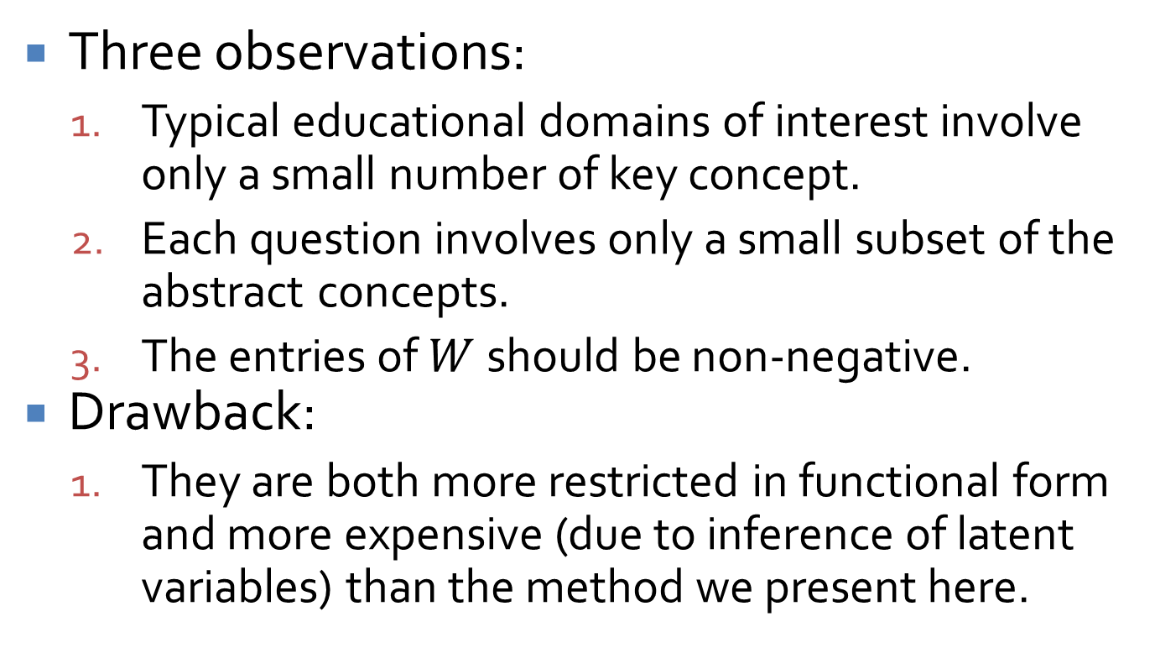
SPARse Factor Analysis (SPARFA) (JMLR 2014)
Three observations:
Typical educational domains of interest involve only a small number of key concept.
Each question involves only a small subset of the abstract concepts.
The entries of $W$ should be non-negative.
Drawback:
They are both more restricted in functional form and more expensive (due to inference of latent variables) than the method we present here.

Slide 18
RNN Model
In contrast to hidden Markov models as they appear in education, which are also dynamic, RNNs have a high dimensional, continuous, representation of latent state.
A notable advantage of the richer representation of RNNs is their ability to use information from an input in a prediction at a much later point in time.

Slide 19

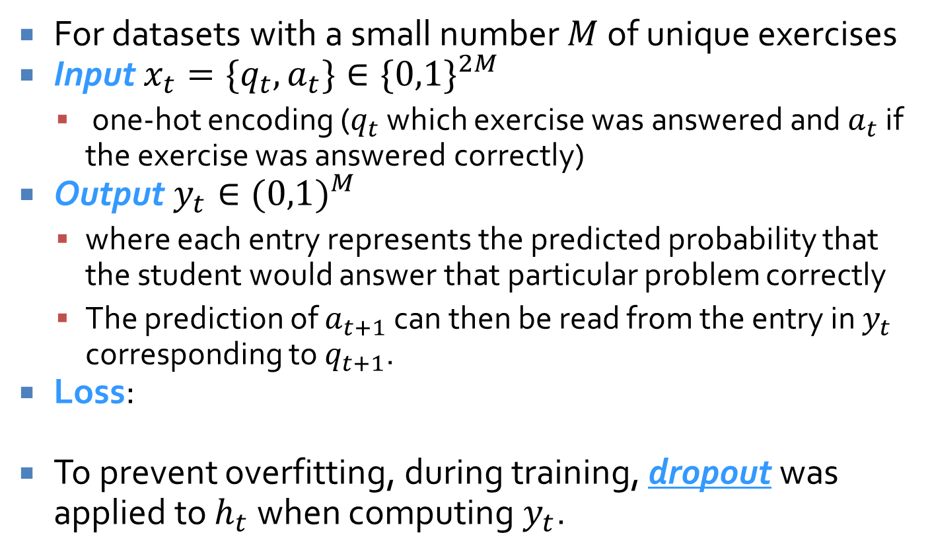
RNN Model
For datasets with a small number $M$ of unique exercises
Input $x_{t}=\{q_{t},a_{t}\}∈{\{0,1\}}^{2M}$
one-hot encoding ($q_{t}$ which exercise was answered and $a_{t}$ if the exercise was answered correctly)
Output $y_{t}∈{(0,1)}^{M}$
where each entry represents the predicted probability that the student would answer that particular problem correctly
The prediction of $a_{t+1}$ can then be read from the entry in $y_{t}$ corresponding to $q_{t+1}$.
Loss:
To prevent overfitting, during training, dropout was applied to $h_{t}$ when computing $y_{t}$.
t
Notes:
The training objective is the negative log likelihood of the observed sequence of student responses
under the model.

Slide 20
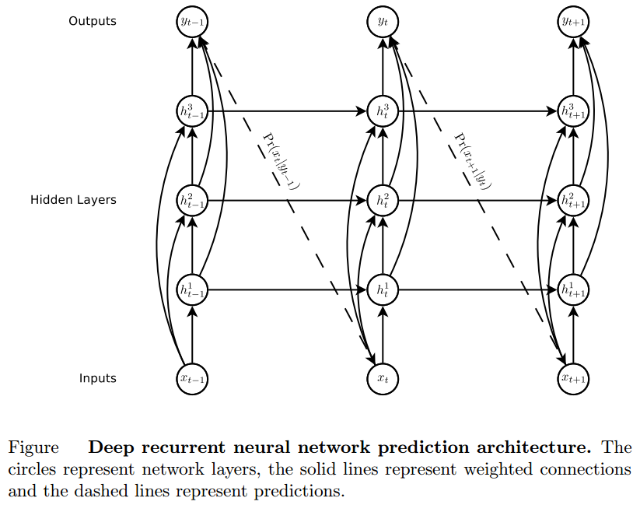
RNN Model

Slide 21
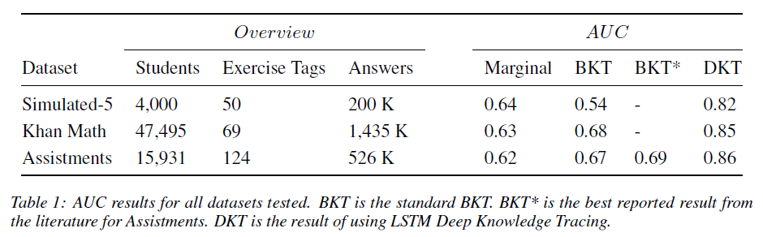
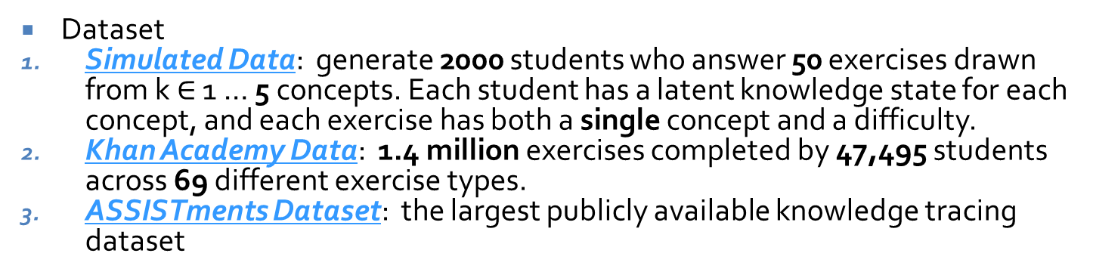
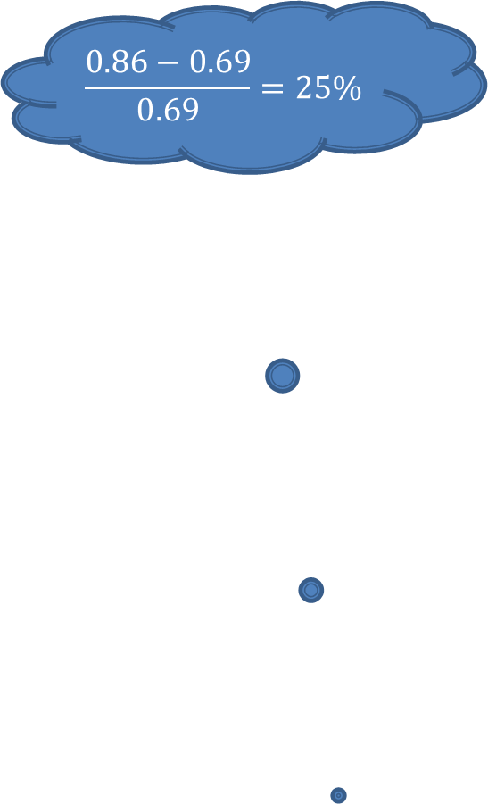
Experiment results
$$\frac{0.86−0.69}{0.69}=25\%$$
Dataset
Simulated Data: generate 2000 students who answer 50 exercises drawn from k $∈$ 1 … 5 concepts. Each student has a latent knowledge state for each concept, and each exercise has both a single concept and a difficulty.
Khan Academy Data: 1.4 million exercises completed by 47,495 students across 69 different exercise types.
ASSISTments Dataset: the largest publicly available knowledge tracing dataset

Slide 22
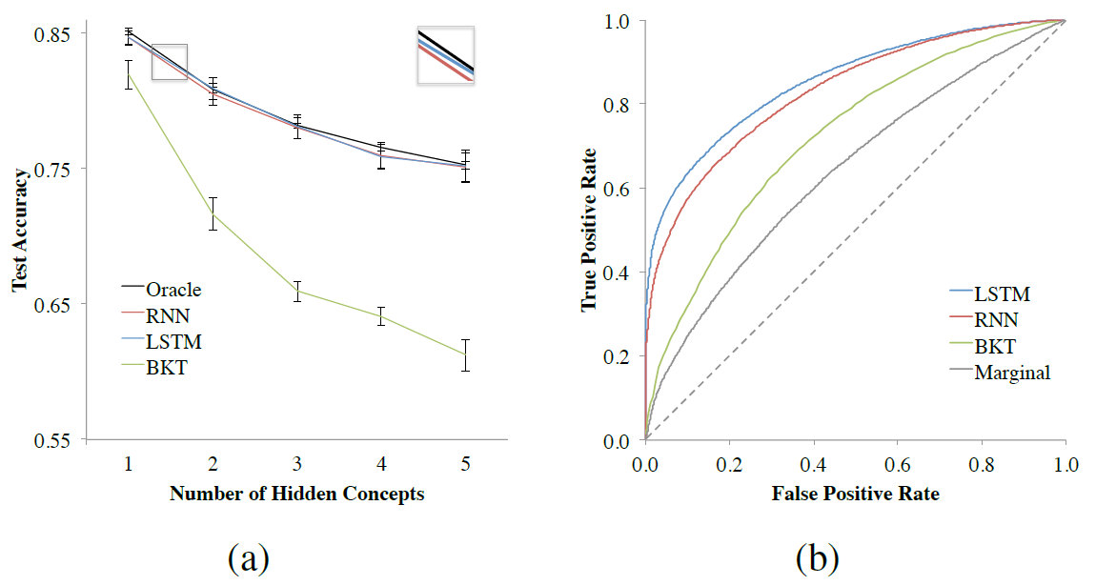
Experiment results

Slide 23
Other Applications(1): Improving Curricula
Choosing the best sequence of learning items to present to a student.
Given a student with an estimated hidden knowledge state, we can query our RNN to calculate what their expected knowledge state would be if we were to assign them a particular exercise.

Slide 24
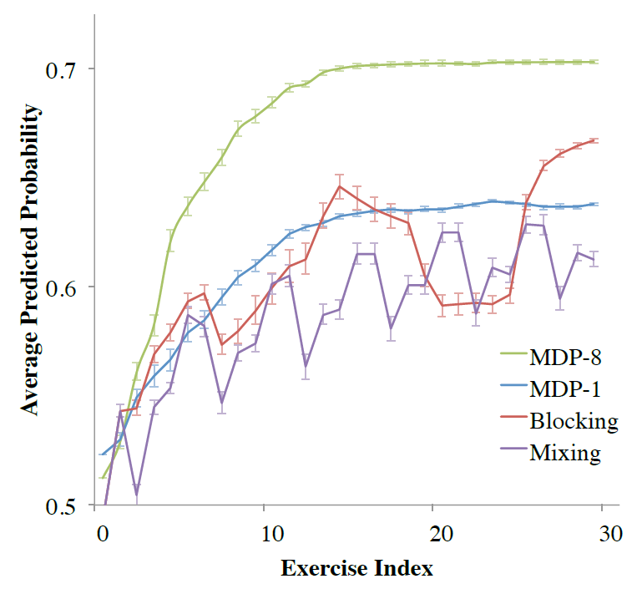
Experimental Results:
Expectimax V.S. mixing (exercises from different topics are intermixed) 、blocking (students answer series of exercises of the same Type).
Tested different curricula for selecting exercises on a subset of five concepts over the span of 30 exercises from the ASSISTment dataset.

Slide 25
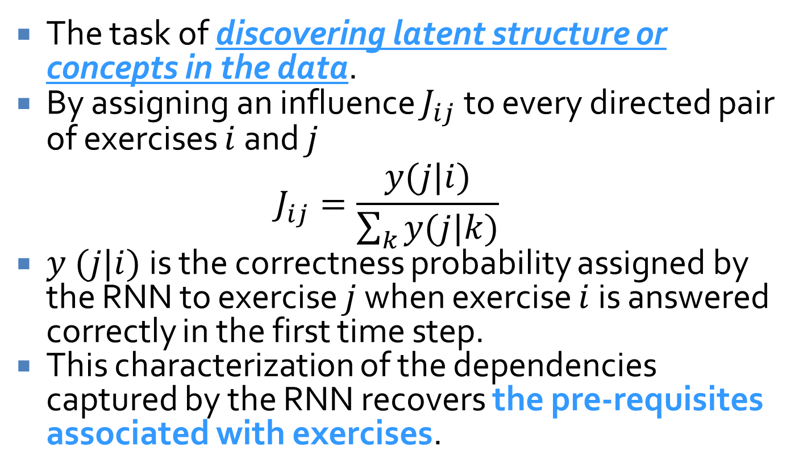
Other Applications(2): Discovering Exercise Relationships
The task of discovering latent structure or concepts in the data.
By assigning an influence $J_{ij}$ to every directed pair of exercises $i$ and $j$
$$J_{ij}=\frac{y(j|i)}{\sum_{k}{y(j|k)}}$$
$y (j|i)$is the correctness probability assigned by the RNN to exercise $j$ when exercise $i$ is answered correctly in the first time step.
This characterization of the dependencies captured by the RNN recovers the pre-requisites associated with exercises.

Slide 26
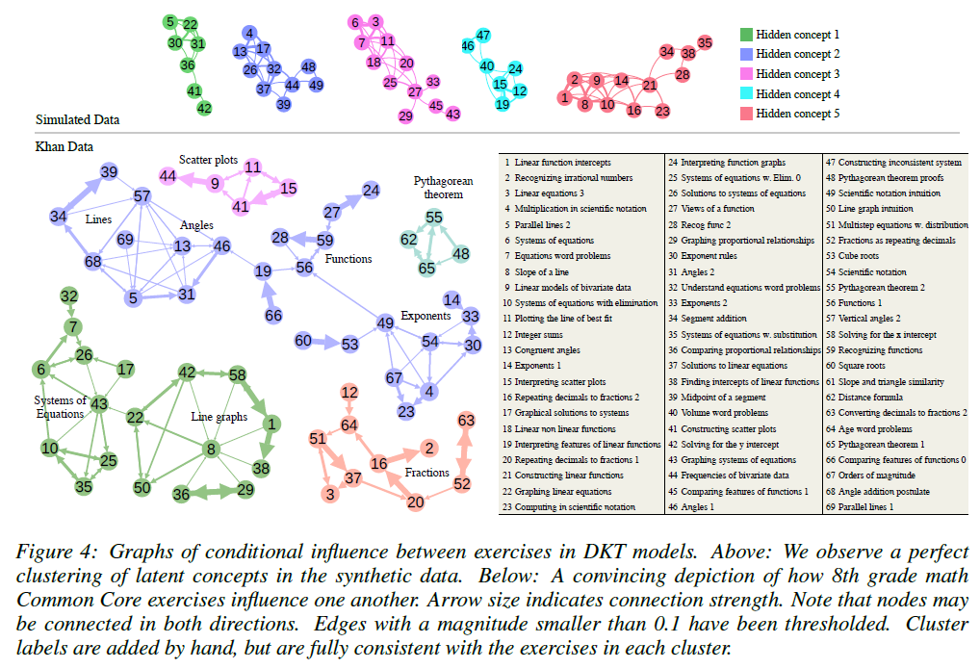
Experimental Results:

Slide 27
Future Work
Incorporate other features as inputs (such as time taken)
Explore other educational impacts (such as hint generation, dropout prediction)
Validate hypotheses posed in education literature (such as spaced repetition, modeling how students forget)
To track knowledge over more complex learning activities

