Slide 1



Rank-GeoFM: A Ranking based Geographical Factorization Method for Point of Interest Recommendation
Xutao Li¹, Gao Cong¹, Xiao-Li Li²
Tuan-Anh Nguyen Pham¹, Shonali Krishnaswamy²
¹Nanyang Technological University, Singapore
²Institute for Infocomm Research (I2R), A* STAR, Singapore

Slide 2
Outline
1. Introduction
2. Related Work
3. Proposed Method: Rank-GeoFM
4. Experimental Results
5. Conclusions

Slide 3




Motivation
Many location-based social networks (LBSNs) have emerged in recent years, e.g. Foursquare, Facebook Places, Gowalla, etc
In these social networks, people can check-in and share their experience when they visit a Point of Interest (POI)
With the check-in records available, POI recommendation becomes an important topic.
Help people explore interesting unknown places in a city;
Attract potential visitors for POI owners to increase their revenues.

Slide 4
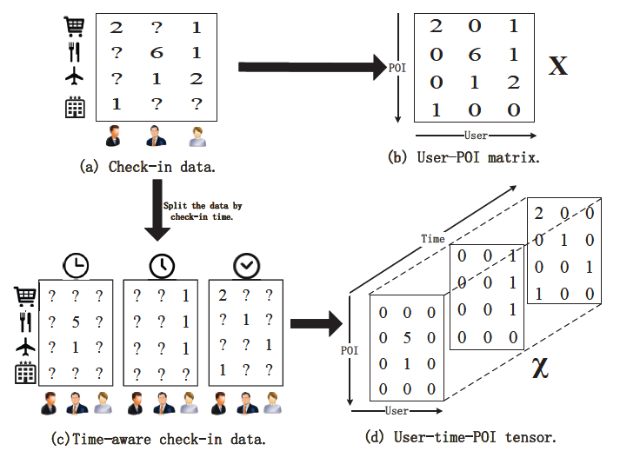
Problem settings
Setting 1: POI recommendation (given u, recommending l)
Setting 2: Context-aware POI recommendation (given u and t , recommending l)
Setting 1
Setting 2

Slide 5

Challenges
Data Sparsity: the check-in data is extremely sparse.
Implicit Feedback Property: check-ins are a type of implicit feedback data.
Context Information Utility: how to incorporate different types of context information?
Density of Netflix | Density of check-ins
1.2% | less than 0.05%
Density is extremely small compared to Netflix!
Movie rating data (Netflix) | Check-in data
Users explicitly denote “like” and “dislike” by giving different scores | We only have check-in frequencies and most of the frequencies are one
We have to infer user’s preferences based on check-in data!
geographical coordinates of POIs (key difference from traditional recommendation!)
time stamps of check-ins
categories of POIs
…

Slide 6
Outline
1. Introduction
2. Related Work
3. Proposed Method: Rank-GeoFM
4. Experimental Results
5. Conclusions

Slide 7


POI recommendation
Memory based CF methods
Ye et al. linear interpolation CF, SIGIR’ 2011.
Levandoski et al. distance penalty CF, ICDE’ 2012.
Matrix factorization based CF methods
Noulas et al. traditional MF worst than CF, PASSAT’ 2012.
Cheng et al. Multi-center Gaussian with MF, AAAI’ 2012.
Liu et al. GTBNMF, SIGKDD’ 2013.
Lian el al. GeoMF, SIGKDD’ 2014.
l₁
l₂
l₃
l₄
When data is too sparse, we cannot calculate reliable similarities for recommendation!
u₁
1 | 1 | 0 | 1
1 | 0 | 1 | 1
0 | 1 | 0 | 0
1 | 0 | 0 | 0
0
u₂
Sim(u₂, u₄) = 1
u₃
u₄
Fitting only non-zeros, they thus suffer from
data sparsity!
Fitting both zeros and non-zeros, which is not reasonable.

Slide 8
Context-aware POI recommendation
Time-aware POI recommendation
Yuan et al. UTE+SE (CF based method) SIGIR’ 2013
Yuan et al. BPP (Graph propagation based method) CIKM’ 2014
Gao et al. LRT(Matrix factorization based method) Recsys’2013
All the above methods either do not appropriately address the data sparsity, or cannot be generalized to handle other types of context information.

Slide 9
Outline
1. Introduction
2. Related Work
3. Proposed Method: Rank-GeoFM
4. Experimental Results
5. Conclusions

Slide 10


Overview of our approach
Components of our Rank-GeoFM approach
Data sparsity
Preference Ranking Objective Function
Implicit feedback property
A Unified Geographical Factorization Method
Context information
Sampling based Fast Optimization
Speeding up the learning
We introduce the three components one by one next!

Slide 11

Preference Ranking Objective Function (1)
Our Assumption: (a) the higher the check-in frequency is, the more the POI is preferred by a user; (b) and the unvisited POIs are less preferred than the visited ones.
Ranking Idea: The assumption enables us to infer a preference ranking list of POIs for each user, and our main idea is to learn a prediction model by fitting the list.
For u₁, we have:
l₂ > l₁ l₂ > l₃ l₂ > l₄
l₁> l₃ l₁ > l₄
l₁
l₂
l₃
l₄
u₁
1 | 3 | 0 | 0
1 | 0 | 0 | 0
Infer preference
based check-ins
u₂
For u₂, we have:
l₁ > l₂ l₁> l₃ l₁ > l₄
For u₃, we have:
…
u₃
u₄
In ranking way, the sparsity problem is alleviated because we exploit zero check-ins, but do not fit them directly. Moreover, ranking objective is more suitable for implicit feedback data.

Slide 12



Preference Ranking Objective Function (2)
Measure the inconsistence between inferred preference and model produced preference:
For user u, the number of POIs incorrectly ranked higher than POI l.
Inferred preference
by check-in data
The preference produced
by prediction model
Convert the inconsistence into a loss via a smooth-weighting function, and then minimize the loss O:
Smooth weighting function 1+1/2+…+1/r
To complete the objective function, we need a prediction model to compute y_{ul} !!

Slide 13




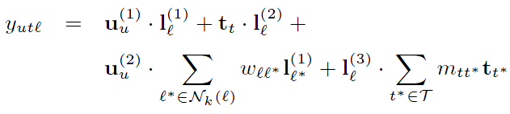
A Unified Geographical Factorization Method
Prediction model for recommendation scores y_{ul} (introducing more pairwise factorization terms to incorporate the contextual information):
(1) POI recommendation setting
user-preference score
geographical influence score
(2) Time-aware POI recommendation setting
temporal popularity score
user-preference score
geographical influence score
temporal influence score

Slide 14





Sampling based Fast Optimization
To optimize the objective function O, we need to calculate the gradient:
Very time-consuming!!
Reason: For each user, we need to compute the recommendation score y_{ul} for all POIs.
Recall that
We estimate it based on sampling:
$$Prob(S=n)={\left(1−p\right)}^{n−1}p$$
Given a pair (u, l)
It follows a geometric distribution with parameter
We thus can estimate:
Sample POI with replacement, n=n+1
No
incorrectly ranked higher than POI l
Yes

Slide 15
Outline
1. Introduction
2. Related Work
3. Proposed Method: Rank-GeoFM
4. Experimental Results
5. Conclusions

Slide 16
Experimental setup
Two datasets
For each user, 20% of most recent check-ins as test set, 10% as tuning set and the
remaining 70% as training set.
Settings
  POI recommendation
  Time-aware POI recommendation
Evaluation Metrics
  Precision@5, 10, 20
  Recall@5, 10, 20
Data sets | # check-ins | # users | # POIs | Region
Foursquare | 194,108 | 2,321 | 5,596 | Singapore
Gowalla | 456,988 | 10,162 | 24,250 | CA, USA

Slide 17
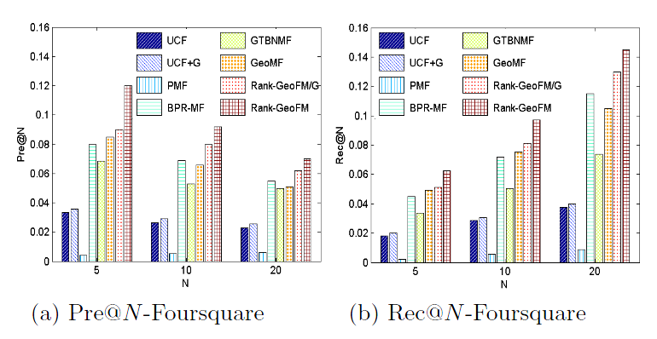
Experimental results (1)
POI recommendation
Rank-GeoFM outperforms state-of-the-art methods, e.g., GeoMF and GTBNMF.
Incorporating geographical influence into Rank-GeoFM leads to a significant improvement.
The performance of BPR-MF is also promising because it is a ranking based method and more suitable for handling sparse and implicit feedback data.

Slide 18
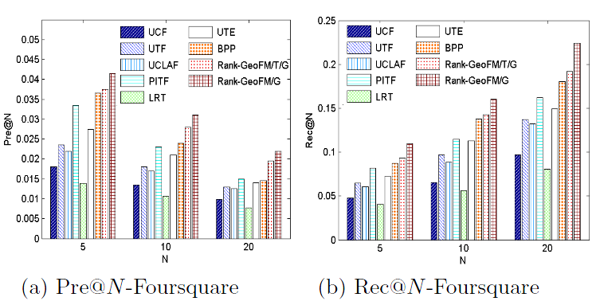
Experimental results (2)
Time-aware POI recommendation (without geographical influence)
Rank-GeoFM outperforms state-of-the-art methods.
By incorporating the temporal influence, Rank-GeoFM gains 10.6% improvements (Pre@5).
The ranking based tensor factorization method PITF also produces promising performance.

Slide 19
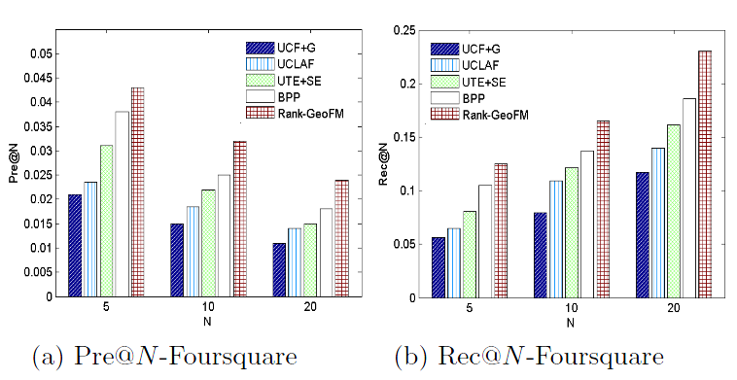
Experimental results (3)
Time-aware POI recommendation (with geographical influence)
Rank-GeoFM outperforms all the other methods by more than 13.1%.

Slide 20
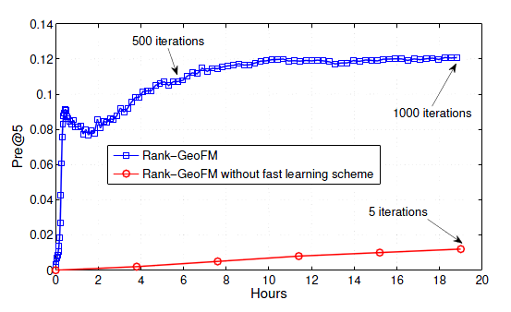
Experimental results (4)
Comparisons of learning rate with/without fast learning
Rank-GeoFM with fast learning scheme gains speedup in orders of magnitude.
The first 500 iterations take 6 hours or so, while the last 500 iterations take 13 hours or so.
(At the beginning, we can easily obtain incorrectly ranked samples because the model is not well trained).

Slide 21
Outline
1. Introduction
2. Related Work
3. Proposed Method: Rank-GeoFM
4. Experimental Results
5. Conclusions

Slide 22

Conclusions
We propose a ranking based geographical factorization method, which not only can alleviate the data sparsity problem for POI recommendation, and but also easily incorporate different contextual information.
Experimental results show that the proposed Rank-GeoFM outperforms state-of-the-art methods significantly under both POI recommendation and time-aware POI recommendation settings.
user-category preference score

Slide 23
Thanks
Q&A

