Slide 1
Weight Normalization: A Simple Reparameterization to Accelerate Training of Deep Neural Networks
Tim Salimans and Diederik P. Kingma
OpenAI

Slide 8
Empirically, we find that $w$ is often (close to) a dominant eigenvector of the covariance matrix $Var[∇_{w}L]$: removing that eigenvector then gives a new covariance matrix $Var[∇_{v}L]$ that is closer to the identity matrix, which may further speed up learning.

Slide 9
Empirically, we find that the ability to grow the norm $||v||$makes optimization of neural networks with weight normalization very robust to the value of the learning rate.

Slide 12
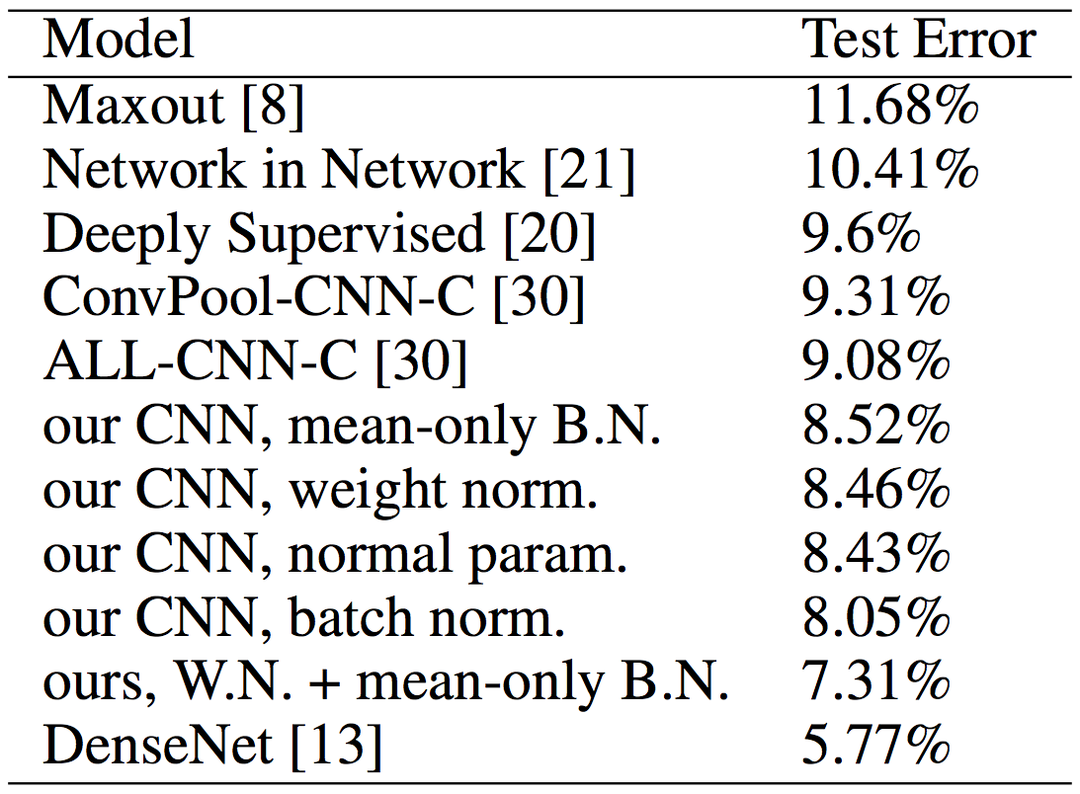
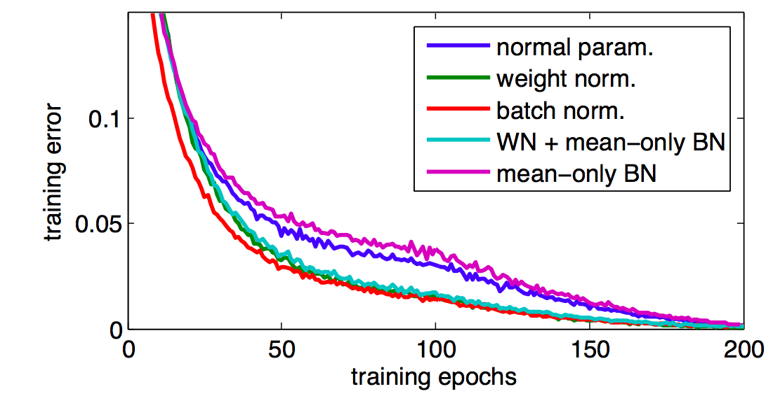

Slide 13
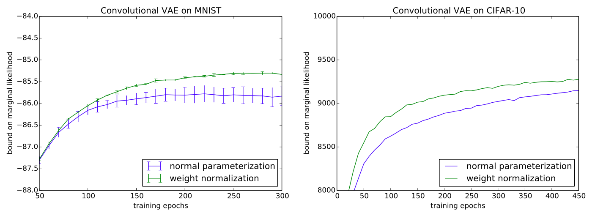

Slide 14
