Slide 1
CNN Demo
LIU Pengpeng

Slide 2
Classification
A simple model on MNIST dataset
Tutorial: https://www.tensorflow.org/get_started/mnist/pros
Code: https://github.com/tensorflow/tensorflow/blob/r1.3/tensorflow/examples/tutorials/mnist/mnist_deep.py
A template for constructing larger and sophisticated models
Tutorial: https://www.tensorflow.org/tutorials/deep_cnn
Code: https://github.com/tensorflow/models/tree/master/tutorials/image/cifar10/
More examples
https://github.com/tensorflow/models
Slim is very convenient: https://github.com/tensorflow/models/tree/master/research/slim

Slide 3
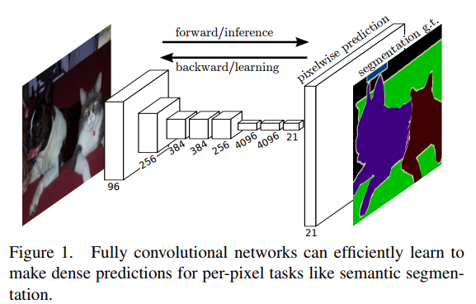
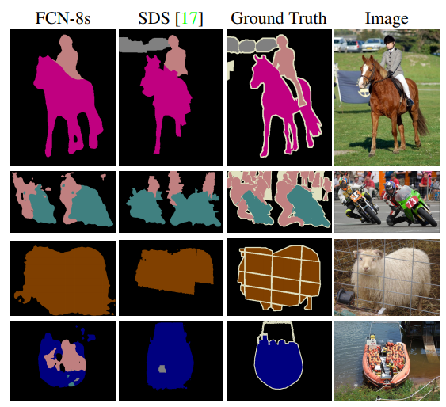
Pixel-wise Classification
Fully convolutional network (FCN)
Paper: Fully Convolutional Networks for Semantic Segmentation
Code: https://github.com/shekkizh/FCN.tensorflow

Slide 4
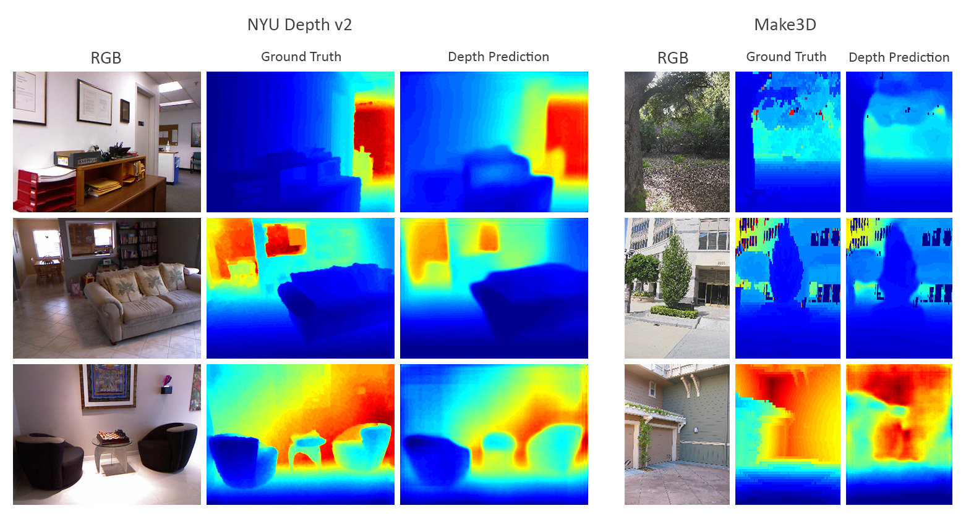
Regression
Depth Prediction with FCNs
Code: https://github.com/iro-cp/FCRN-DepthPrediction

Slide 5
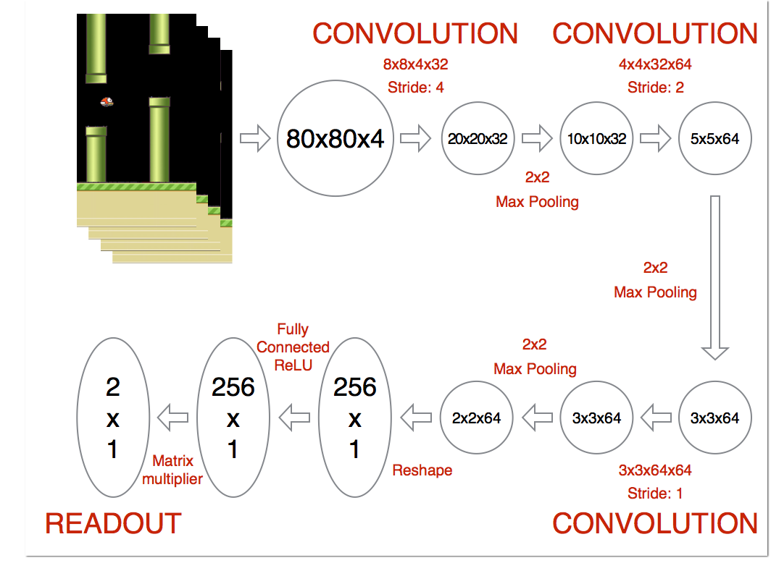
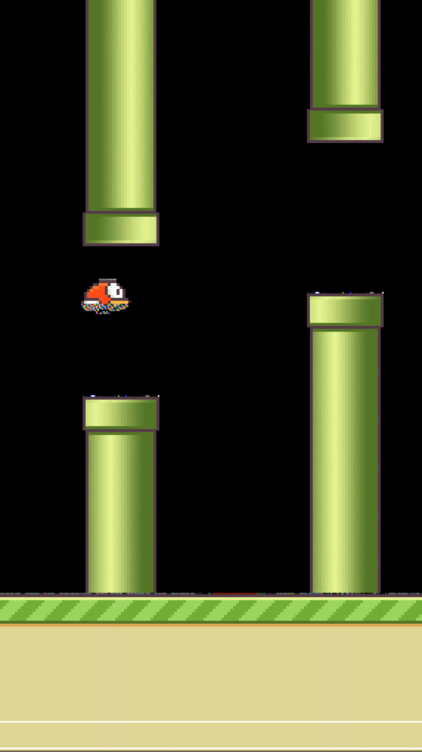
Deep Reinforcement Learning
Using Deep Q-Network to Learn How To Play Flappy Bird
Code: https://github.com/yenchenlin/DeepLearningFlappyBird

Slide 6
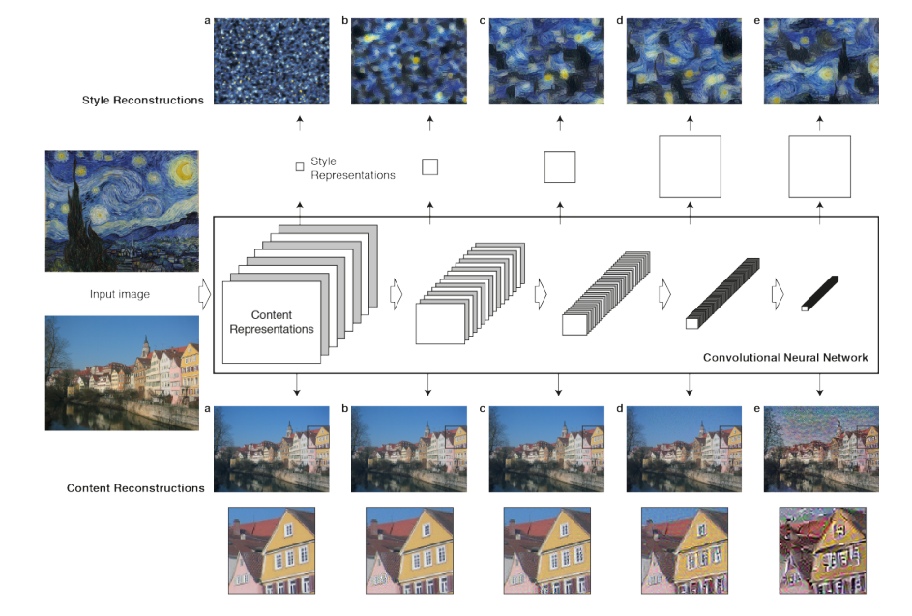
Style Transfer
Neural style transfer
Paper: A Neural Algorithm of Artistic Style
Code: https://github.com/anishathalye/neural-style

Slide 7
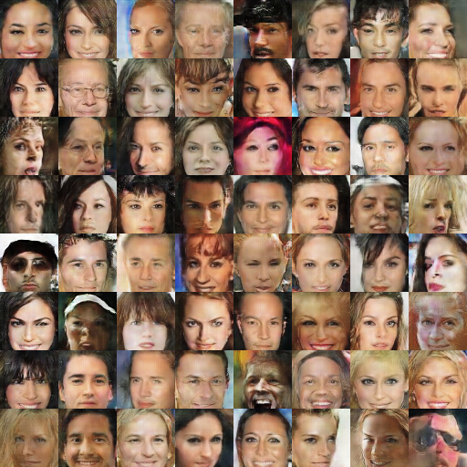
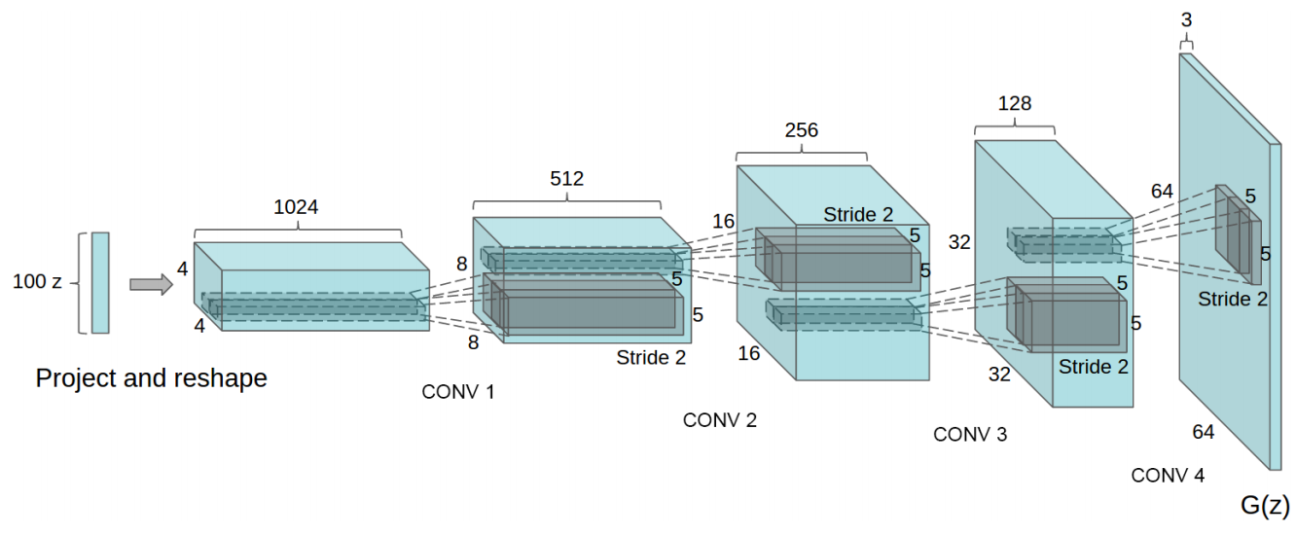
Generative Adversarial Networks (GANs)
Deep Convolutional Generative Adversarial Network (DCGAN)
Paper: Unsupervised Representation Learning with Deep Convolutional Generative Adversarial Networks
Code: https://github.com/carpedm20/DCGAN-tensorflow (a very good template)

