Slide 1
Weight Normalization:
A Simple Reparameterization to Accelerate Training of Deep Neural Networks
Tim Salimans and Diederik P. Kingma
OpenAI

Slide 2
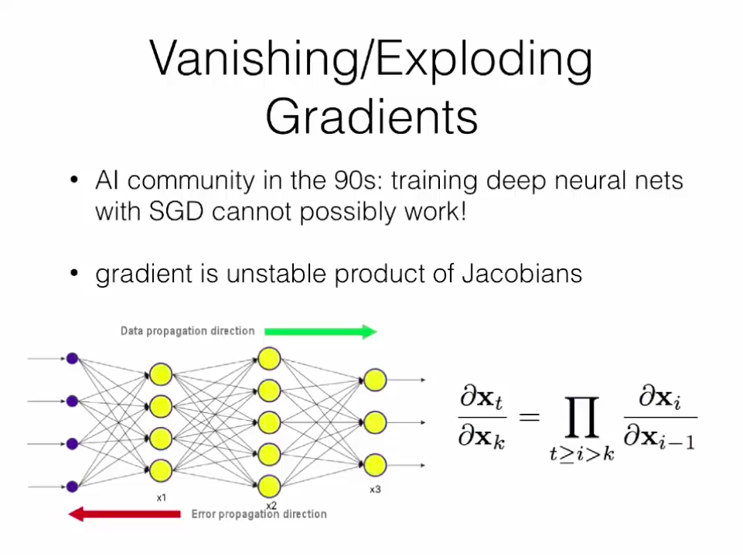

Slide 3
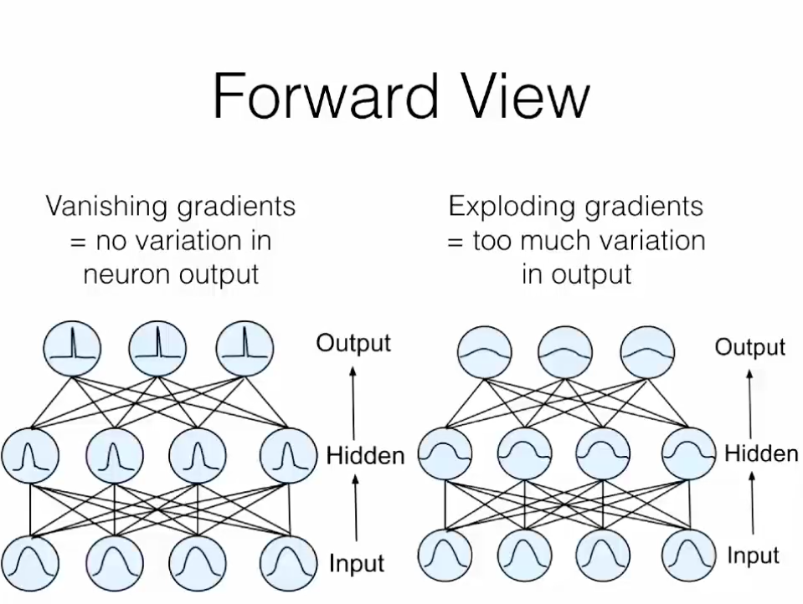

Slide 4
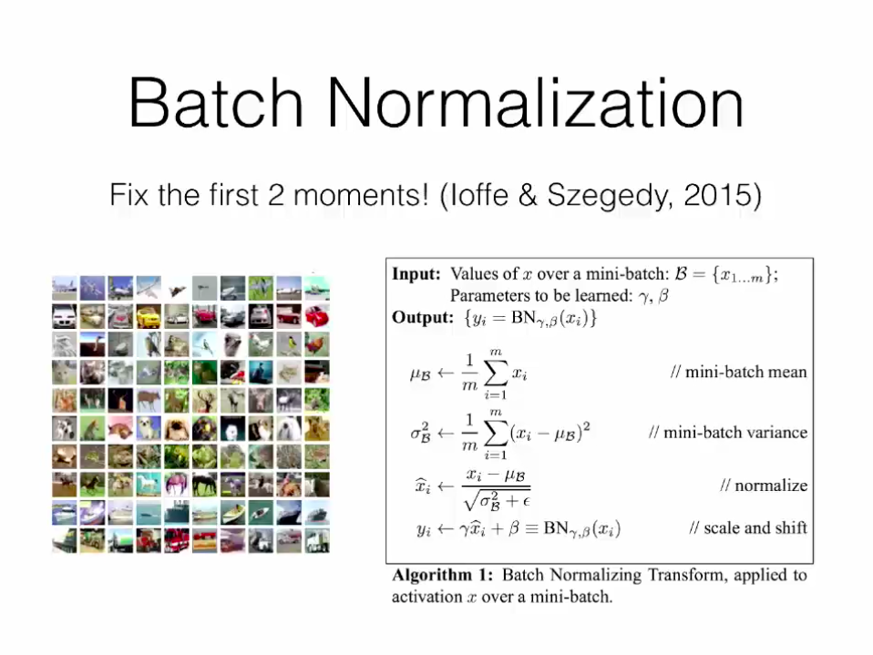

Slide 5
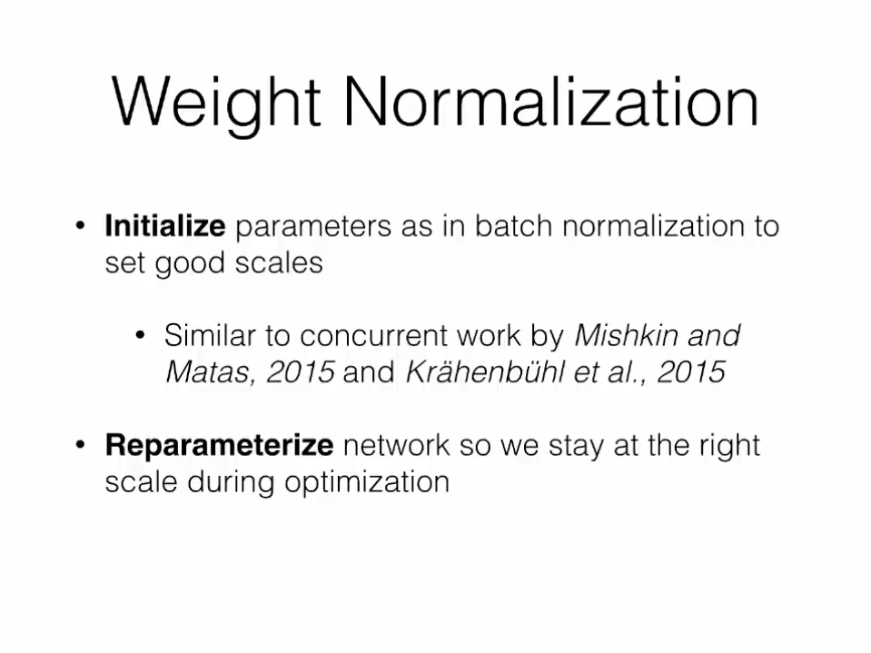

Slide 6
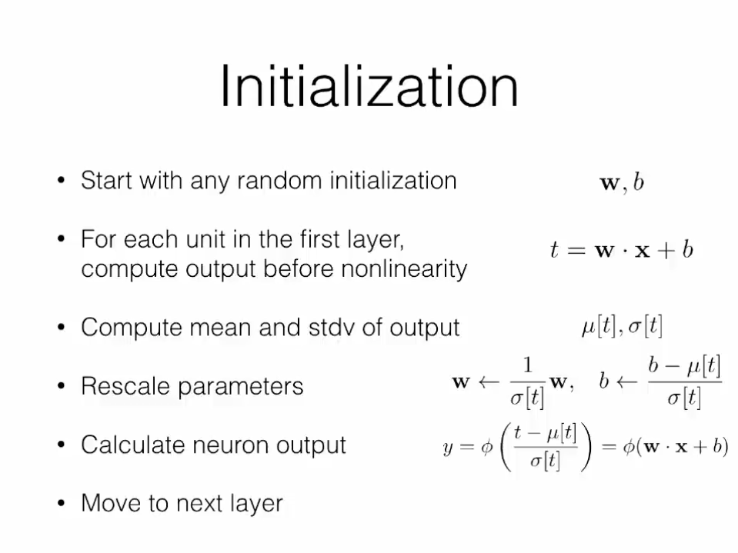

Slide 7
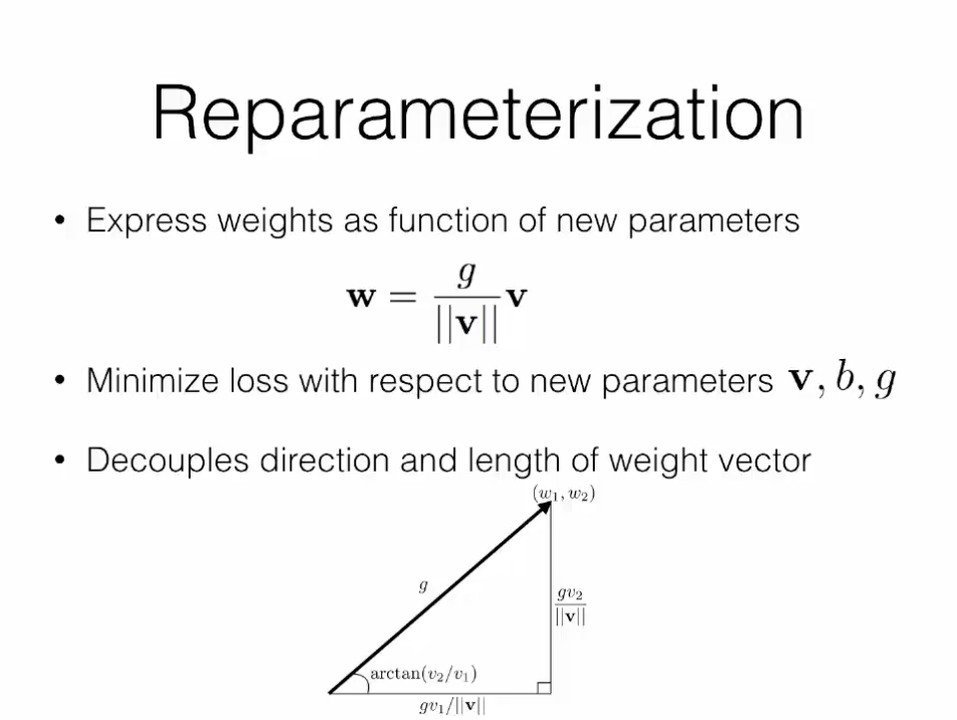

Slide 8
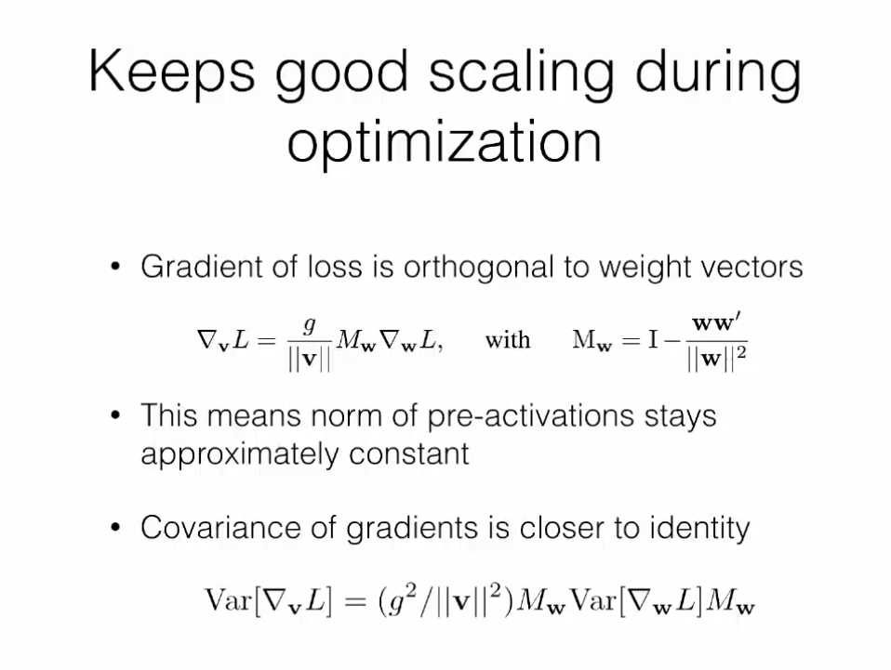

Empirically, we find that $w$ is often (close to) a dominant eigenvector of the covariance matrix $Var[∇_{w}L]$: removing that eigenvector then gives a new covariance matrix $Var[∇_{v}L]$ that is closer to the identity matrix, which may further speed up learning.

Slide 9
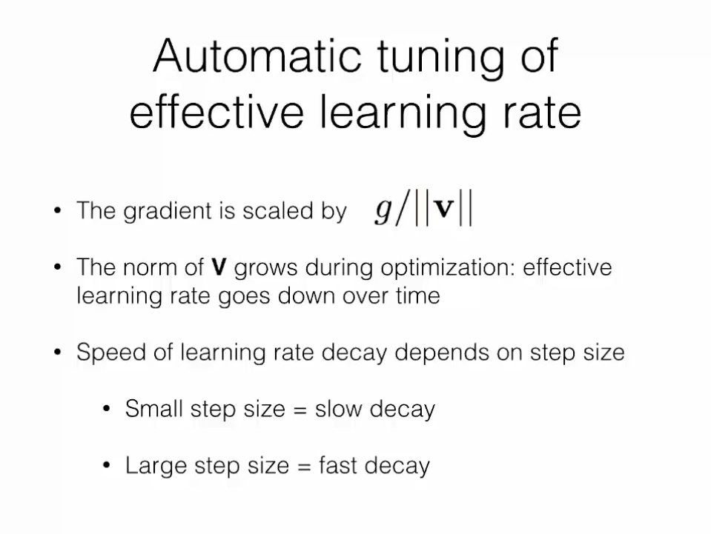

Empirically, we find that the ability to grow the norm $||v||$makes optimization of neural networks with weight normalization very robust to the value of the learning rate.

Slide 10
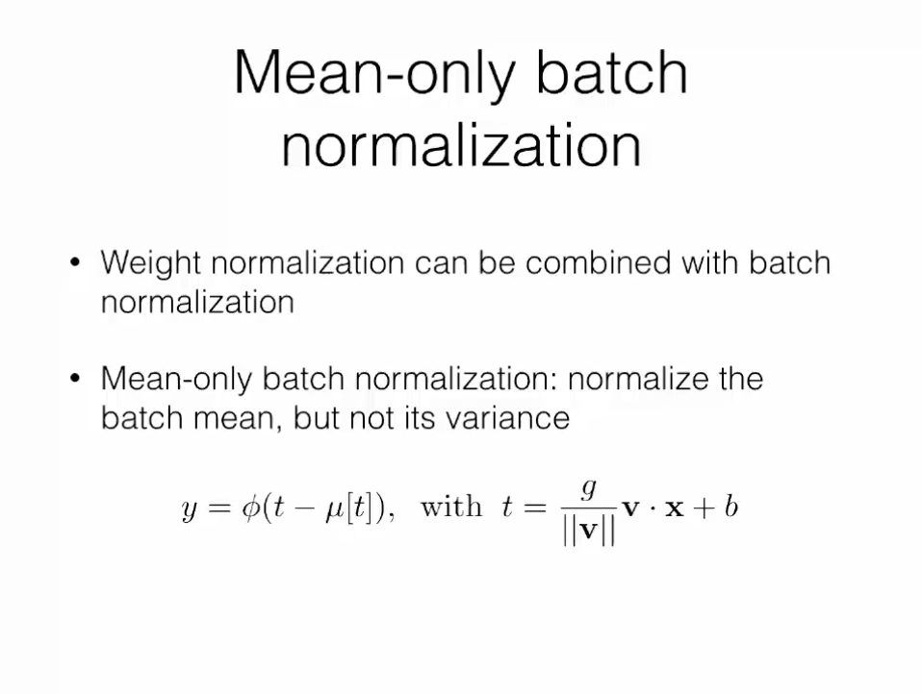

Slide 11
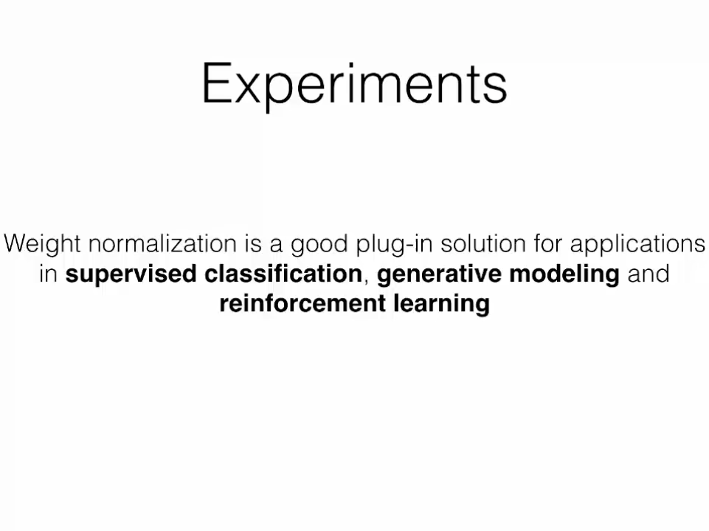

Slide 12
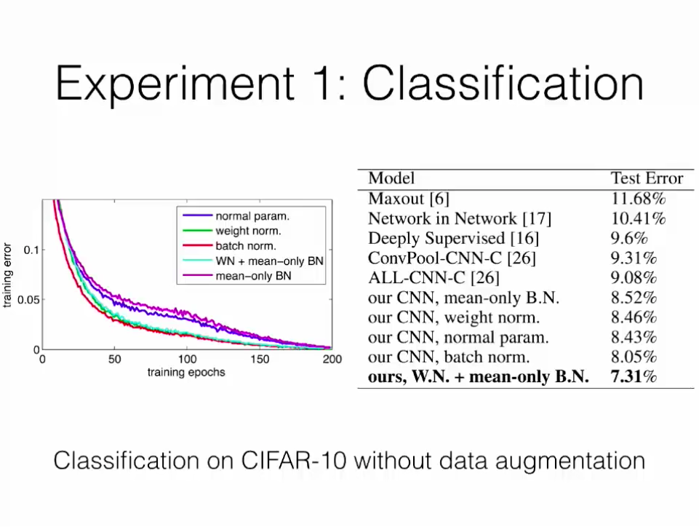
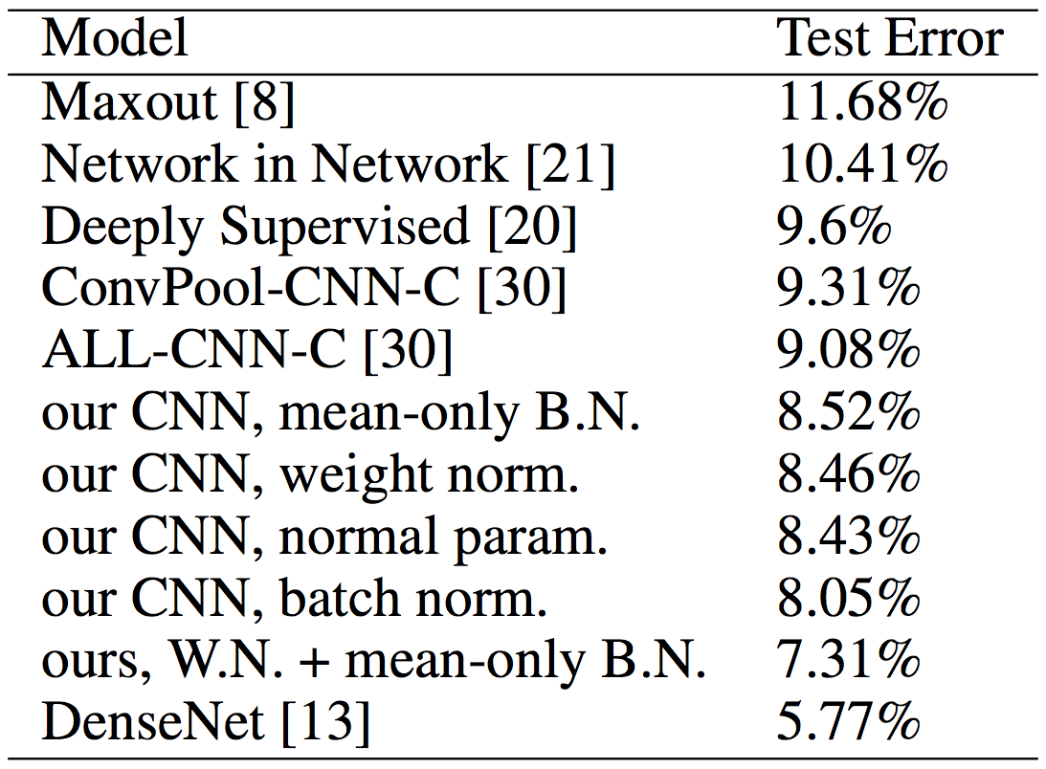
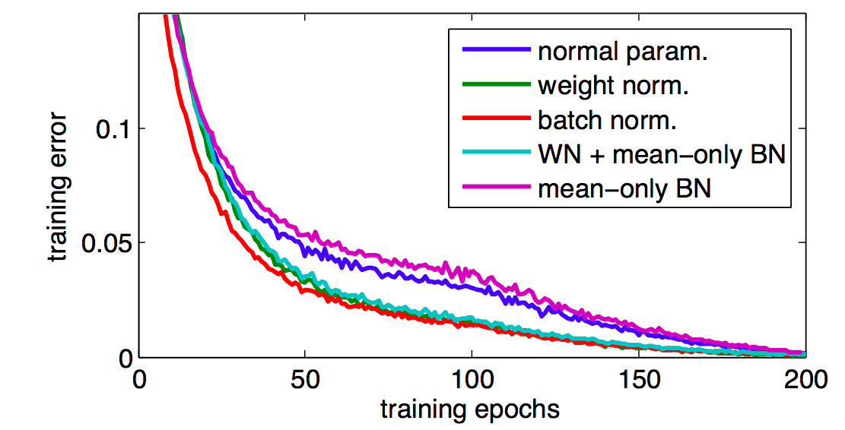

Slide 13
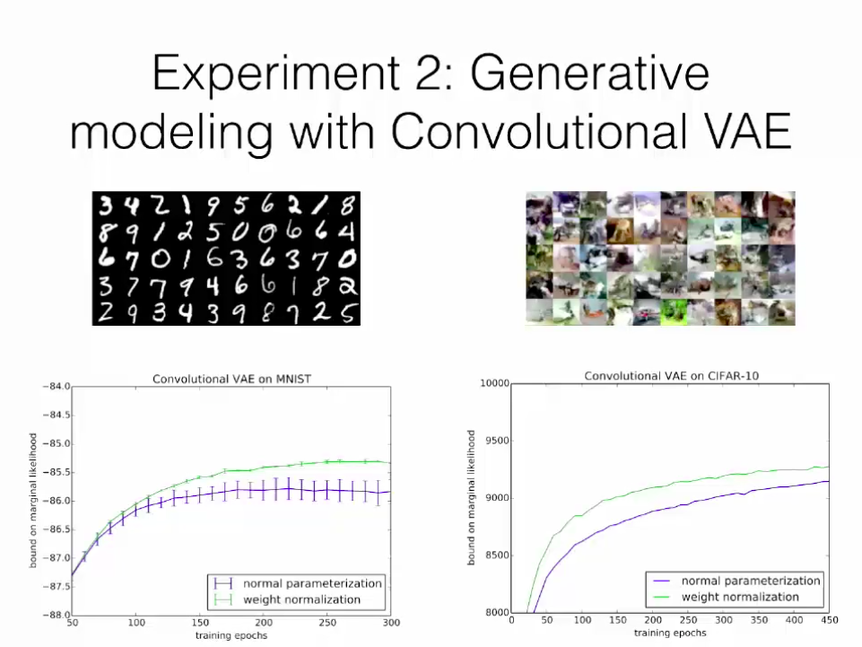
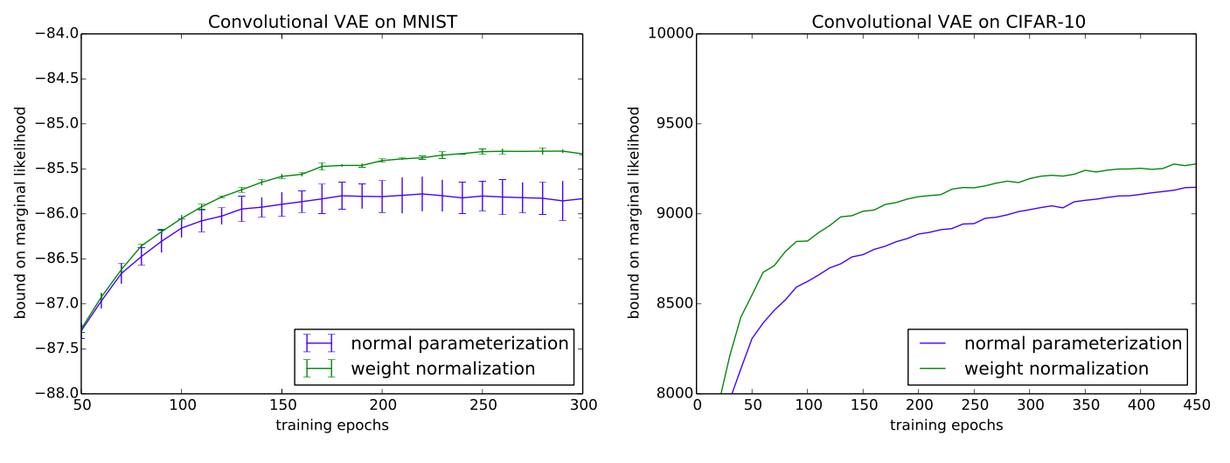

Slide 14
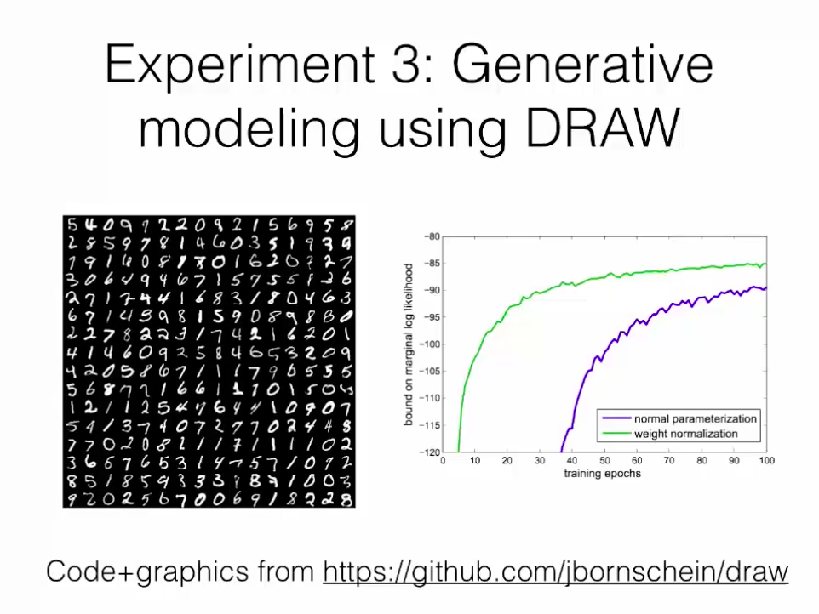
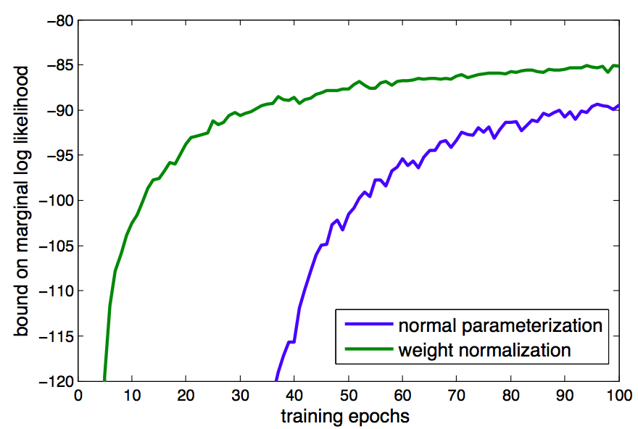

Slide 15
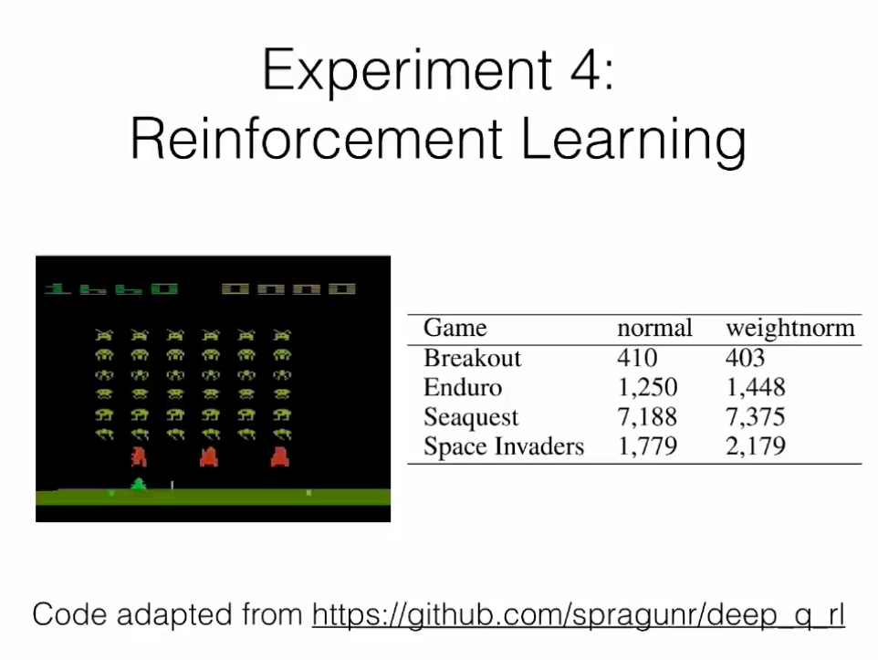


Slide 16
