Slide 1
Parallel and Distributed Block Coordinate Frank Wolfe
Yu-Xiang Wang
Joint work with
Veeru Sadhanala, Willie Neiswanger, Wei Dai, Suvrit Sra (MIT LIDS) and Eric Xing
CMU
ICML 2016

Slide 2
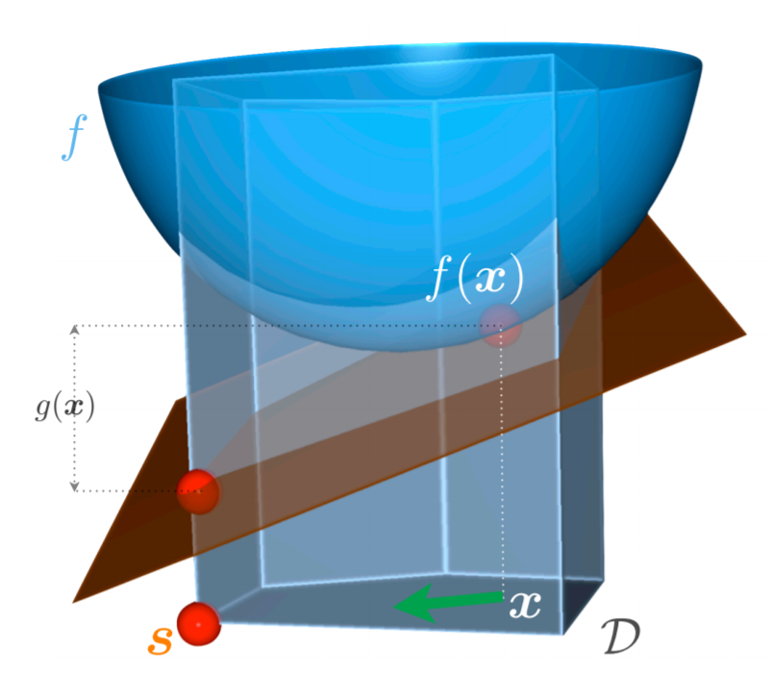
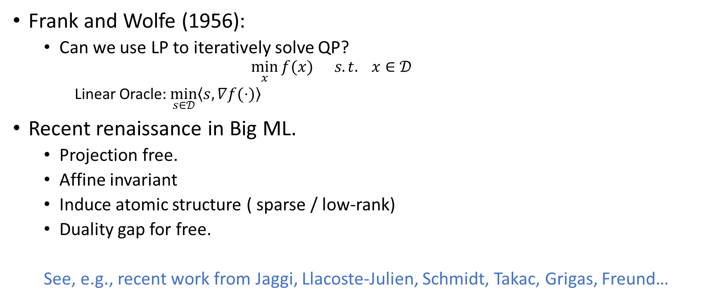
Frank-Wolfe and why Frank-Wolfe?
Frank and Wolfe (1956):
  Can we use LP to iteratively solve QP?
    $$\min_{x}{f(x)} s.t. x∈𝒟$$
    Linear Oracle: $\min_{s∈𝒟}\left\langle s,∇f(⋅)\right\rangle$
Recent renaissance in Big ML.
  Projection free.
  Affine invariant
  Induce atomic structure ( sparse / low-rank)
  Duality gap for free.
  See, e.g., recent work from Jaggi, Llacoste-Julien, Schmidt, Takac, Grigas, Freund…

Slide 3

Standard Frank-Wolfe Algorithm
Let $x^{\left(0\right)}∈𝒟$
  for $k=0…K$ do
    Compute $s ≔\arg{\min_{s∈𝒟}{〈s,∇f\left(x^{\left(k\right)}\right)〉}}$
    Update $x^{\left(k+1\right)} ≔\left(1−γ\right)x^{k}+γs$, for $γ≔\frac{2}{k+2}$
  end for

Slide 4

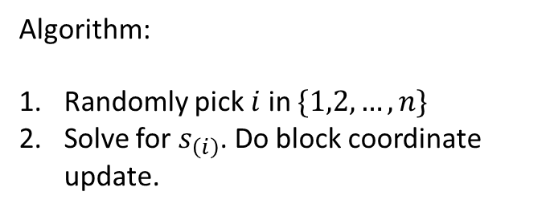

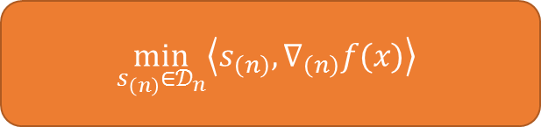

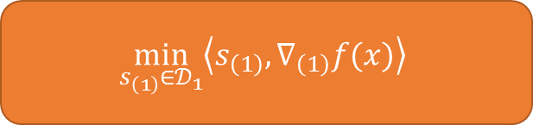
Block Coordinate Frank-Wolfe (BCFW)
Lacoste-Julien et. al. (2013)
$$\min_{x}{f(x)} s.t. x=\left[x_{\left(1\right)},…,x_{\left(n\right)}\right]∈𝒟_{1}×⋯𝒟_{n}=:𝒟$$
$$\min_{s_{\left(1\right)}∈𝒟_{1}}\left\langle s_{\left(1\right)}, ∇_{\left(1\right)}f(x)\right\rangle$$
$$\min_{s∈𝒟}\left\langle s,∇f(⋅)\right\rangle$$
$$\min_{s_{\left(i\right)}∈𝒟_{i}}\left\langle s_{\left(i\right)}, ∇_{\left(i\right)}f(x)\right\rangle$$
Algorithm:
Randomly pick $i$ in $\{1,2,…,n\}$
Solve for $s_{\left(i\right)}$. Do block coordinate update.
$$\min_{s_{\left(n\right)}∈𝒟_{n}}\left\langle s_{\left(n\right)}, ∇_{\left(n\right)}f(x)\right\rangle$$

Slide 5


Can we parallelize it?
A mini-batch version of BCFW
  Randomly pick subset $S⊂[n]$
  Solve subroutine for each $i∈S$
  Update the parameter vector
$$\left|S\right|=:τ$$
What if we can solve this in parallel? Can we speed things up further?

Slide 6
Questions of interest
Does it converge / convergence rate?
  Yes
Does it converge faster than BCFW?
  Sometimes. It depends on each problem at hand.
Is it robust to delayed updates?
  Yes, very much so

Slide 7
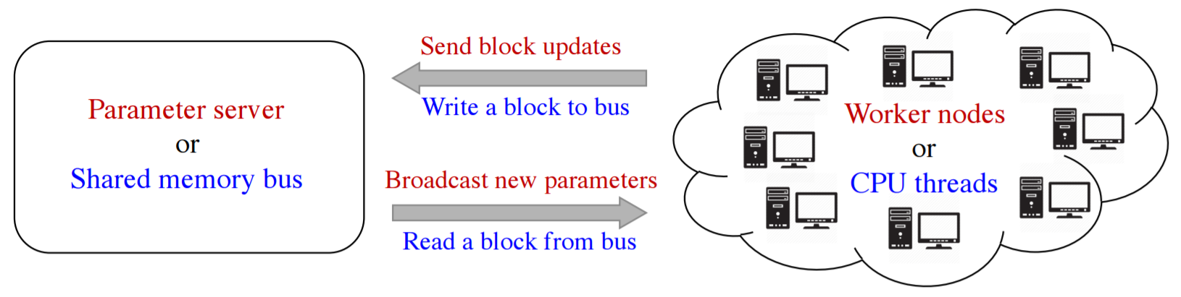
“Cloud” Oracle model
Different types of randomization
Various system schemes
Parallel and distributed.

Slide 8
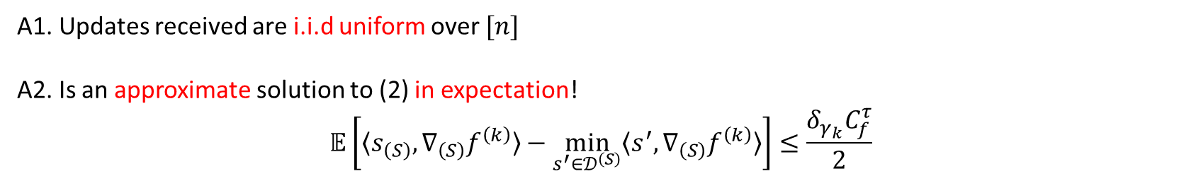
“Cloud” Oracle model
A1. Updates received are i.i.d uniform over $[n]$
A2. Is an approximate solution to (2) in expectation!
$$𝔼\left[〈s_{\left(S\right)}, ∇_{\left(S\right)}f^{\left(k\right)}〉−\min_{s^{′}∈𝒟^{\left(S\right)}}{〈s^{′}, ∇_{\left(S\right)}f^{\left(k\right)}〉}\right]≤\frac{δ_{γ_{k}}C_{f}^{τ}}{2}$$
Much weaker than what’s required previously!

Slide 9
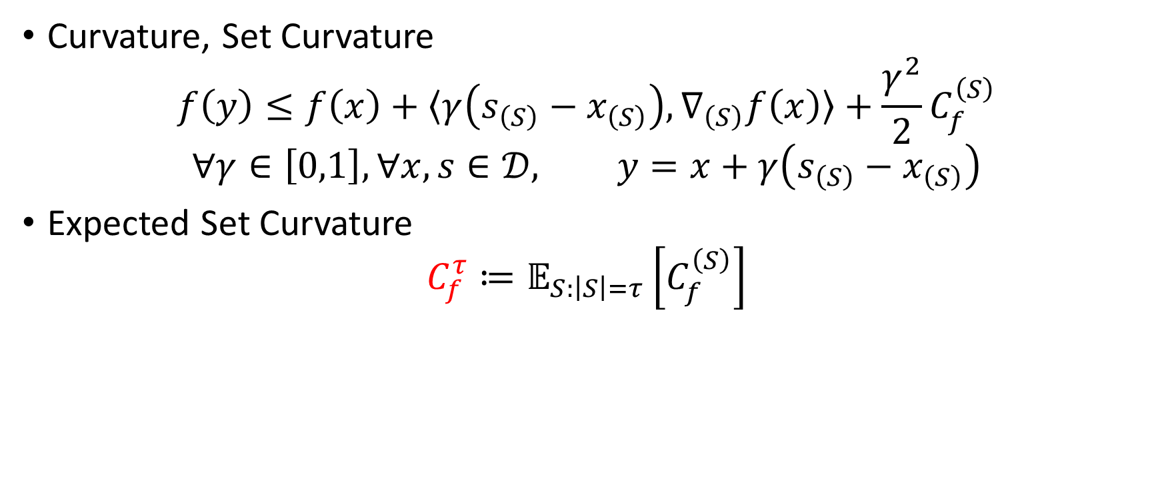
Set Curvatures
Curvature, Set Curvature
$$f\left(y\right)≤f\left(x\right)+〈γ\left(s_{\left(S\right)}−x_{\left(S\right)}\right), ∇_{\left(S\right)}f\left(x\right)〉+\frac{γ^{2}}{2}C_{f}^{\left(S\right)}$$
$$∀γ∈\left[0,1\right], ∀x,s∈𝒟, y=x+γ\left(s_{\left(S\right)}−x_{\left(S\right)}\right)$$
Expected Set Curvature
$$C_{f}^{τ}≔𝔼_{S:\left|S\right|=τ}\left[C_{f}^{\left(S\right)}\right]$$

Slide 10

Question 1: Does it converge?
For appropriately chosen stepsizes:
$$γ_{k}=\frac{2nπ}{τ^{2}k+2n}$$
$$𝔼\left(\text{DualityGap}\right)=O\left(\frac{n^{2}C_{f}^{τ}\left(1+δ\right)}{τ^{2}k}\right)$$

Slide 11
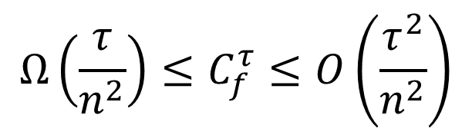
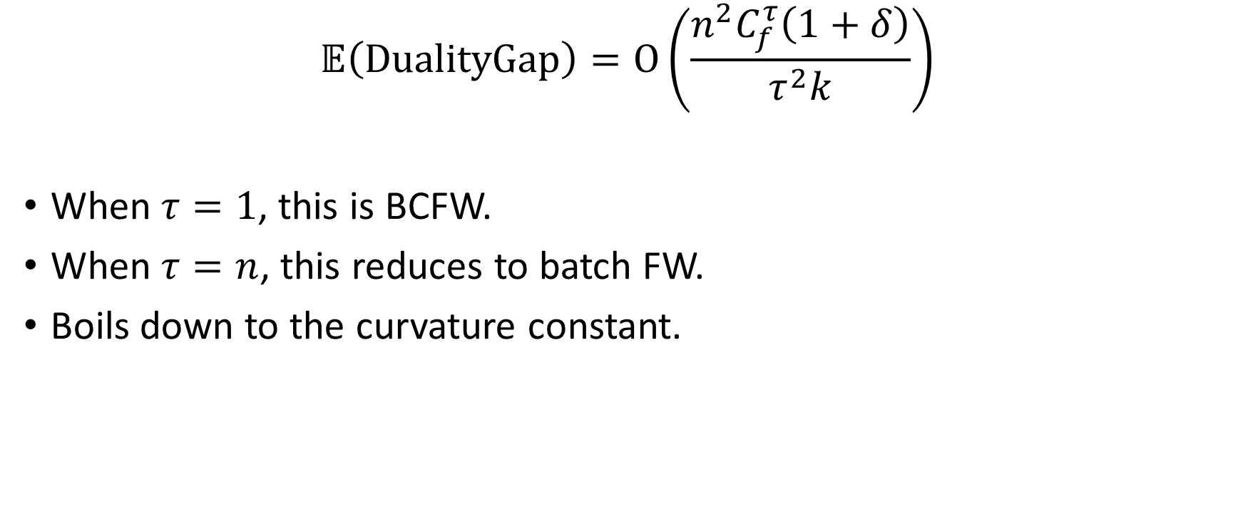


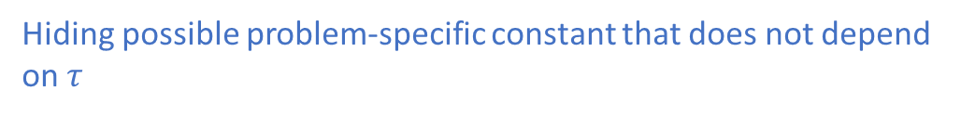
Question 2: Does it converge faster?
$$𝔼\left(\text{DualityGap}\right)=O\left(\frac{n^{2}C_{f}^{τ}\left(1+δ\right)}{τ^{2}k}\right)$$
When $τ=1$, this is BCFW.
When $τ=n$, this reduces to batch FW.
Boils down to the curvature constant.
$$Ω\left(\frac{τ}{n^{2}}\right)≤C_{f}^{τ}≤O\left(\frac{τ^{2}}{n^{2}}\right)$$
$$O\left(\frac{1}{k}\right)$$
$$O\left(\frac{1}{τk}\right)$$
Hiding possible problem-specific constant that does not depend on $τ$

Slide 12


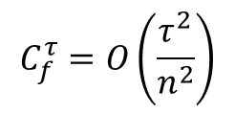
A coupling condition
$$f\left(y\right)≤f\left(x\right)+〈y−x, ∇f\left(x\right)〉+{\left(y−x\right)}^{⊤}H(y−x)$$
(a) No coupling
(b) High coupling
(c) Typical coupling
1.00
0.00
0.00
0.00
0.00
1.20
1.00
1.00
1.00
1.00
1.27
0.29
0.08
0.30
0.32
0.00
1.00
0.00
0.00
0.00
1.00
1.20
1.00
1.00
1.00
0.29
1.22
0.60
0.02
0.14
0.00
0.00
1.00
0.00
0.00
1.00
1.00
1.20
1.00
1.00
0.08
0.60
1.19
0.41
0.17
0.00
0.00
0.00
1.00
0.00
1.00
1.00
1.00
1.20
1.00
0.30
0.02
0.41
1.10
0.08
0.00
0.00
0.00
0.00
1.00
1.00
1.00
1.00
1.00
1.20
0.32
0.14
0.17
0.08
1.33
$$C_{f}^{τ}=O\left(\frac{τ}{n^{2}}\right)$$
$$C_{f}^{τ}=O\left(\frac{τ^{2}}{n^{2}}\right)$$
In between; $O\left(τ/n^{2}\right)$ if SDD
Lower coupling implies faster convergence with larger minibatch.

Slide 13

Concrete examples
Group fused lasso over an arbitrary graph
$$C_{f}^{τ}=O\left(τλ^{2}\right)$$
Multiclass SVM (a special model)
$$C_{f}^{τ}=O_{p}\left(\frac{τ}{n^{2}}\right) \text{for} τ≤\# \text{of} \text{classes}$$

Slide 14
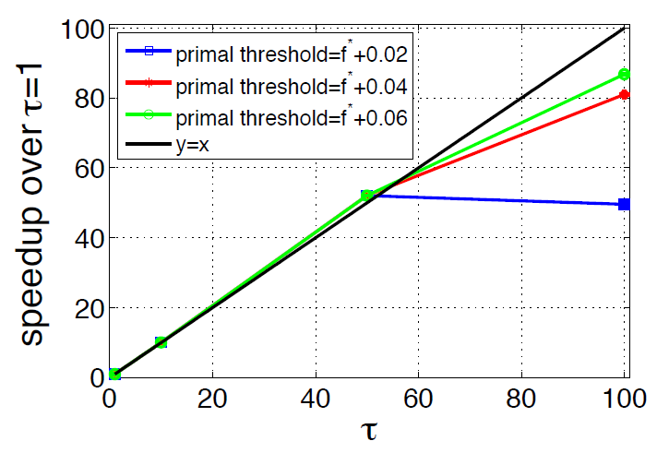
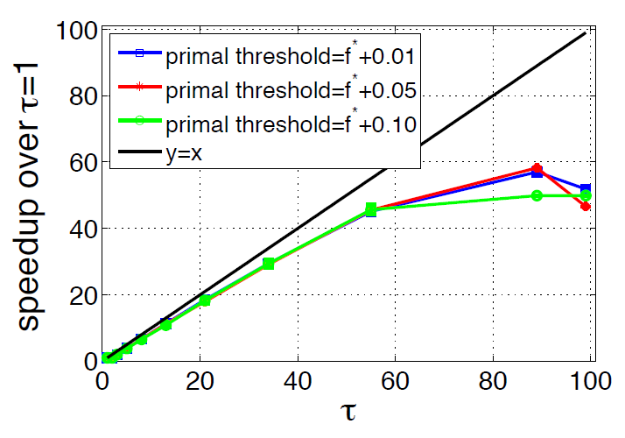
Speed-up in simulation
Speed-up over BCFW
Speedup on OCR dataset
Speedup on Group fused lasso
Measured in terms of # of iterations

Slide 15
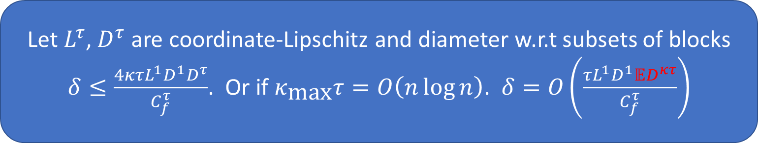
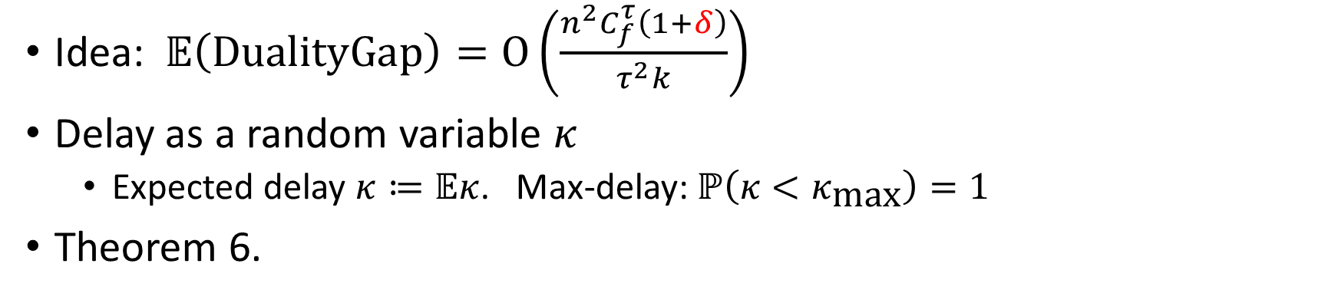

Question 3: delayed updates?
Idea: $𝔼\left(\text{DualityGap}\right)=O\left(\frac{n^{2}C_{f}^{τ}\left(1+δ\right)}{τ^{2}k}\right)$
Delay as a random variable $κ$
  Expected delay $κ≔𝔼κ$. Max-delay: $ℙ\left(κ<κ_{\text{max}}\right)=1$
Theorem 6.
Let $L^{τ}$, $D^{τ}$ are coordinate-Lipschitz and diameter w.r.t subsets of blocks
$δ≤\frac{4κτL^{1}D^{1}D^{τ}}{C_{f}^{τ}}$. Or if $κ_{\text{max}}τ=O\left(n\log{n}\right)$. $δ=O\left(\frac{τL^{1}D^{1}𝔼D^{κτ}}{C_{f}^{τ}}\right)$
$$≈\sqrt{κ}D^{τ}$$

Slide 16
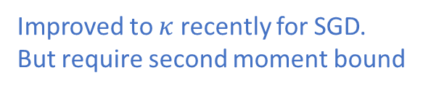
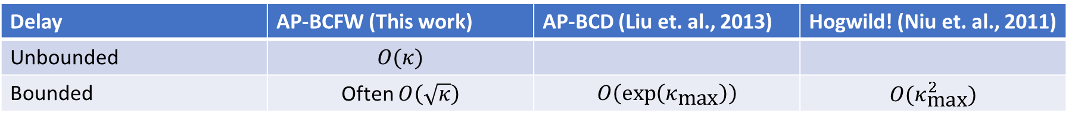
Compare to Async SGD and Async BCD
Delay | AP-BCFW (This work) | AP-BCD (Liu et. al., 2013) | Hogwild! (Niu et. al., 2011)
Unbounded | $$O(κ)$$
Bounded | Often $O\left(\sqrt{κ}\right)$ | $$O\left(\exp\left(κ_{\text{max}}\right)\right)$$ | $$O(κ_{\text{max}}^{2})$$
Open problem:
Can we get similar bound for AP-BCD?
Improved to $κ$ recently for SGD.
But require second moment bound
Suvrit Sra, Adams Wei Yu, Mu Li, AdaDelay(AISTATS’16)

Slide 17
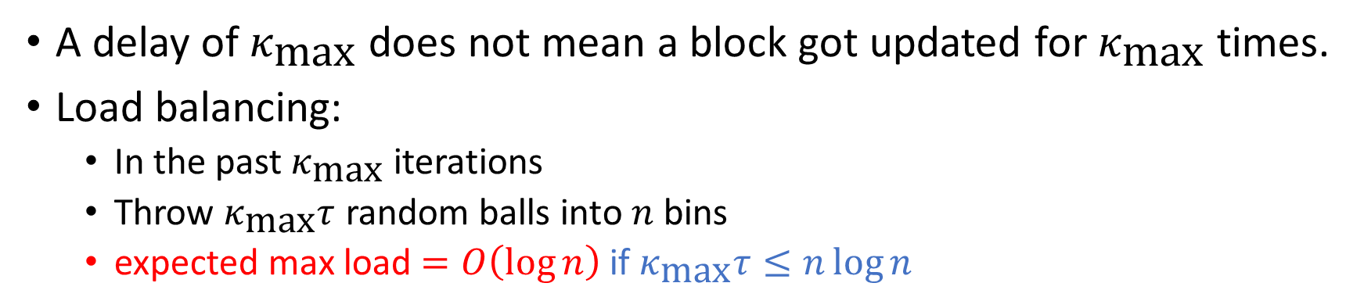
Proof idea of getting sublinear rate
A delay of $κ_{\text{max}}$ does not mean a block got updated for $κ_{\text{max}}$ times.
Load balancing:
  In the past $κ_{\text{max}}$ iterations
  Throw $κ_{\text{max}}τ$ random balls into $n$ bins
  expected max load $=O\left(\log{n}\right)$ if $κ_{\text{max}}τ≤n\log{n}$
Mitzenmacher, Michael. “The power of two choices in randomized load balancing.” IEEE Transactions on Parallel and Distributed Systems 12.10 (2001): 1094-1104.

Slide 18
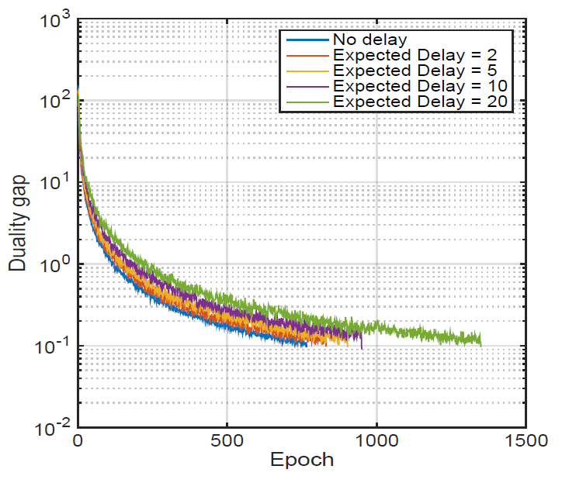
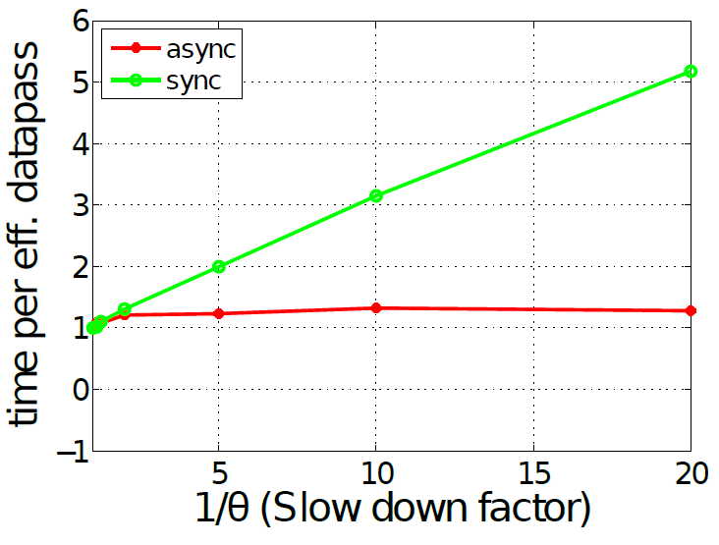
Effect of delay and straggler
Convergence with heavy-tailed delay (measured by number of iterations)
Effect of a straggler worker

Slide 19
System implications and caveats
Heterogeneous workers
  No problem. Average performance.
Heterogeneous blocks?
  This may break A1 (uniform over block)
  Need additional algorithmic tricks to enforce A1.
Is it lock-free?
  Almost. Atomic operation over blocks (rather than over a “double” as in Hogwild).

Slide 20
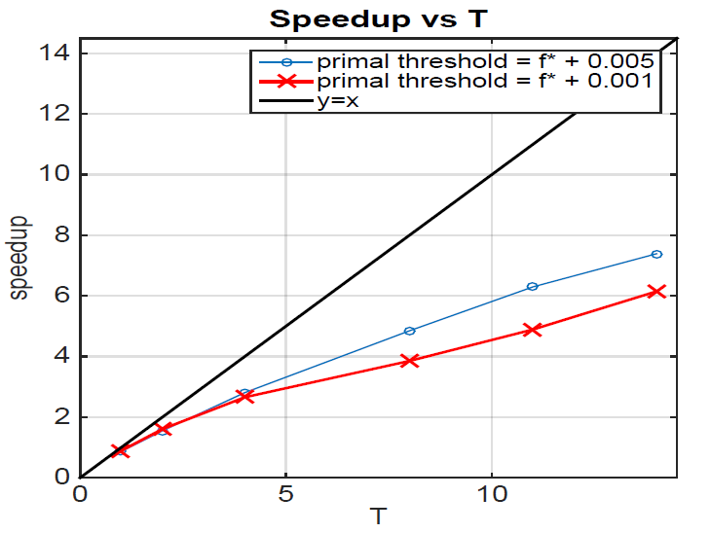
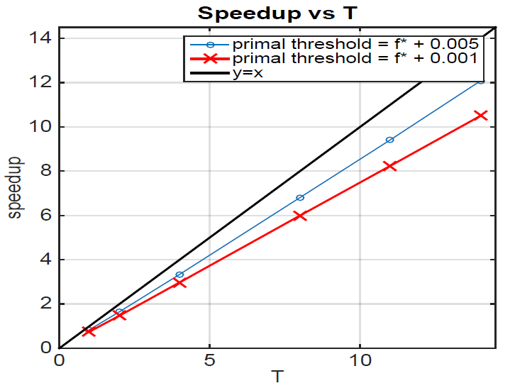
Speed-up in real clock time
Real data experiments in OCR.
For more complex subroutine solve

Slide 21
Summary
Minibatch BCFW converges.
It converges provably faster than BCFW for problems with low coupling over blocks.
It converges under delayed updates.
  Depends only on expected delay, sometimes sublinearly.

Slide 22
Open problems
Solve problems with heterogeneous blocks without “padding”.
Can AP-BCD be improved to handle “delay” better?
  Projection free
  Affine invariant
  Induce atomic structure
    (sparse / low-rank)
  Duality gap for free
  Robust to delay (?)

