Slide 1
Ten Words
… that promise adequate capacity to digest massive datasets and offer powerful predictive analytics thereupon.
These principles and strategies span a continuum from application, to engineering, and to theoretical research.
By exposing underlying statistical and algorithmic characteristics unique to ML programs but not typically seen in traditional computer programs and by dissecting successful cases to reveal how we have harnessed these principles to design and develop both high-performance distributed ML software.
Machine Learning (ML) has become a primary mechanism for distilling structured information and knowledge from raw data
Conventional ML research and development — which excels in model, algorithm, and theory innovations — are now challenged by the growing prevalence of Big Data collections such as hundreds of hours of video uploaded to video-sharing sites every minute…

Slide 2
Tushar's Birthday Bombs
It’s Tushar’s birthday today and he has N friends. Friends are numbered [0, 1, 2, …., N-1] and i-th friend have a positive strength S(i). Today being his birthday, his friends have planned to give him birthday bombs (kicks :P). Tushar’s friends know Tushar’s pain bearing limit and would hit accordingly.
If Tushar’s resistance is denoted by R (>=0) then find the lexicographically smallest order of friends to kick Tushar so that the cumulative kick strength (sum of the strengths of friends who kicks) doesn’t exceed his resistance capacity and total no. of kicks hit are maximum. Also note that each friend can kick unlimited number of times (If a friend hits x times, his strength will be counted x times)
For example: if R = 11, S = [6,8,5,4,7], then the answer is [0,2]

Slide 3
Can Decentralized Algorithms Outperform Centralized Algorithms? A Case Study for Decentralized Parallel Stochastic Gradient Descent
Xiangru Lian , Ce Zhang , Huan Zhang , Cho-Jui Hsieh, Wei Zhang , and Ji Liu
University of Rochester
ETH Zurich
University of California, Davis
IBM T. J. Watson Research Center
NIPS 2017 (oral)

Slide 4
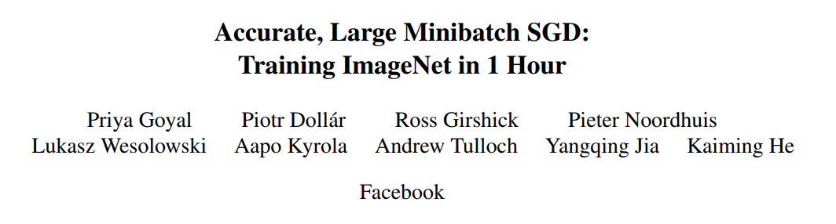
Distributed Environment for Big Data/Model
352 GPUs (P100) (50k RMB per P100)

Slide 5
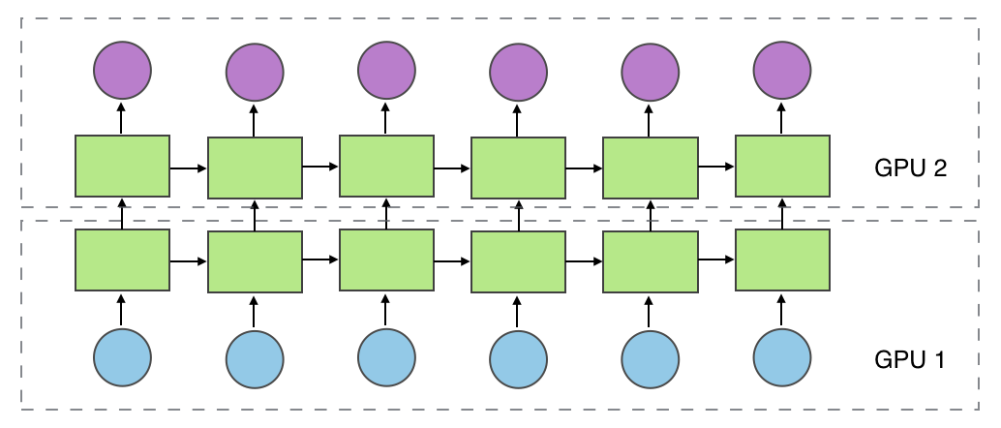
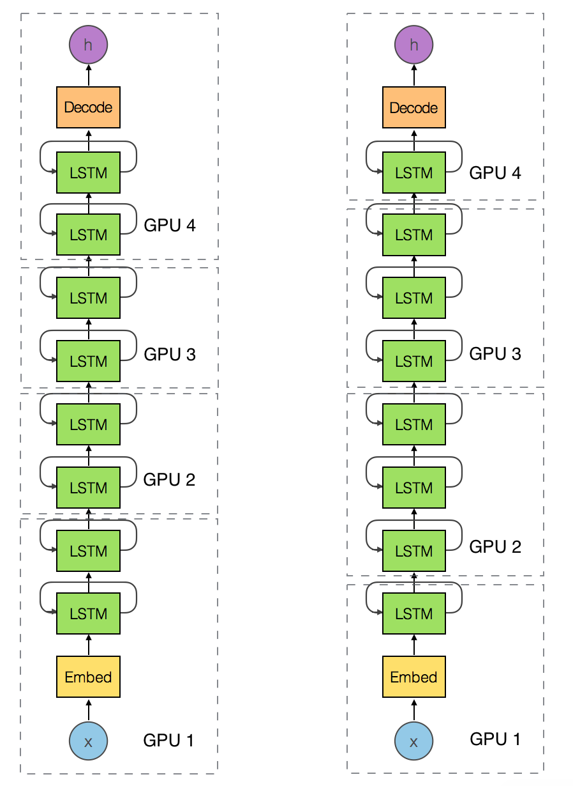
Model Parallelism
Ideal Situation
Different Workload
Varied Performance
Degrade by the slowest one!

Slide 6
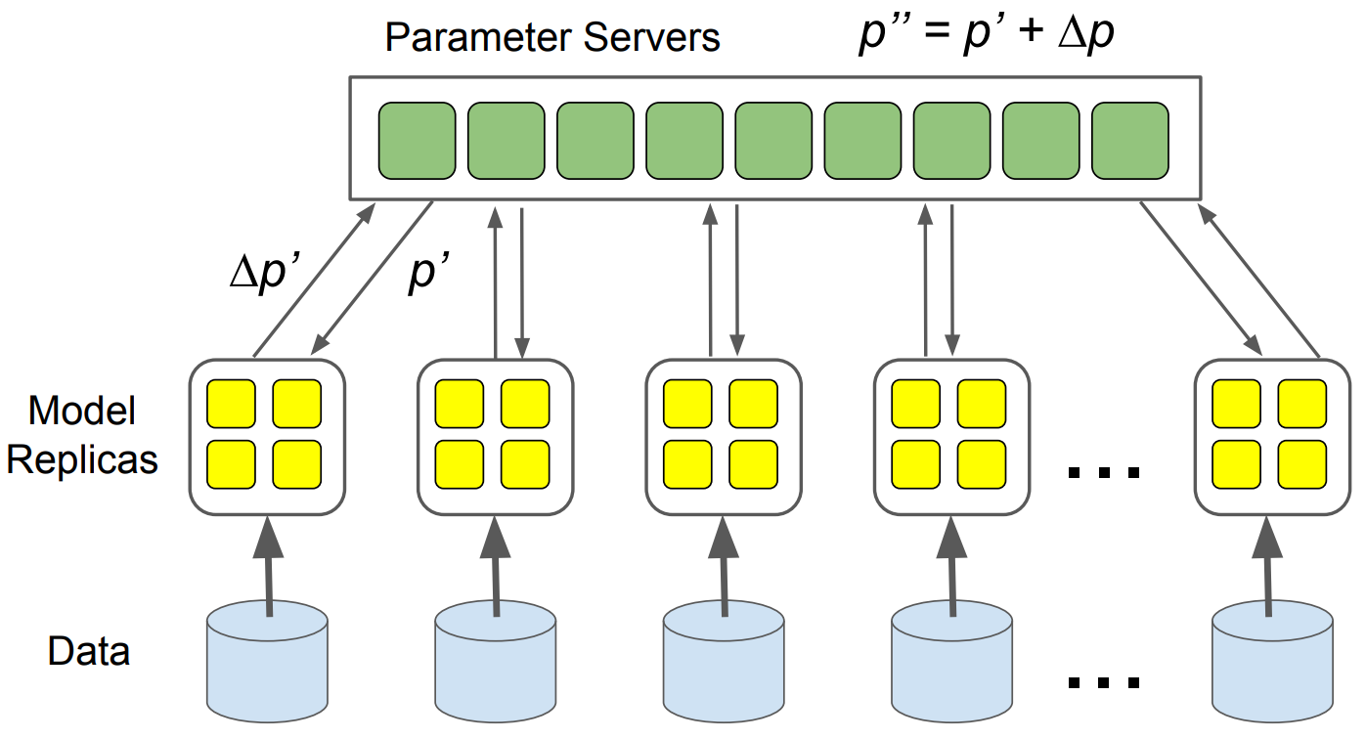
Data Parallelism

Slide 7
Hierarchical Topology
GPU0
PCIe Switch
PCIe Switch
GPU0
GPU1
GPU1
CPU
CPU
GPU2
Network Switch
GPU2
GPU3
GPU3
GPU0
PCIe Switch
Network Switch
Network Switch
PCIe Switch
GPU0
GPU1
GPU1
CPU
CPU
GPU2
GPU2
GPU3
GPU3
GPU0
PCIe Switch
PCIe Switch
GPU0
GPU1
Network Switch
GPU1
CPU
CPU
GPU2
GPU2
GPU3
GPU3

Slide 8

Centralized vs Decentralized

Slide 9
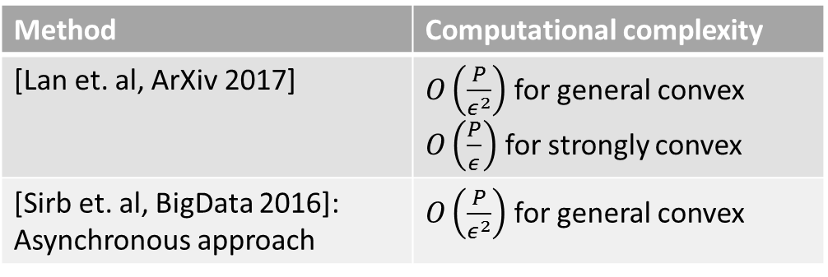
Related Work
P2P network: wireless sensing network
[Zhang and Kwok, ICML2014]: ADMM without speedup
[Yuan et. al, Optimization2016]: Inconsistent with the centralized
[Wu et. al, ArXiv 2016]: convergence with asynchronous setting
Decentralized parallel stochastic algorithms
Method | Computational complexity
[Lan et. al, ArXiv 2017] | $O\left(\frac{P}{ε^{2}}\right)$ for general convex $O\left(\frac{P}{ε}\right)$ for strongly convex
[Sirb et. al, BigData 2016]: Asynchronous approach | $O\left(\frac{P}{ε^{2}}\right)$ for general convex
“None of them is proved to have speedup when we increase the number of nodes.”

Slide 10
Contributions
The first positive answer to this question:
“Can decentralized algorithms be faster than its centralized counterpart?”
Theoretical Analysis
Large-scale empirical experiments (112 GPUs for ResNet20)

Slide 11

Problem Formulation
Stochastic Optimization Problem
$$\min_{x∈ℝ^{N}}{f\left(x\right)≔𝔼_{ξ∼𝒟}F(x;ξ)}$$
Deep learning
Linear regression
Logistic regression

Slide 12


















Distributed Setting
$$F_{2}(x;ξ)$$
$$𝒟_{2}$$
$$f_{2}(x)$$
$$F_{1}(x;ξ)$$
$$F_{3}(x;ξ)$$
$$f_{1}(x)$$
$$f_{3}(x)$$
$$𝒟_{1}$$
$$𝒟_{3}$$
$$F_{5}(x;ξ)$$
$$F_{4}(x;ξ)$$
$$f_{5}(x)$$
$$f_{4}(x)$$
$$𝒟_{5}$$
$$𝒟_{4}$$
$$\min_{x∈ℝ^{d}}{f\left(x\right)=\frac{1}{P}\sum_{i=1}^{P}{f_{i}(x)}=\frac{1}{P}\sum_{i=1}^{P}{𝔼_{ξ∼𝒟_{i}}F_{i}(x;ξ)}}$$
$$𝒟_{1}=𝒟_{2}=⋯=𝒟_{P}$$
$𝒟_{i}$ is a proper partition from $𝒟$

Slide 13


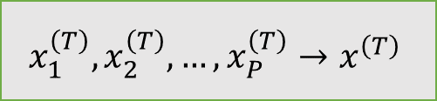




Runtime: Decentralized Setting
$$x_{2}^{(t)}$$
$$𝒟_{2}$$
$$x_{1}^{(t)}$$
$$x_{3}^{(t)}$$
$$𝒟_{1}$$
$$𝒟_{3}$$
$$x_{5}^{(t)}$$
$$x_{4}^{(t)}$$
$$𝒟_{5}$$
$$𝒟_{4}$$
We expect:
Or the average is optimal
$$x_{1}^{\left(T\right)},x_{2}^{\left(T\right)},…,x_{P}^{\left(T\right)}→x^{\left(T\right)}$$
$$x=\frac{1}{P}\sum_{i=1}^{P}{x_{i}^{\left(T\right)}}$$

Slide 14











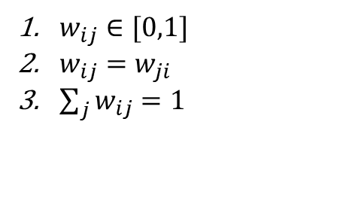




Algorithm: at Iteration $t$
$$x_{2}^{\left(t\right)}$$
$$x_{2}^{\left(t\right)}$$
$$𝒟_{2}$$
$$F_{2}\left(x_{2}^{\left(t\right)};ξ_{2}^{\left(t\right)}\right)$$
$$x_{1}^{\left(t\right)}$$
$$x_{3}^{\left(t\right)}$$
$$F_{3}\left(x_{3}^{\left(t\right)};ξ_{3}^{\left(t\right)}\right)$$
$$F_{1}\left(x_{1}^{\left(t\right)};ξ_{1}^{\left(t\right)}\right)$$
$$x_{3}^{\left(t\right)}$$
$$𝒟_{1}$$
$$𝒟_{3}$$
$$x_{5}^{\left(t\right)}$$
$$x_{5}^{\left(t\right)}$$
$$x_{4}^{\left(t\right)}$$
$$F_{4}\left(x_{4}^{\left(t\right)};ξ_{4}^{\left(t\right)}\right)$$
$$F_{5}\left(x_{5}^{\left(t\right)};ξ_{5}^{\left(t\right)}\right)$$
$$𝒟_{5}$$
$$𝒟_{4}$$
$$x_{i}^{\left(t+1\right)}=\sum_{j∈\left\{N\left(i\right),i\right\}}{x_{j}^{\left(t\right)}w_{ij}}−γ∂F_{i}\left(x_{i}^{\left(t\right)};ξ_{i}^{\left(t\right)}\right)$$
$w_{ij}∈[0,1]$
$w_{ij}=w_{ji}$
$\sum_{j}{w_{ij}}=1$
$W∈ℝ^{P×P}$ is a symmetric doubly stochastic matrix:

Slide 15
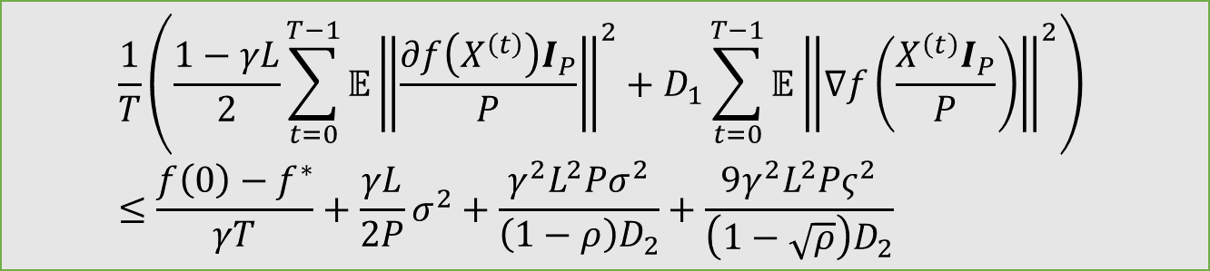
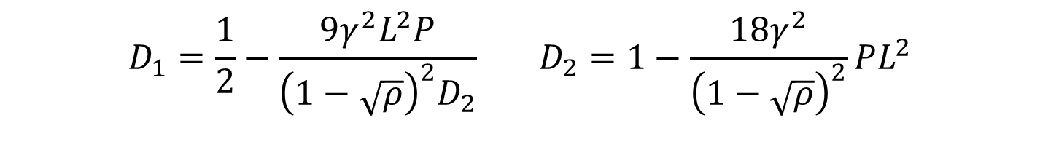

Convergence Rate Analysis
Convergence of Algorithm
$$\frac{1}{T}\left(\frac{1−γL}{2}\sum_{t=0}^{T−1}{𝔼{\left\|\frac{∂f\left(X^{\left(t\right)}\right)I_{P}}{P}\right\|}^{2}}+D_{1}\sum_{t=0}^{T−1}{𝔼{\left\|∇f\left(\frac{X^{\left(t\right)}I_{P}}{P}\right)\right\|}^{2}}\right) \\ ≤\frac{f\left(0\right)−f^{∗}}{γT}+\frac{γL}{2P}σ^{2}+\frac{γ^{2}L^{2}Pσ^{2}}{\left(1−ρ\right)D_{2}}+\frac{9γ^{2}L^{2}Pς^{2}}{\left(1−\sqrt{ρ}\right)D_{2}}$$
$$D_{1}=\frac{1}{2}−\frac{9γ^{2}L^{2}P}{{\left(1−\sqrt{ρ}\right)}^{2}D_{2}} D_{2}=1−\frac{18γ^{2}}{{\left(1−\sqrt{ρ}\right)}^{2}}PL^{2}$$
Assumptions
$$ρ={\left(\max\left\{\left|λ_{2}\left(W\right)\right|,\left|λ_{P}\left(W\right)\right|\right\}\right)}^{2}$$
$$𝔼_{ξ∼𝒟_{i}}{\left\|∇F_{i}\left(x;ξ\right)−∇f_{i}\left(x\right)\right\|}^{2}≤σ^{2},∀i,∀x$$
$$𝔼_{i∼𝒰\left(\left[P\right]\right)}{\left\|∇f_{i}\left(x\right)−∇f\left(x\right)\right\|}^{2}≤ς^{2},∀x$$

Slide 16
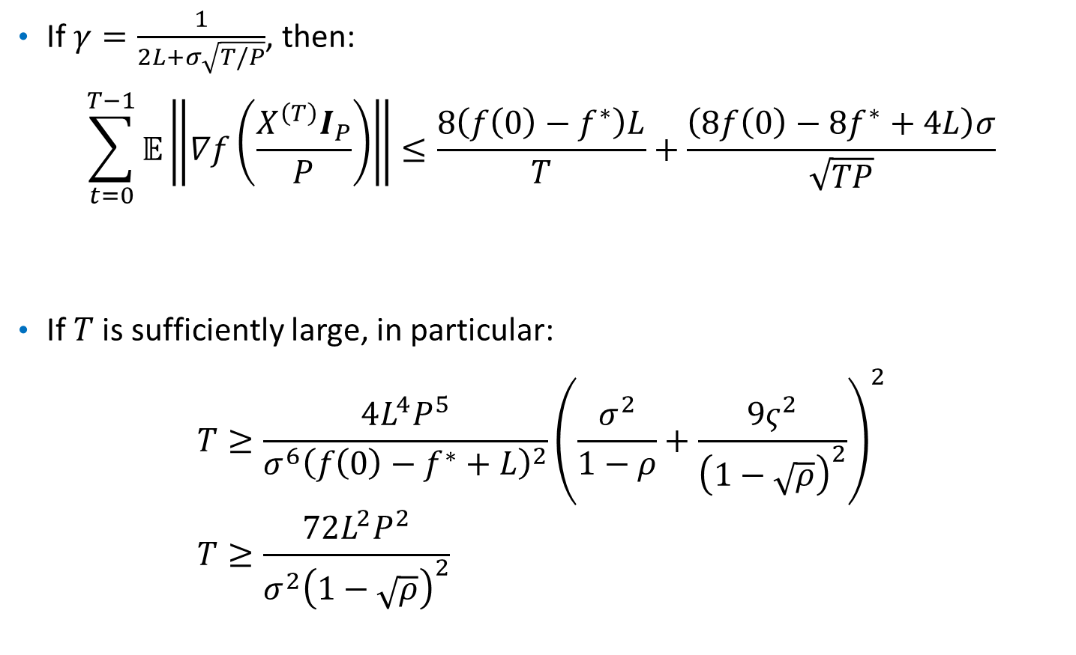
Convergence Rate Analysis
If $γ=\frac{1}{2L+σ\sqrt{T/P}}$, then:
$$\sum_{t=0}^{T−1}{𝔼\left\|∇f\left(\frac{X^{\left(T\right)}I_{P}}{P}\right)\right\|}≤\frac{8\left(f\left(0\right)−f^{∗}\right)L}{T}+\frac{\left(8f\left(0\right)−8f^{∗}+4L\right)σ}{\sqrt{TP}}$$
If $T$ is sufficiently large, in particular:
$$T≥\frac{4L^{4}P^{5}}{σ^{6}{\left(f\left(0\right)−f^{∗}+L\right)}^{2}}{\left(\frac{σ^{2}}{1−ρ}+\frac{9ς^{2}}{{\left(1−\sqrt{ρ}\right)}^{2}}\right)}^{2} \\ T≥\frac{72L^{2}P^{2}}{σ^{2}{\left(1−\sqrt{ρ}\right)}^{2}}$$

Slide 17
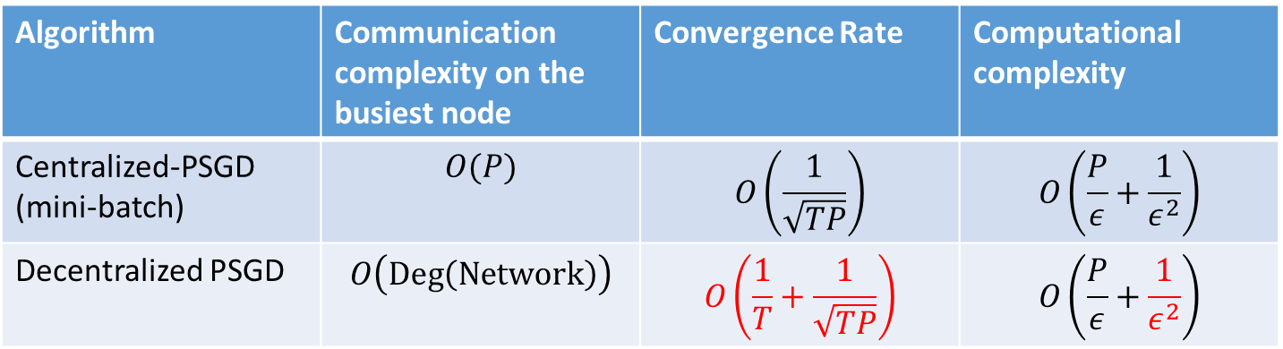
Centralized PSGD vs Decentralized PSGD
Algorithm | Communication complexity on the busiest node | Convergence Rate | Computational complexity
Centralized-PSGD (mini-batch) | $$O(P)$$ | $$O\left(\frac{1}{\sqrt{TP}}\right)$$ | $$O\left(\frac{P}{ε}+\frac{1}{ε^{2}}\right)$$
Decentralized PSGD | $$O\left(\text{Deg}\left(\text{Network}\right)\right)$$ | $$O\left(\frac{1}{T}+\frac{1}{\sqrt{TP}}\right)$$ | $$O\left(\frac{P}{ε}+\frac{1}{ε^{2}}\right)$$
D-PSGD is better than C-PSGD:
avoid communication traffic jam
Linear speedup

Slide 18

Ring Network
$$W=\left(\begin{matrix}1/3 & 1/3 & & & 1/3 \\ 1/3 & 1/3 & 1/3 & & \\ & 1/3 & 1/3 & ⋱ & \\ & & ⋱ & ⋱ & \\ 1/3 & & & 1/3 & 1/3\end{matrix}\right)∈ℝ^{P×P}$$
Linear speedup can be achieved if:
  $P=O\left(T^{\frac{1}{9}}\right)$ if share the $𝒟$
  $P=O\left(T^{\frac{1}{13}}\right)$ if $𝒟$ is partitioned
These results are too loose!

Slide 19
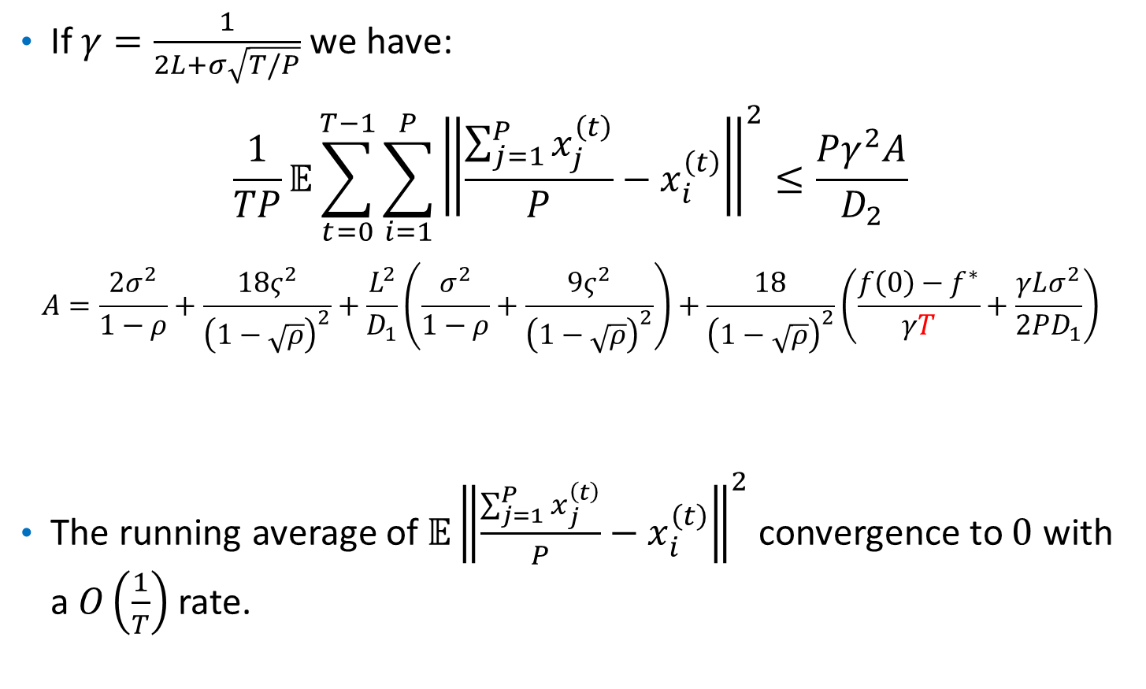
Convergence Rate for the Average of Local Variables
If $γ=\frac{1}{2L+σ\sqrt{T/P}}$ we have:
$$\frac{1}{TP}𝔼\sum_{t=0}^{T−1}{\sum_{i=1}^{P}{{\left\|\frac{\sum_{j=1}^{P}{x_{j}^{\left(t\right)}}}{P}−x_{i}^{\left(t\right)}\right\|}^{2}}}≤\frac{Pγ^{2}A}{D_{2}}$$
$$A=\frac{2σ^{2}}{1−ρ}+\frac{18ς^{2}}{{\left(1−\sqrt{ρ}\right)}^{2}}+\frac{L^{2}}{D_{1}}\left(\frac{σ^{2}}{1−ρ}+\frac{9ς^{2}}{{\left(1−\sqrt{ρ}\right)}^{2}}\right)+\frac{18}{{\left(1−\sqrt{ρ}\right)}^{2}}\left(\frac{f\left(0\right)−f^{∗}}{γT}+\frac{γLσ^{2}}{2PD_{1}}\right)$$
The running average of $𝔼{\left\|\frac{\sum_{j=1}^{P}{x_{j}^{\left(t\right)}}}{P}−x_{i}^{\left(t\right)}\right\|}^{2}$ convergence to $0$ with a $O\left(\frac{1}{T}\right)$ rate.

Slide 20
Experimental Settings
RestNet on CIFAR-10
Implementations
CNTK with MPI’s AllReduce primitive
Centralized: Standard parameter-server based synchronous SGD and one parameter server
Decentralized: CNTK with MPI point-to-point primitive
EASGD: standard implementation of Torch
Machines
7GPUs: single local machine, Nvidia TITAN Xp
10GPUs: 10 p2.xlarge EC2 instances, Nvidia K80
16GPUs: 16 local machines, Nvidia K20
112 GPUs: 4 p2.16xlarge and 6 p2.8xlarge EC2 instances. Nvidia K80

Slide 21
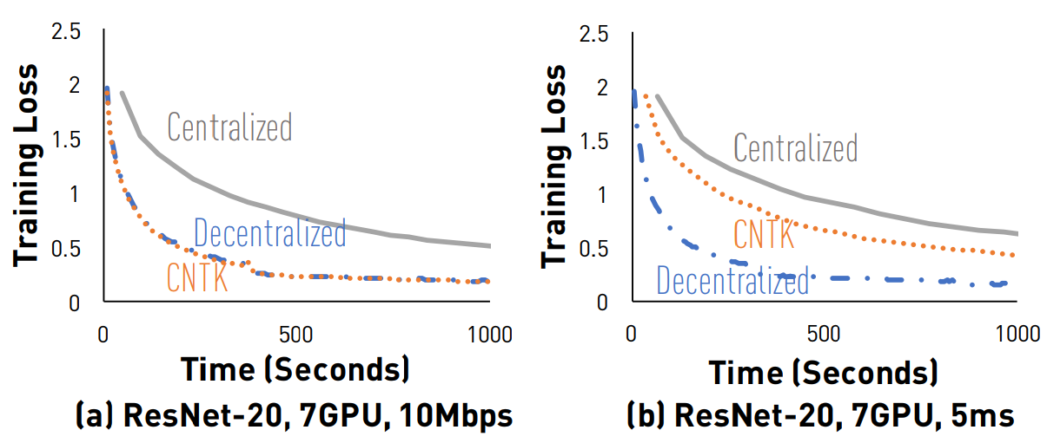
Comparison between D-PSGD and two centralized implementations (7 and 10 GPUs)

Slide 22
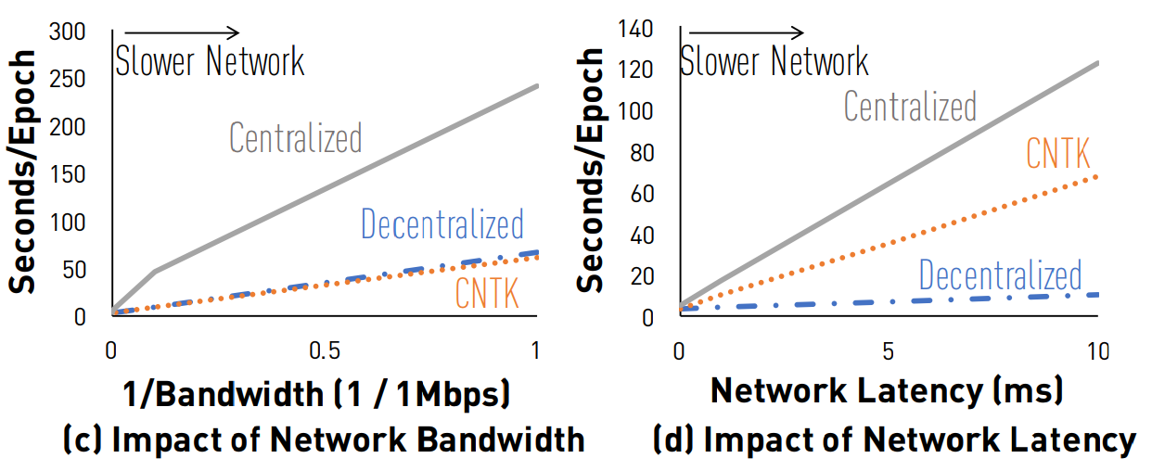
Comparison between D-PSGD and two centralized implementations (7 and 10 GPUs)

Slide 23
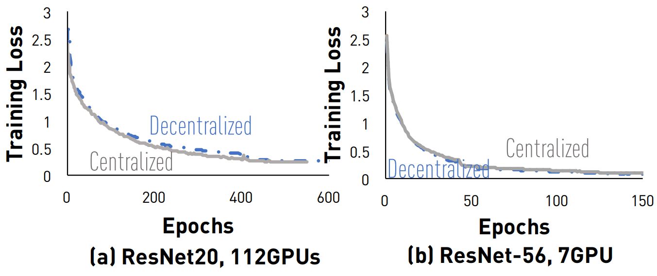
Convergence Rate

Slide 24
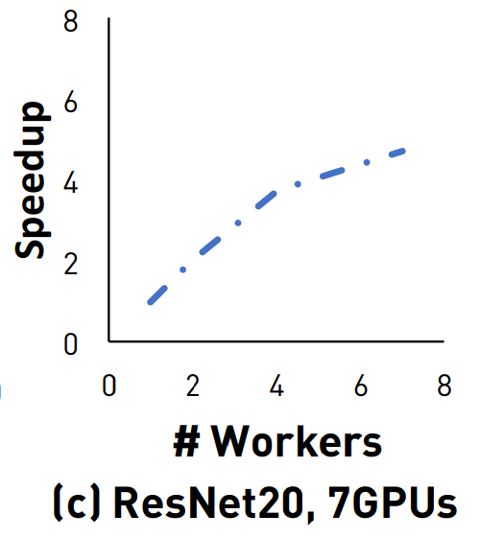
D-PSGD Speedup

Slide 25
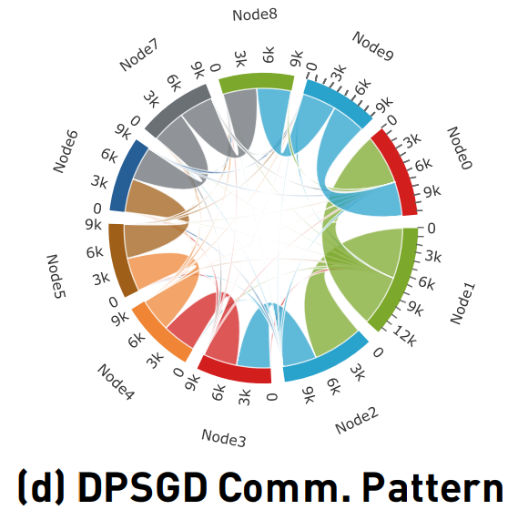
D-PSGD Communication Patterns

Slide 26
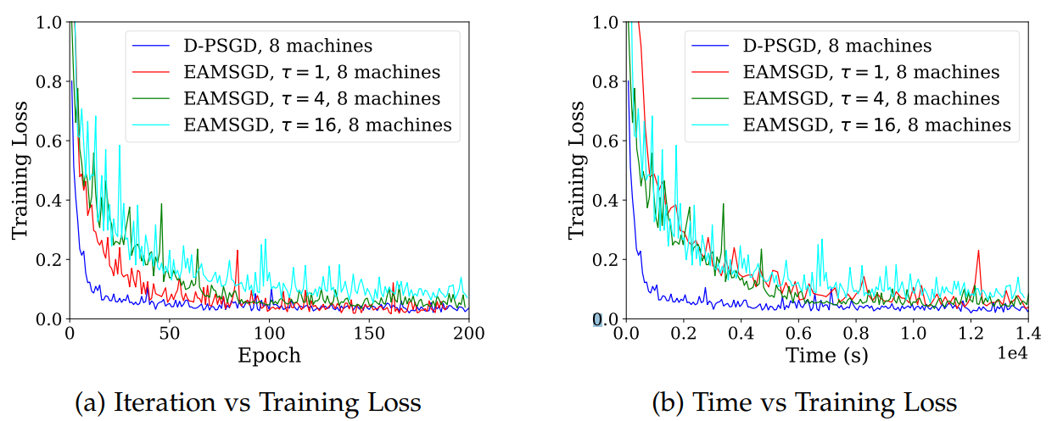
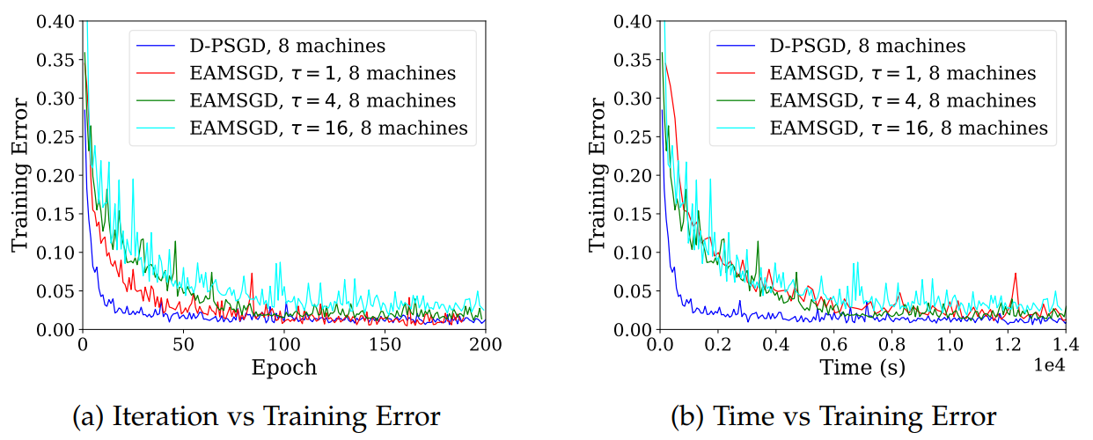
Convergence comparison between D-PSGD and EAMSGD (EASGD’s momentum variant)

Slide 27
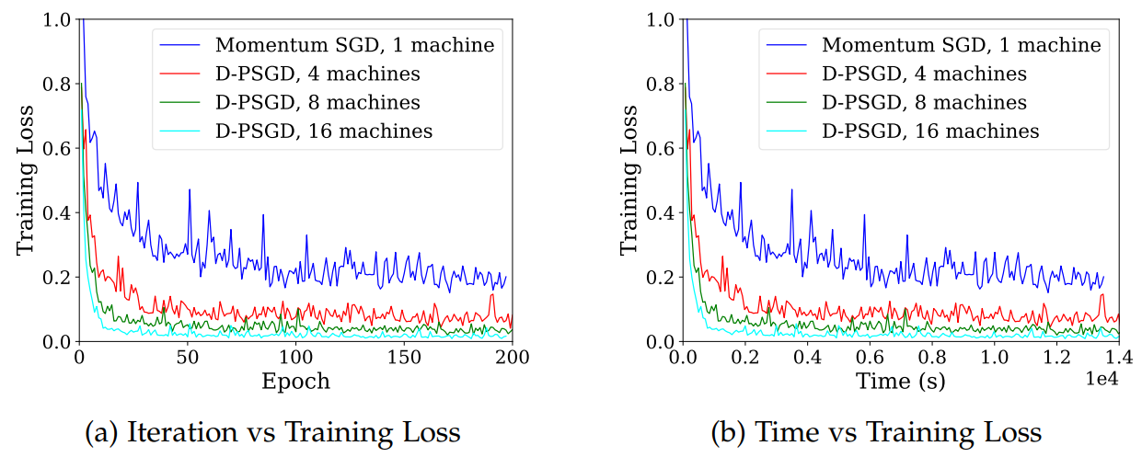
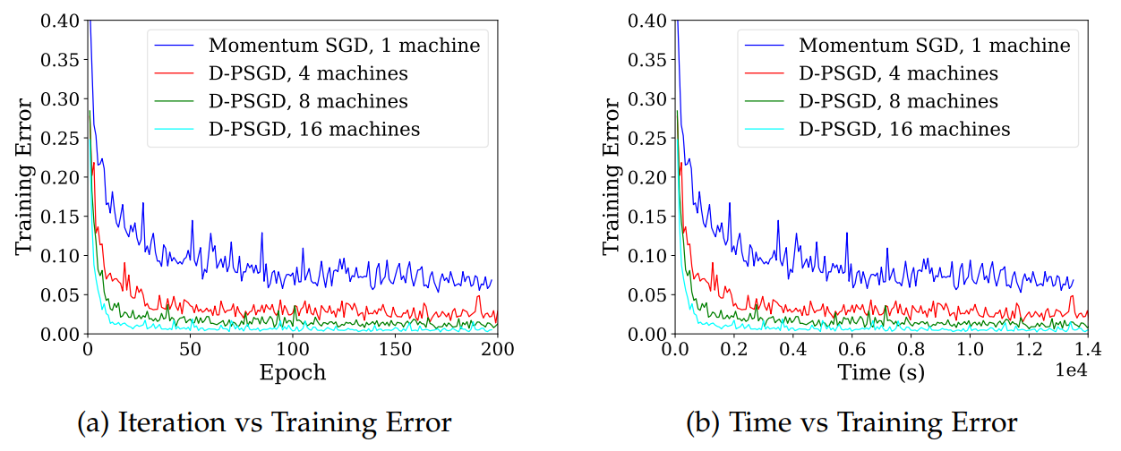
Convergence comparison between D-PSGD and Momentum SGD

Slide 28
Thanks

