Slide 1
Attention Model in NLP
Jichuan ZENG

Slide 2
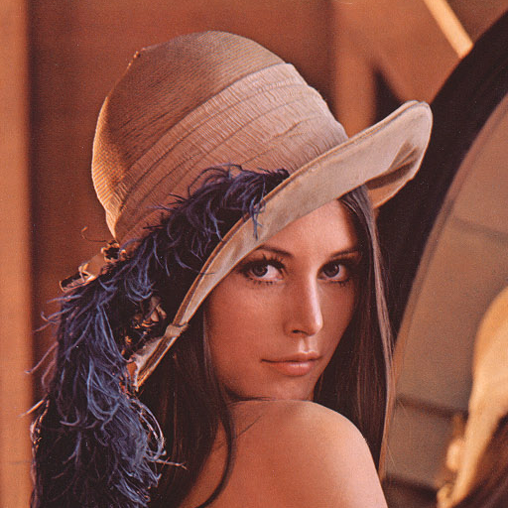

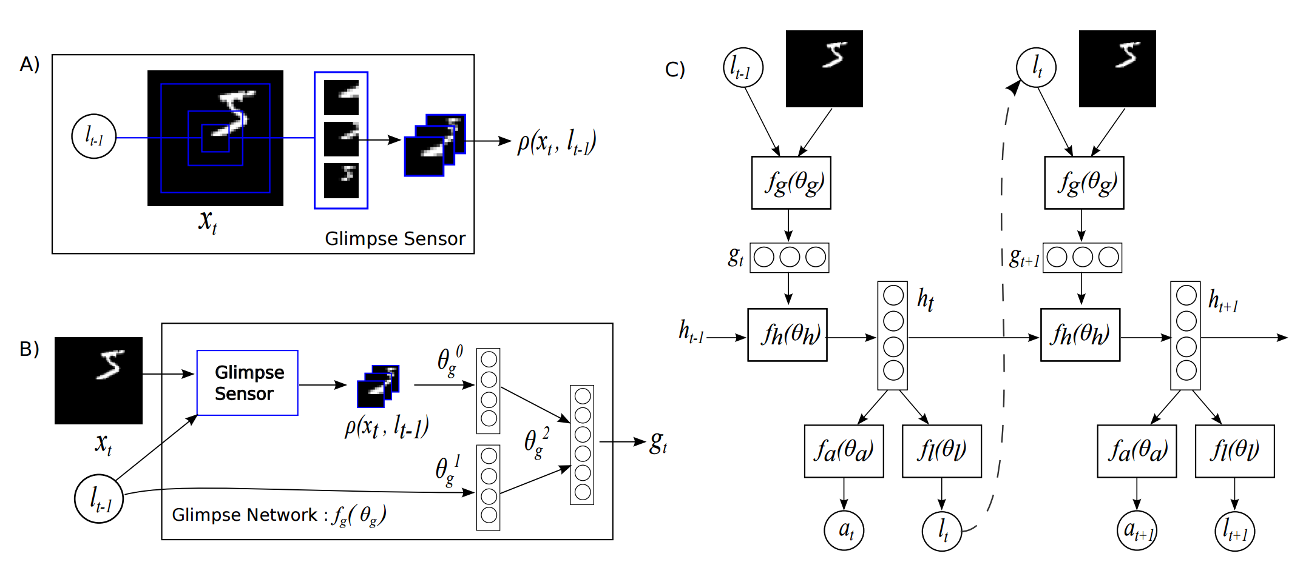
Attention Model
Mnih NIPS’ 14
Notes:
Figure 1: A) Glimpse Sensor: Given the coordinates of the glimpse and an input image, the sensor extracts a retina-like representation ρ(xt, lt−1) centered at lt−1 that contains multiple resolution patches. B) Glimpse Network: Given the location (lt−1) and input image (xt), uses the glimpse sensor to extract retina representation ρ(xt, lt−1). The retina representation and glimpse location is then mapped into a hidden space using independent linear layers parameterized by θ 0 g and θ 1 g respectively using rectified units followed by another linear layer θ 2 g to combine the information from both components. The glimpse network fg(.; {θ 0 g , θ1 g , θ2 g}) defines a trainable bandwidth limited sensor for the attention network producing the glimpse representation gt. C) Model Architecture: Overall, the model is an RNN. The core network of the model fh(.; θh) takes the glimpse representation gt as input and combining with the internal representation at previous time step ht−1, produces the new internal state of the model ht. The location network fl(.; θl) and the action network fa(.; θa) use the internal state ht of the model to produce the next location to attend to lt and the action/classification at respectively. This basic RNN iteration is repeated for a variable number of steps

Slide 3
Encoder-Decoder Framework
Encoder: from word sequence to sentence representation
Decoder: from representation to word sequence distribution
Intermediate representation of meaning
  = ‘universal representation’
English sentence
English sentence
English
decoder
English
decoder
For bitext data
For unilingual data
French
encoder
English
encoder
French sentence
English sentence

Slide 4
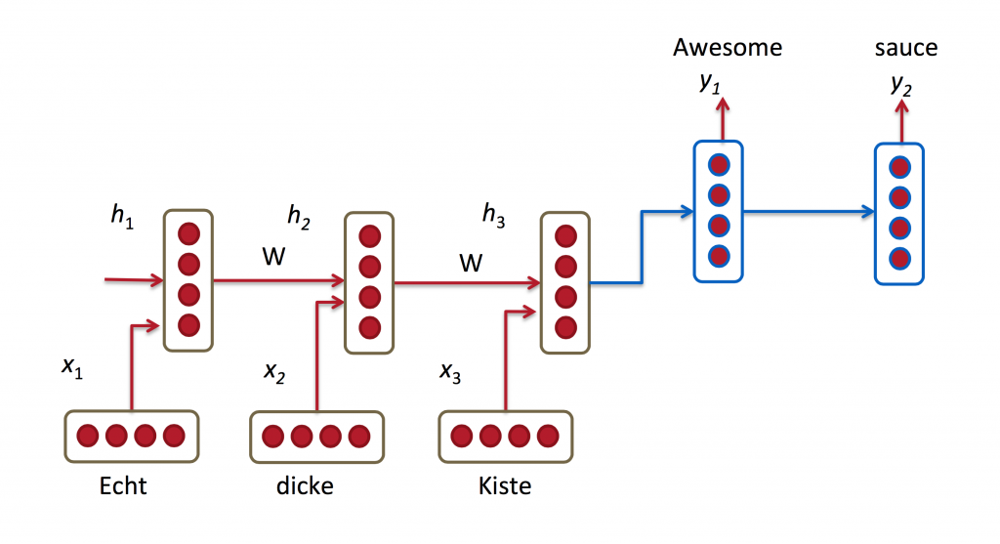
Motivation
Limited representation
Long distance constrained

Slide 5
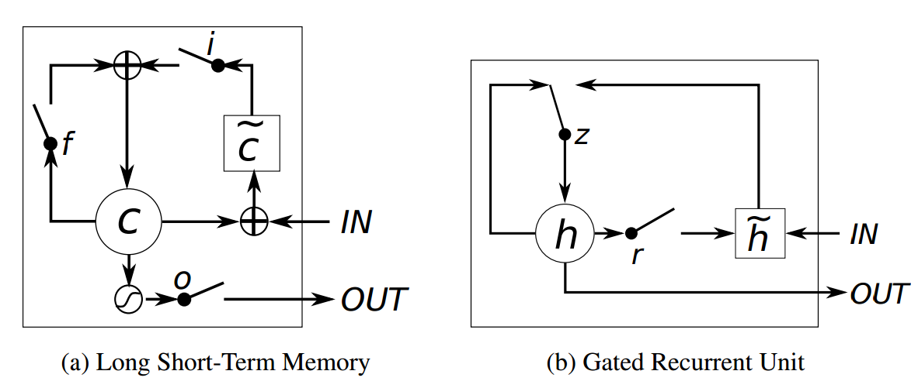
Motivation
LSTM, GRU

Slide 6
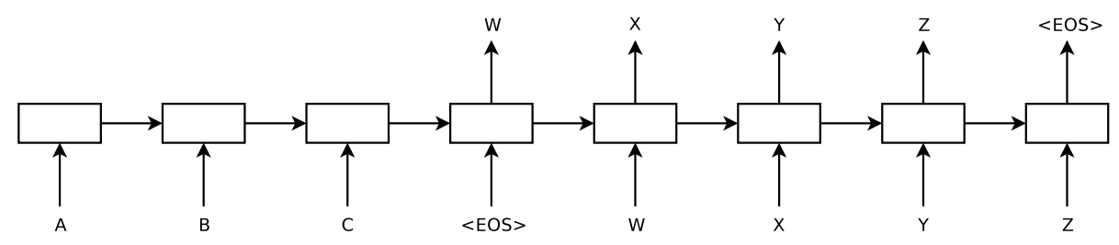
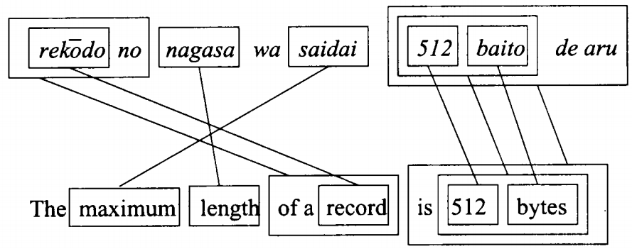

Motivation
Reverse the order (Sutskever et al. NIPS’ 14)
Input twice (Zaremba et al. Arxiv’14)
Notes:
Our model reads an input sentence “ABC” and produces “WXYZ” as the output sentence. The model stops making predictions after outputting the end-of-sentence token. Note that the LSTM reads the input sentence in reverse, because doing so introduces many short term dependencies in the data that make the optimization problem much easier
, we found it extremely valuable to reverse the order of the words of the input sentence. So for example, instead of mapping the sentence a, b, c to the sentence α, β, γ, the LSTM is asked to map c, b, a to α, β, γ, where α, β, γ is the translation of a, b, c. This way, a is in close proximity to α, b is fairly close to β, and so on, a fact that makes it easy for SGD to “establish communication” between the input and the output. We found this simple data transformation to greatly improve the performance of the LSTM.

Slide 7
Attention Mechanism for Deep Learning
Consider an input (or intermediate) sequence or image
Consider an upper level representation, which can choose « where to look », by assigning a weight or probability to each input position, applied at each position
Higher-level
Softmax over lower
locations conditioned
on context at lower and
higher locations
Lower-level

Slide 8
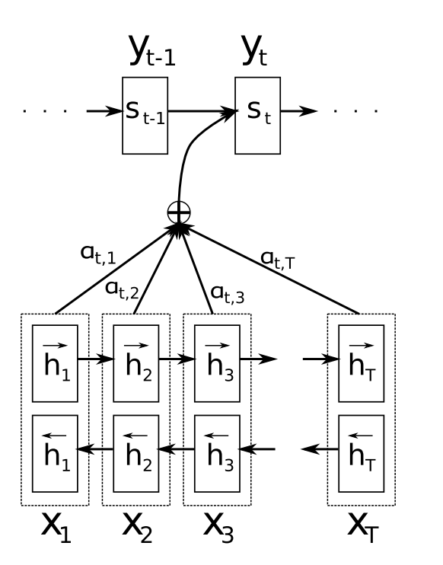
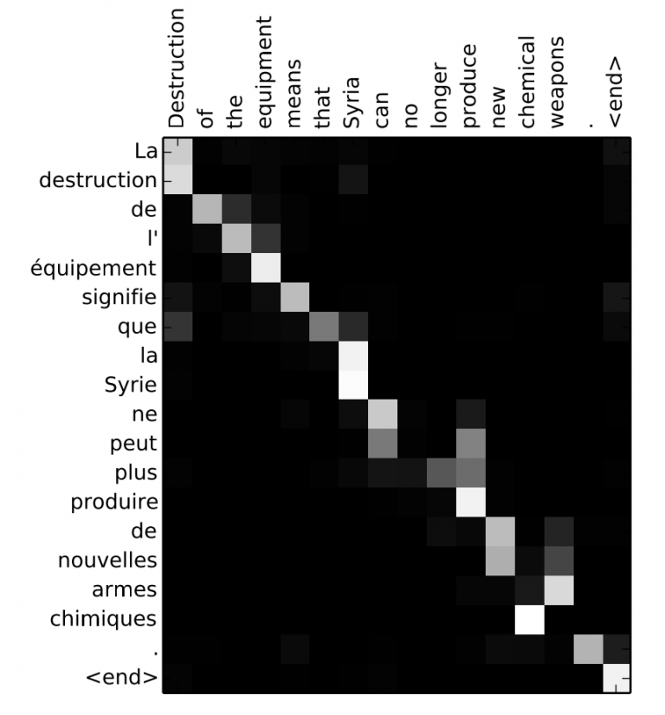
NMT with Recurrent Nets and Attention Mechanism
Bahdanau, ICLR’15
Notes:
Intuitively, this implements a mechanism of attention in the decoder. The decoder decides parts of the source sentence to pay attention to. By letting the decoder have an attention mechanism, we relieve the encoder from the burden of having to encode all information in the source sentence into a fixedlength vector. With this new approach the information can be spread throughout the sequence of annotations, which can be selectively retrieved by the decoder accordingly.

Slide 9
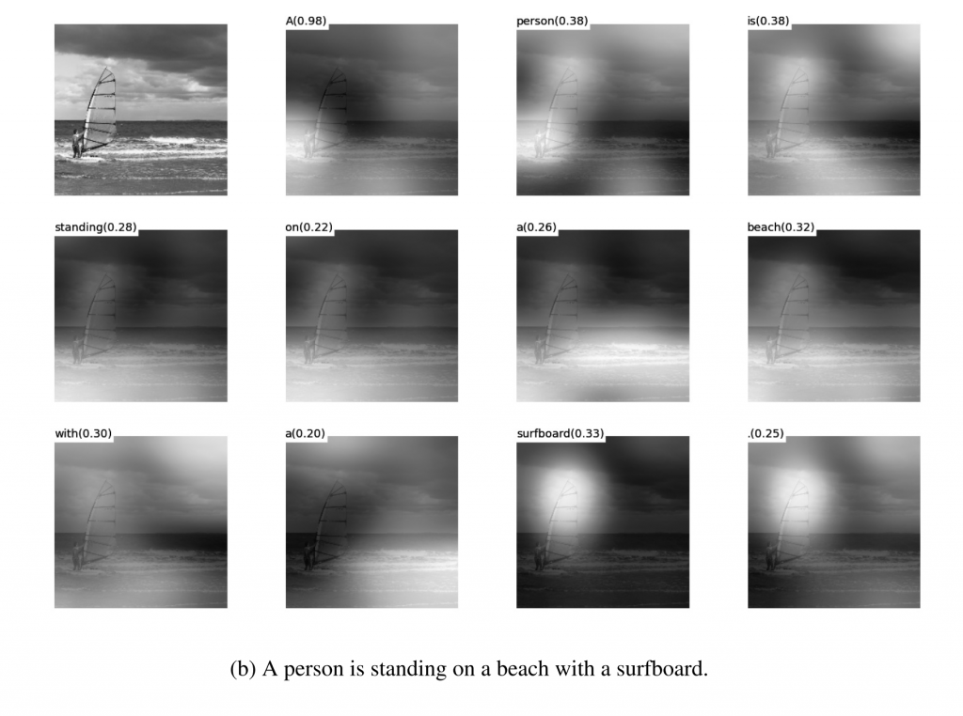
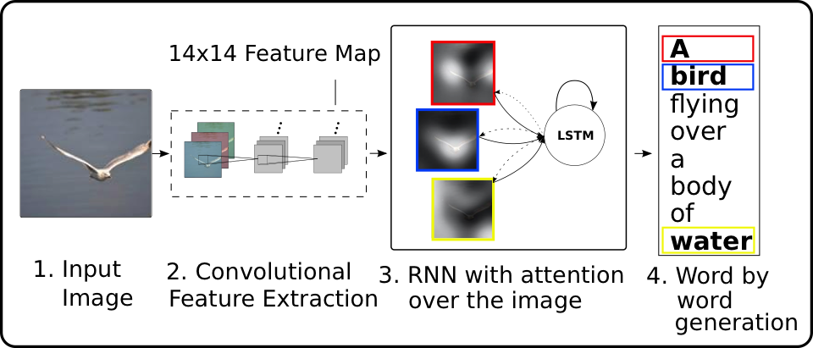
Image-to-Text: Caption Generation with Attention
Xu, Kelvin, et al. Arxiv’15

Slide 10
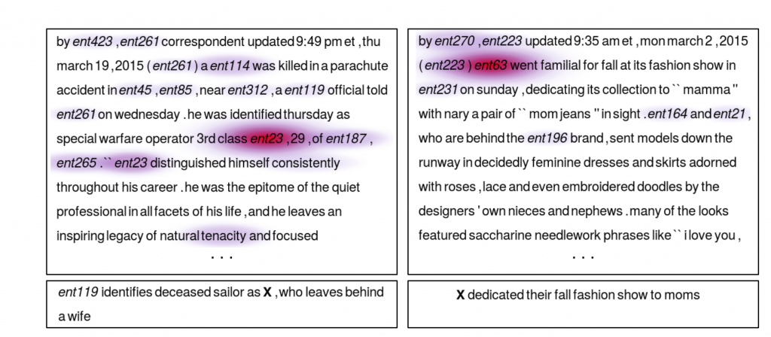
Teaching Machines to Read and Comprehend
Hermann et al. NIPS’ 15

Slide 11
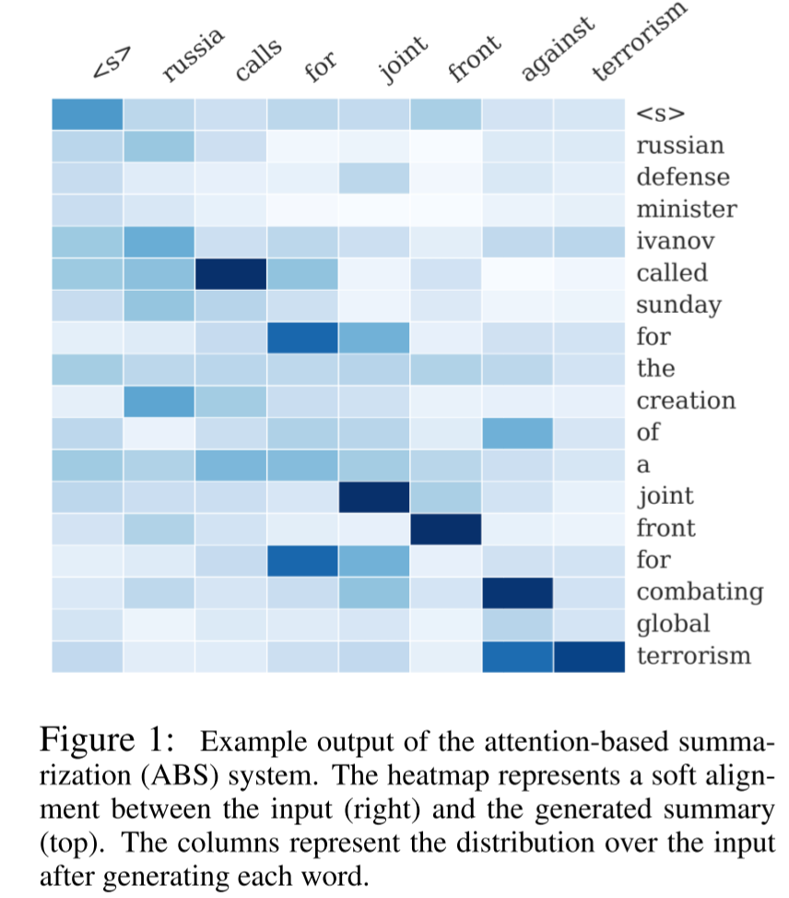
Neural Attention Model for Sentence Summarization
Rush et al. EMNLP’15

Slide 12
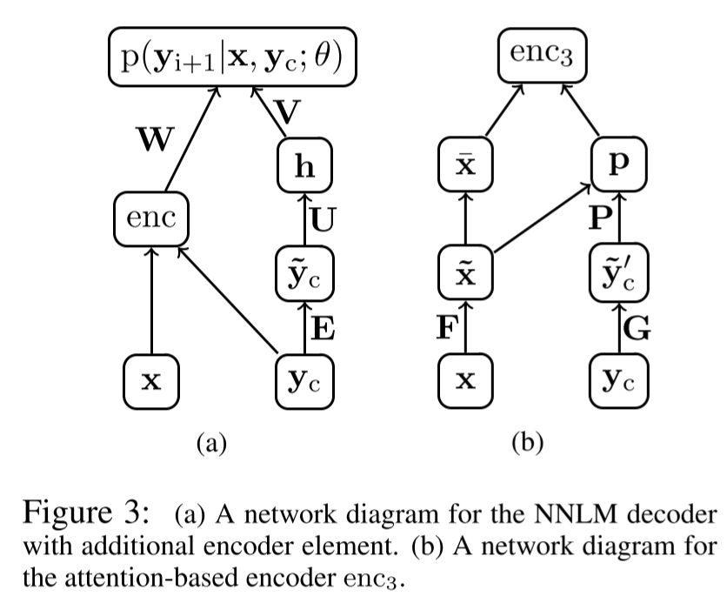
Neural Attention Model for Sentence Summarization
Rush EMNLP’15

Slide 13
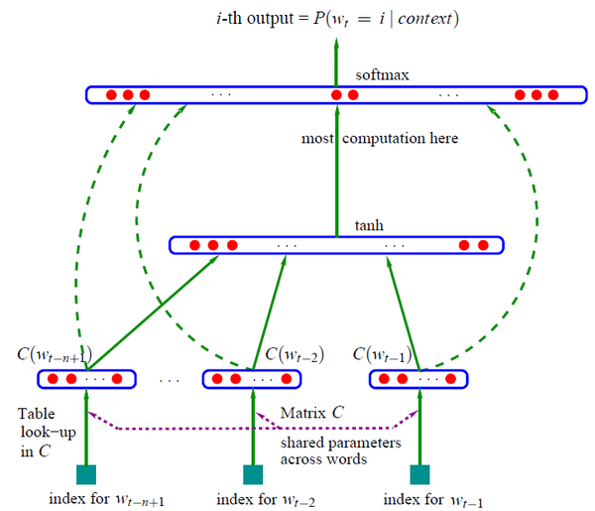
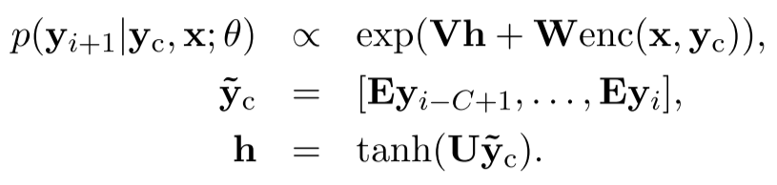

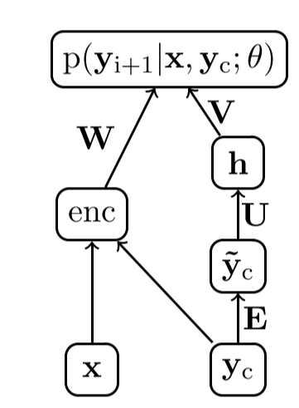
Neural Attention Model for Sentence Summarization
Decoder: NNLM (Bengio et al. 2003)

Slide 14
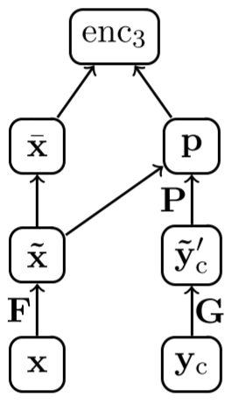
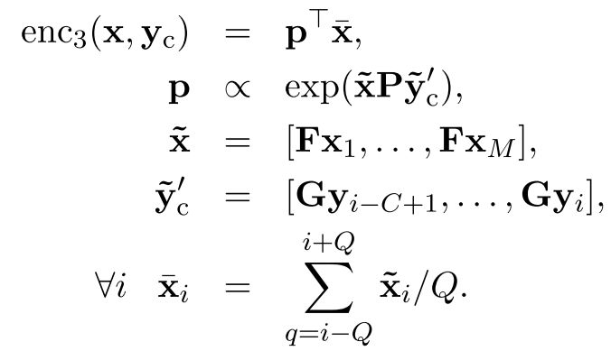
Neural Attention Model for Sentence Summarization
Encoder: Attention-based

Slide 15
Neural Attention Model for Sentence Summarization
Training
  Mini-batch
Generating Summaries
  Beam search (O(KNV))
Code

Slide 16
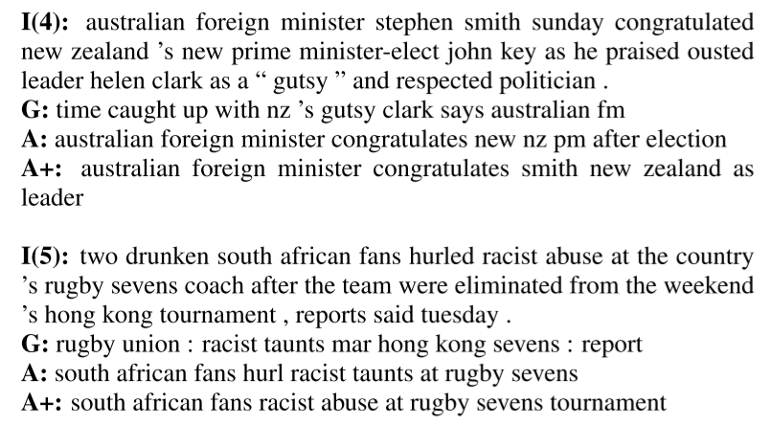
Neural Attention Model for Sentence Summarization
Experiment Results

Slide 17
Conclusion
Attention mechanism allows the network to refer back to the input sequence, instead of forcing it to encode all information into one fixed-length vector.
Pros: Soft access to memory, Model interpretation
Cons: Computational expensive

Slide 18
References
Volodymyr Mnih, Nicolas Heess, Alex Graves, Koray Kavukcuoglu. Recurrent Models of Visual Attention. 2014. In Advances in Neural Information Processing Systems.
Bahdanau D, Cho K, Bengio Y. Neural machine translation by jointly learning to align and translate[J]. arXiv preprint arXiv:1409.0473, 2014.
Sutskever, Ilya, Oriol Vinyals, and Quoc V. Le. "Sequence to sequence learning with neural networks." Advances in neural information processing systems. 2014.
Hermann K M, Kocisky T, Grefenstette E, et al. Teaching machines to read and comprehend[C]//Advances in Neural Information Processing Systems. 2015: 1693-1701.
Xu, Kelvin, et al. "Show, attend and tell: Neural image caption generation with visual attention." arXiv preprint arXiv:1502.03044 2.3 (2015): 5.
Zaremba, Wojciech, and Ilya Sutskever. "Learning to execute." arXiv preprint arXiv:1410.4615 (2014).
http://www.wildml.com/2016/01/attention-and-memory-in-deep-learning-and-nlp/
http://yanran.li/peppypapers/2015/10/07/survey-attention-model-1.html#fn:1

