Slide 1
Java Implementation of Petuum
Yuxin Su
September 2, 2014

Slide 2
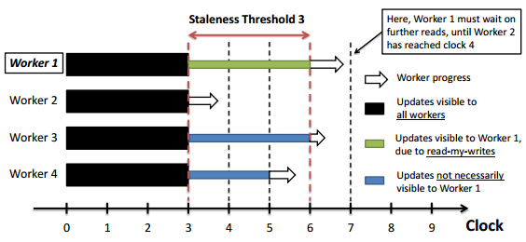
About Petuum
Distributed System for Machine Learning Algorithms
Staleness Synchronized Parallel
Error-tolerance in iteration

Slide 3
Motivations -- Drawback of C/C++ Implementation
Depend on Platforms
  Ubuntu 14.04
  Ubuntu 12.04
  Solaris
  Other UNIX-like systems…
Maybe…LLVM Bytecode solution
  redirect all system-related APIs
  modify many third-party libs
Depend on many unfriend libs
  Gflags, boost, libconfig, libcuckoo, zeromq…
  configure; make; make install
inefficiency to interactive with industry level languages
  Many components written by Java
So, the robustness is hard to guarantee among many OSs

Slide 4
Motivations – Advantage of Java Implementation
Platform independency
Easily collaborate with other components like HDFS
Easy to use for end users or programmer
Performance ???
User Interface
Java Implementation
Preprocessing
Auto-Parallel
HDFS

Slide 5
Performance Test: An Example
Concurrent Hash Map
The Influence of Heap Size
#items | Java | C++
5,000,000 | 0.20s | 0.35s
 |  | Reserve: 0.26s
10,000,000 | 0.41s | 0.71s
 |  | Reserve: 0.53s
Java: Heap size is 4G, Java 8
C++: -O3 Optimization, g++ 4.8.2, C++11

Slide 6
Let’s talk about Java for Petuum

Slide 7
Java Interface
Objective:
Requirements about the Interface:
  Easy to maintenance
  Full support for template and new features in C++11
  Better to keep C++ code unchanged
Java Apps(MF, LASSO…)
Java/C++ Interface
Petuum C/C++ Implementation

Slide 8
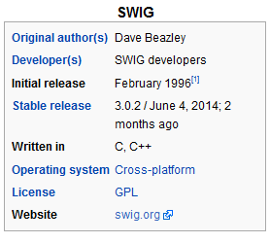
Simplified Wrapper and Interface Generator(SWIG)
It’s an old but lively solution
Support for the interface between C++ and many other languages
  C++ -> Java, Python, PHP, C#
Avoid to write Java Native Interface(JNI) directly
Generate Java Wrapper:
Write Wrapper
Original C++ code
Java Class
C++ Wrapper
Binary Library
JNI
Java Package
Java Apps

Slide 9
Drawback of SWIG-solution
LASSO App
We are happy to avoid to write JNI directly
But we found the low performance of JNI is unavoidable
  communicate with JVM frequently
N * D | C++ |  | Java
 | Matrix Ops | Table Ops | Matrix Ops | Table Ops
1000*1000 | 22.43s | 0.122s | 3.792s | 4.963s
100*10000 | 8.966s | 0.775s | 11.107s | 40.72s
100*40000 | 25.447s | 3.167s | 43.277s | 178.278s
About 60x slower than C++

Slide 10
Next: reduce the number of JNI call
Try to put JNI at different levels
JNI call is always the biggest one for time consuming!
JNI
JNI
JNI
JNI
Apps
Table Ops
Client Cache
Communication Thread
Server

Slide 11
Now: Pure Java Implementation of Petuum
Production Values
  The performance of Java is not a problem, especially for Java 8
  Easy to collaborate with other mature components
  Easy to use and to popularize
  Lower the learning curve of Petuum
Research Value
  Java/Scala and related framework are powerful tools to explore new parallel paradigm for machine learning algorithms.
    e.g. Actor model is a ideal tool to explore auto-parallel and model-parallel.

Slide 12
Overview of Petuum v0.9
Node 1
Node 2
Node 3
Workers
Workers
Workers
Servers
Servers
Servers
Communication Bus
Workers
Workers
Workers
Servers
Servers
Servers
Node 4
Node 5
Node 6

Slide 13
Basic Architecture of Petuum v0.9
The Most Complicated Part
SSP Consistency Controller
Server Thread
Threads
Highly Concurrent
Table Operations
LRU Cache
Background Threads
Send/Handle messages
Background Threads
Send/Handle messages
Threads
SSP Consistency Controller
LRU Cache
Server Thread
Threads
ZMQ messages
SSP Consistency Controller
LRU Cache
In / Inter Node
Server Thread
Threads
SSP Consistency Controller
LRU Cache
Threads
Server Thread

Slide 14
Related Techniques
Thread Pool
Thread-Safety Operations
Raw Message Handling
Reflection
…
Lots of engineering work
The only problem is the time for coding

Slide 15
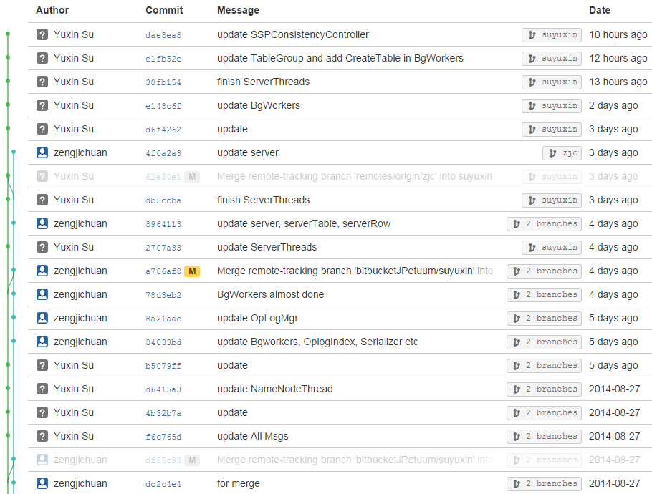
Progress
The major coding work is finished
Testing the whole procedure steps by steps
Amending related subsidiary code
We plan to finish the testing at this weekend.
Currently, we have written 9091 lines of code.

Slide 16
Thanks!

