Slide 1

Deep keyphrase generation
Group presentation
Wang Yue 2018.03.27

Slide 2
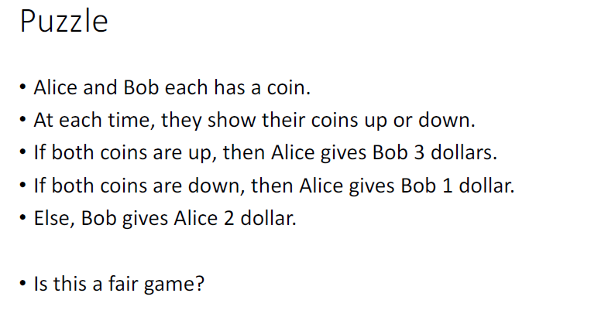
Part 0
Puzzle

Slide 3
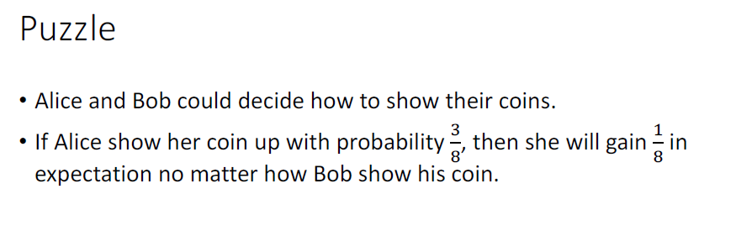
Part 0
Puzzle

Slide 4
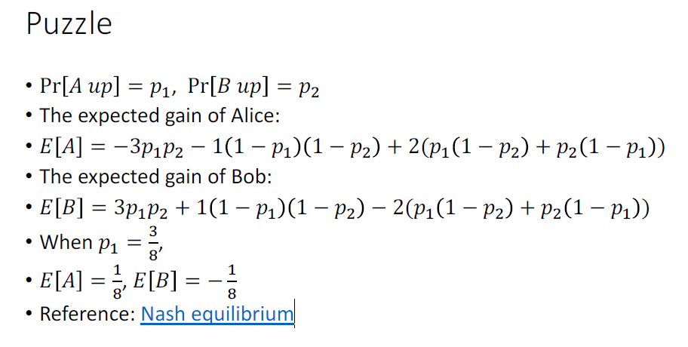
Part 0
Puzzle

Slide 5
Part 0
Ten English sentences
We use the term “keyphrase” interchangeably with “keyword” in the rest of this paper.
To overcome the limitations of previous studies, we re-examine the process of keyphrase prediction with a focus on how real human annotators would assign keyphrases
A keyphrase provides a succinct and accurate way of describing a subject or a subtopic in a document
The model would potentially give preference to the appearing words, which caters to the fact that most keyphrases tend to appear in the source text
Previous methods are liable to reproduce factual details inaccurately
Summarization is the task of condensing a piece of text to a shorter version that contains the main information from the original
Though these systems are promising, they exhibit undesirable behavior such as inaccurately reproducing factual details, an inability to deal with out-of-vocabulary (OOV) words, and repeating themselves
We find our simpler approach suffices
Originating from Statistical Machine Translation (Koehn, 2009), coverage was adapted for NMT by Tu et al. (2016)
We found this to be ineffective, with no discernible reduction in repetition
(The first 4 sentences are from the paper “deep keyphrase generation” while the rest are from the paper “Get To The Point: Summarization with Pointer-Generator Networks”)

Slide 6
Outline
Slides for “Deep keyphrase generation” (2017 ACL paper) link
  http://memray.me/uploads/acl17-deep-keyphrase-generation-slides.pdf
Copy mechanism from the paper “Get To The Point: Summarization with Pointer-Generator Networks” (2017 ACL paper)
Transformer

Slide 7
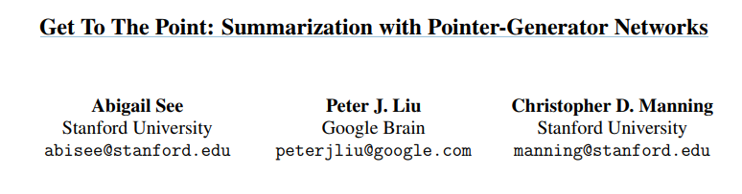
Part 1
Overview
ACL 2017

Slide 8
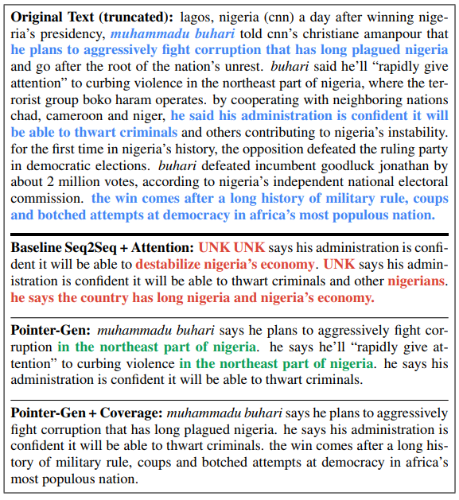
Part 1
Overview
Task: multi-sentence summarization
Challenge
  Previous methods are liable to reproduce factual details inaccurately
  Tend to repeat themselves
Proposed model:
  Pointer and generator architecture
  Coverage mechanism
Comment: adopted as a mainstream copy mechanism

Slide 9
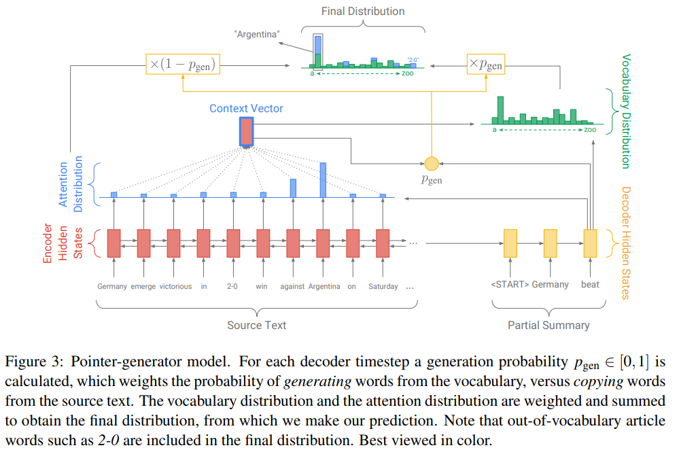



Part 1
Overview
Pointer-generator model
Final distribution:

Slide 10
Deep keyphrase generation
Yue Wang, 1155085636, CSE, CUHK
Thank you!

