Slide 1
4. Random variables part two

Slide 2
Review
A discrete random variable X assigns a discrete value to every outcome in the sample space.
E[N]
Probability mass function of X: p(x) = P(X = x)
Expected value of X:
E[X] = ∑_{x} x p(x).
N: number of heads
in two coin flips

Slide 3
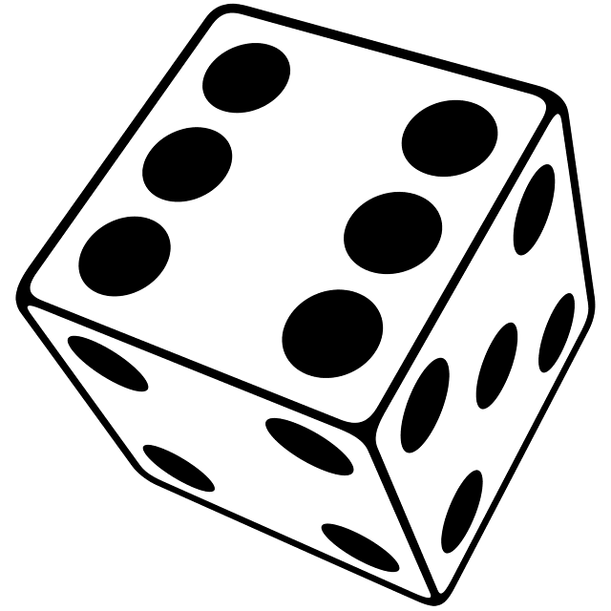
One die
Example from last time
F = face value of fair 6-sided die
1
1
1
1
1
1
E[F] = 1 + 2 + 3 + 4 + 5 + 6 = 3.5
6
6
6
6
6
6

Slide 4
Two dice
S = sum of face values of
two fair 6-sided dice
Solution 1
We calculate the p.m.f. of S:
s
2 3 4 5 6 7 8 9 10 11 12
p_{S}(s)
1
2
3
4
5
6
5
4
3
2
1
36
36
36
36
36
36
36
36
36
36
36
1
2
1
= 7
E[S] = 2 + 3 + … + 12
36
36
36

Slide 5
Two dice again
S = sum of face values of
two fair 6-sided dice
F₁
F₂
S = F₁ + F₂
F₁ = outcome of first die
F₂ = outcome of second die

Slide 6
Sum of random variables
Let X, Y be two random variables.
X assigns value X(ω) to outcome ω
Y assigns value Y(ω) to outcome ω
X + Y is the random variable that assigns value
X(ω) + Y(ω) to outcome ω.

Slide 7
Sum of random variables
F₁
F₂
S = F₁ + F₂
11
1
1
2
12
1
2
3
…
…
21
2
1
3
…
…
66
6
6
12

Slide 8
Linearity of expectation
For every two random variables X and Y
E[X + Y] = E[X] + E[Y]

Slide 9
Two dice again
S = sum of face values of
two fair 6-sided dice
F₁
F₂
Solution 2
S = F₁ + F₂
E[S] = E[F₁] + E[F₂]
= 3.5 + 3.5 = 7

Slide 10
Balls
We draw 3 balls without replacement from this urn:
0
1
-1
0
1
-1
1
-1
-1
What is the expected sum of values on the 3 balls?

Slide 11
Balls
0
1
-1
0
S = B₁ + B₂ + B₃
1
-1
1
where B_{i} is the value of i-th ball.
-1
-1
E[S] = E[B₁] + E[B₂] + E[B₃]
x
-1 0 1
p.m.f of B₁:
p(x)
4
2
3
9
9
9
E[B₁] = -1 (4/9) + 0 (2/9) + 1 (3/9) = -1/9
same for B₂, B₃
E[S] = 3 (-1/9) = -1/3.

Slide 12
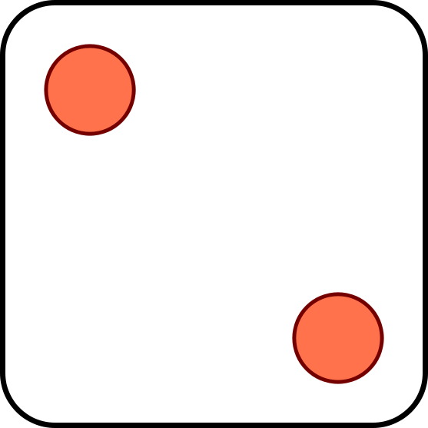
Three dice
N = number of s. Find E[N].
I₁
I₂
I₃
Solution
1 if face value of kth die equals
I_{k} =
0 if not
N = I₁ + I₂ + I₃
E[N] = E[I₁] + E[I₂] + E[I₃]
= 3 (1/6)
= 1/2
E[I₁] = 1 (1/6) + 0(5/6) = 1/6
E[I₂], E[I₃] = 1/6

Slide 13
Problem for you to solve
Five balls are chosen without replacement from an urn with 8 blue balls and 10 red balls.
(a)
What is the expected number of blue balls that are chosen?
(b)
What if the balls are chosen with replacement?

Slide 14
The indicator (Bernoulli) random variable
Perform a trial that succeeds with probability p and fails with probability 1 – p.
x
0 1
p(x)
p(x)
1 – p p
p = 0.5
If X is Bernoulli(p) then
E[X] = p
p(x)
p = 0.4

Slide 15
The binomial random variable
Binomial(n, p): Perform n independent trials, each of which succeeds with probability p.
X = number of successes
Examples
Toss n coins. “number of heads” is Binomial(n, ½).
Toss n dice. “Number of s” is Binomial(n, 1/6).

Slide 16
A less obvious example
Toss n coins. Let C be the number of consecutive changes (HT or TH).
Examples:
ω
C(ω)
HHHHHHH
0
THHHHHT
2
HTHHHHT
3
Then C is Binomial(n – 1, ½).

Slide 17
A non-example
Draw a 10 card hand from a 52-card deck.
Let N = number of aces among the drawn cards
Is N a Binomial(10, 1/13) random variable?
No!
Trial outcomes are
not independent.

Slide 18
Properties of binomial random variables
If X is Binomial(n, p), its p.m.f. is
p(k) = P(X = k) = C(n, k) p^{k} (1 - p)^{n-k}
We can write X = I₁ + … + I_{n}, where I_{i} is an indicator random variable for the success of the i-th trial
E[X] = E[I₁] + … + E[I_{n}]
= p + … + p = np.
E[X] = np

Slide 19
Probability mass function
Binomial(10, 0.5)
Binomial(50, 0.5)
Binomial(10, 0.3)
Binomial(50, 0.3)

Slide 20
Functions of random variables
p.m.f. of X:
p.m.f. of X - 1:
x
0 1 2
y
-1 0 1
p(x)
1/3 1/3 1/3
p(y)
1/3 1/3 1/3
p.m.f. of (X – 1)²:
y
0 1
p(y)
1/3 2/3
If X is a random variable, then Y = f(X) is a random variable with p.m.f.
p_{Y}(y) = ∑_{x: f(x) = y} p_{X}(x).

Slide 21
Investments
You have two investment choices:
A: put $25 in one stock
B: put $½ in each of 50 unrelated stocks
Which do you prefer?

Slide 22
Investments
Probability model
doubles in value with probability ½
Each stock
loses all value with probability ½
Different stocks perform independently

Slide 23
Investments
A: put $50 in one stock
B: put $½ in each of 50 stocks
N_{A} = amount on choice A
N_{B} = amount on choice B
50 × Bernoulli(½)
Binomial(50, ½)
E[N_{A}]
E[N_{B}]

Slide 24
Variance and standard deviation
Let μ = E[X] be the expected value of X.
The variance of X is the quantity
Var[X] = E[(X – μ)²]
The standard deviation of X is σ = √Var[X]
It measures how close X and μ are typically.

Slide 25
Calculating variance
μ = E[N_{A}]
x
0 50
p(x)
½ ½
μ – σ
μ + σ
p.m.f of N_{A}
Var[N_{A}] = E[(N_{A} – μ)²]
y
25²
= 25²
q(y)
1
σ = std. dev. of N_{A} = 25
p.m.f of (N_{A} – μ)²

Slide 26
Another formula for variance
for constant c, E[cX] = cE[X]
Var[X] = E[(X – μ)²]
for constant c, E[c] = c
= E[X² – 2μX + μ²]
= E[X²] + E[–2μX] + E[μ²]
= E[X²] – 2μ E[X] + μ²
= E[X²] – 2μ μ + μ²
= E[X²] – μ²
Var[X] = E[X²] – E[X]²

Slide 27
Variance of binomial random variable
Suppose X is Binomial(n, p).
Then X = I₁ + … + I_{n}, where I_{i} =
1, if trial i succeeds
0, if trial i fails
μ = E[X] = np
Var[X] = E[X²] – μ² = E[X²] – (np)²
= np + n(n-1) p² – (np)²
E[X²]
= E[(I₁ + … + I_{n})²]
= E[I₁² + … + I_{n}² + I₁I₂ + I₁I₃ + … + I_{n}I_{n-1}]
= E[I₁²] + … + E[I_{n}²] + E[I₁I₂] + … + E[I_{n}I_{n-1}]
= n p
= n(n-1) p²
E[I_{i}²] = E[I_{i}] = p
E[I_{i} I_{j}] = P(I_{i} = 1 and I_{j} = 1)
= P(I_{i} = 1) P(I_{j} = 1) = p²

Slide 28
Variance of binomial random variable
Suppose X is Binomial(n, p).
μ = E[X] = np
Var[X] = np + n(n-1) p² – (np)²
= np – np² = np(1-p)
Var[X] = np(1-p)
The standard deviation of X is
σ = √np(1-p).

Slide 29
Investments
A: put $50 in one stock
B: put $½ in each of 50 stocks
N_{A} = amount on choice A
N_{B} = amount on choice B
50 × Bernoulli(½)
Binomial(50, ½)
μ
μ
μ – σ
μ + σ
σ = 25
σ = √50 ½ ½ = 3.536…

Slide 30
Average household size
In 2011 the average household in Hong Kong had 2.9 people.
Take a random person. What is the average number of people in his/her household?
A: < 2.9
B: 2.9
C: > 2.9

Slide 31








Average household size
average
household size
3
3
3
average size of random
person’s household
4⅓

Slide 32
Average household size
What is the average household size?
household size 1 2 3 4 5 more
% of households 16.6 25.6 24.4 21.2 8.7 3.5
From Hong Kong Annual Digest of Statistics, 2012
Probability model
The sample space are the households of Hong Kong
Equally likely outcomes
X = number of people in the household
E[X]
≈ 1×.166 + 2×.256 + 3×.244 + 4×.214 + 5×.087 + 6×.035
= 2.91

Slide 33
Average household size
Take a random person. What is the average number of people in his/her household?
Probability model
The sample space are the people of Hong Kong
Equally likely outcomes
Y = number of people in household
Let’s find the p.m.f. p_{Y}(y) = P(Y = y)

Slide 34
Average household size
household size 1 2 3 4 5 more
% of households 16.6 25.6 24.4 21.2 8.7 3.5
N = number of people in Hong Kong
H = number of households in Hong Kong
N
≈ 1×.166H + 2×.256H + 3×.244H
+ 4×.214H + 5×.087H + 6×.035H
p_{Y}(1) = P(Y = 1)
= 1×.166H/N
p_{Y}(2) = P(Y = 2)
= 2×.256H/N
p_{Y}(y) = P(Y = y)
= y×P(X = y) H/N
= y×p_{X}(y)/E[X]

Slide 35
Average household size
X = number of people in a random household
Y = number of people in household of a random person
y p_{X}(y)
∑_{y} y² p_{X}(y)
p_{Y}(y) =
E[Y] = ∑_{y} y p_{Y}(y)
=
E[X]
E[X]
household size 1 2 3 4 5 more
% of households 16.6 25.6 24.4 21.2 8.7 3.5
1²×.166 + 2²×.256 + 3²×.244 + 4²×.214 + 5²×.087 + 6²×.035
E[Y] ≈
≈ 3.521
2.91

Slide 36
Preview
X = number of people in a random household
Y = number of people in household of a random person
E[X²]
E[Y]
=
E[X]
Because Var[X] ≥ 0,
E[X²] ≥ (E[X])²
So E[Y] ≥ E[X]. The two are equal only if all households have the same size.

Slide 37

This little mobius strip of a phenomenon is called the “generalized friendship paradox,” and at first glance it makes no sense. Everyone’s friends can’t be richer and more popular — that would just escalate until everyone’s a socialite billionaire.
The whole thing turns on averages, though. Most people have small numbers of friends and, apparently, moderate levels of wealth and happiness. A few people have buckets of friends and money and are (as a result?) wildly happy. When you take the two groups together, the really obnoxiously lucky people skew the numbers for the rest of us. Here’s how MIT’s Technology Review explains the math:
  The paradox arises because numbers of friends people have are distributed in a way that follows a power law rather than an ordinary linear relationship. So most people have a few friends while a small number of people have lots of friends.
  It’s this second small group that causes the paradox. People with lots of friends are more likely to number among your friends in the first place. And when they do, they significantly raise the average number of friends that your friends have. That’s the reason that, on average, your friends have more friends than you do.
And this rule doesn’t just apply to friendship — other studies have shown that your Twitter followers have more followers than you, and your sexual partners have more partners than you’ve had. This latest study, by Young-Ho Eom at the University of Toulouse and Hang-Hyun Jo at Aalto University in Finland, centered on citations and coauthors in scientific journals. Essentially, the “generalized friendship paradox” applies to all interpersonal networks, regardless of whether they’re set in real life or online.
So while it’s tempting to blame social media for what the New York Times last month called “the agony of Instagram” — that peculiar mix of jealousy and insecurity that accompanies any glimpse into other people’s glamorously Hudson-ed lives — the evidence suggests that Instagram actually has little to do with it. Whenever we interact with other people, we glimpse lives far more glamorous than our own.
That’s not exactly a comforting thought, but it should assuage your FOMO next time you scroll through your Facebook feed.

Slide 38

Sam
Bob
Zoe
X = number of friends
Alice
Y = number of friends
of a friend
Jessica
Mark
Eve
In your homework you will show that E[Y] ≥ E[X] in any social network

Slide 39




Apples
About 10% of the apples on your farm are rotten.
You sell 10 apples. How many are rotten?
Probability model
Number of rotten apples you sold is
Binomial(n = 10, p = 1/10).
E[N] = np = 1

Slide 40

Apples
You improve productivity; now only 5% apples rot.
You can now sell 20 apples and only one will be rotten on average.
N is now Binomial(20, 1/20).

Slide 41
.387
Binomial(10, 1/10)
.349
.194
.001
10⁻¹⁰
.377
.354
Binomial(20, 1/20)
.189
.002
10⁻⁸
10⁻²⁶
.367
.367
.183
.003
10⁻⁷
10⁻¹⁹

Slide 42
The Poisson random variable
A Poisson(μ) random variable has this p.m.f.:
p(k) = e^{-μ} μ^{k}/k!
k = 0, 1, 2, 3, …
Poisson random variables do not occur “naturally” in the sample spaces we have seen.
They approximate Binomial(n, p) random variables when μ = np is fixed and n is large (so p is small)
p_{Poisson(μ)}(k) = lim_{n → ∞} p_{Binomial(n, μ/n)}(k)

Slide 43


Raindrops
Rain is falling on your head at an average speed of 2.8 drops/second.
0
1
Divide the second evenly in n intervals of length 1/n.
Let E_{i} be the event “raindrop hits during interval i.”
Assuming E₁, …, E_{n} are independent, the number of drops in the second N is a Binomial(n, p) r.v.
Since E[N] = 2.8, and E[N] = np, p must equal 2.8/n.

Slide 44
Raindrops
0
1
Number of drops N is Binomial(n, 2.8/n)
As n gets larger, the number of drops within the second “approaches” a Poisson(2.8) random variable:

Slide 45
Expectation and variance of Poisson
If X is Binomial(n, p) then
E[X] = np
Var[X] = np(1-p)
When p = μ/n, we get
E[X] = μ
Var[X] = μ(1-μ/n)
As n → ∞, E[X] → μ and Var[X] → μ. This suggests
When X is Poisson(μ), E[X] = μ and Var[X] = μ.

Slide 46

Problem for you to solve
Rain falls on you at an average rate of 3 drops/sec.
When 100 drops hit you, your hair gets wet.
You walk for 30 sec from MTR to bus stop.
What is the probability your hair got wet?

Slide 47
Problem for you to solve
Solution
On average, 90 drops fall in 30 seconds.
So we model the number of drops N you receive as a Poisson(90) random variable.
Using the online Poisson calculator at or the poissonpmf(n, L) function in 14L07.py we get
P(N > 100) = 1 - ∑_{i = 0} P(N = i) ≈ 13.49%
⁹⁹

