Slide 1
4. Random variables part one

Slide 2
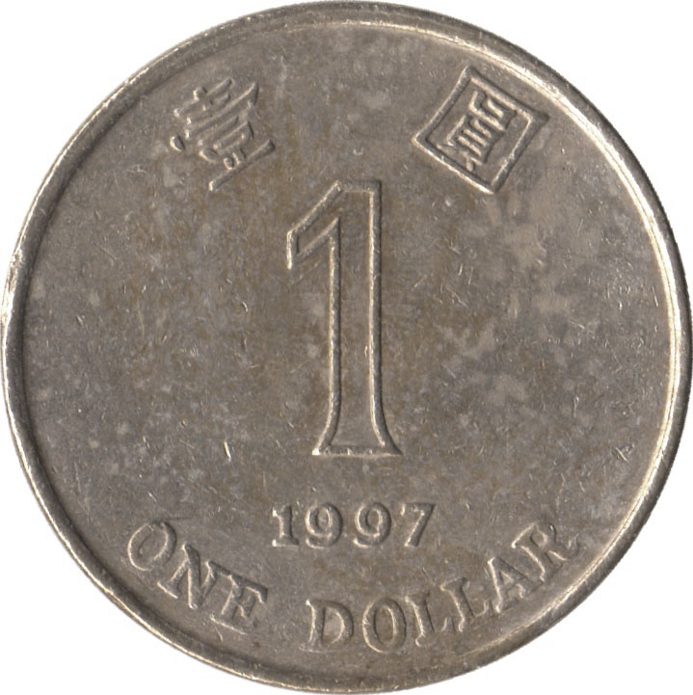
Random variable
A discrete random variable assigns a discrete value to every outcome in the sample space.
Example
{ HH, HT, TH, TT }
N = number of Hs

Slide 3
Probability mass function
The probability mass function (p.m.f.) of discrete random variable X is the function
p(x) = P(X = x)
Example
{ HH, HT, TH, TT }
¼
¼
¼
¼
N = number of Hs
p(0) = P(N = 0) = P({TT}) = 1/4
p(1) = P(N = 1) = P({HT, TH}) = 1/2
p(2) = P(N = 2) = P({HH}) = 1/4

Slide 4
Probability mass function
We can describe the p.m.f. by a table or by a chart.
x 0 1 2
p(x)
p(x) ¼ ½ ¼
x

Slide 5
Balls
We draw 3 balls without replacement from this urn:
0
1
-1
0
1
0
1
-1
-1
Let X be the sum of the values on the balls. What is the p.m.f. of X?

Slide 6
Balls
0
1
-1
0
X = sum of values on the 3 balls
1
0
1
E_{abc}: we chose balls of type a, b, c
-1
-1
P(X = 0)
= P(E₀₀₀) + P(E₁₍₋₁₎₀)
= (1 + 3×3×3)/C(9, 3) = 28/84
P(X = 1)
= P(E₁₀₀) + P(E₁₁₍₋₁₎)
= (3×3 + 3×3)/C(9, 3) = 18/84
P(X = -1)
= P(E₍₋₁₎₀₀) + P(E₍₋₁₎₍₋₁₎₁)
= (3×3 + 3×3)/C(9, 3) = 18/84
P(X = 2)
= P(E₁₁₀)
= 3×3/C(9, 3)
= 9/84
P(X = -2)
= P(E₍₋₁₎₍₋₁₎₀)
= 3×3/C(9, 3)
= 9/84
P(X = 3)
= P(E₁₁₁)
= 1/C(9, 3)
= 1/84
P(X = -3)
= P(E₍₋₁₎₍₋₁₎₍₋₁₎)
= 1/C(9, 3)
= 1/84
1

Slide 7
Probability mass function
p.m.f. of X
The events “X = x” are disjoint and partition the sample space, so for every p.m.f
∑_{x} p(x) = 1

Slide 8
Events from random variables
28/84
p.m.f. of X
18/84
18/84
9/84
9/84
1/84
1/84
P(X > 0)
= 18/84 + 9/84 + 1/84
= 1/3
P(X is even)
= 9/84 + 28/84 + 9/84
= 23/42

Slide 9

Example
Two six-sided dice are tossed. Calculate the p.m.f. of the difference D of the outcomes.
What is the probability that D > 1? D is odd?

Slide 10
Cumulative distribution function
The cumulative distribution function (c.d.f.) of discrete random variable X is the function
F(x) = P(X ≤ x)
p(x)
F(x)
x
x

Slide 11


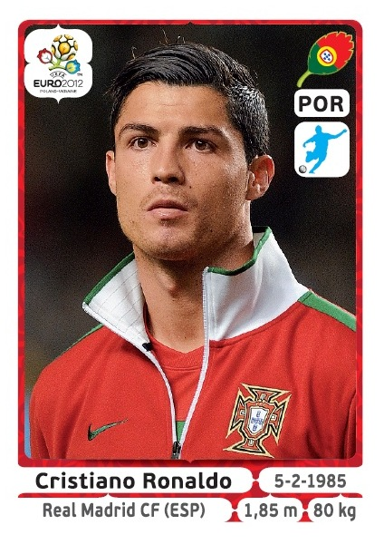
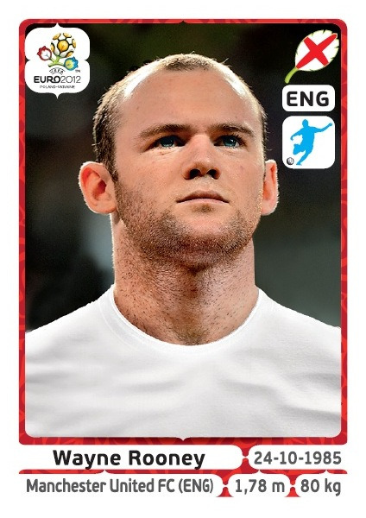

Coupon collection

Slide 12
Coupon collection
There are n types of coupons. Every day you get one. By when will you get all the coupon types?
Solution
Let X be the day on which you collect all coupons
Let X_{t} be the day you collect the (first) type t coupon
(X ≤ d) = (X₁ ≤ d) and (X₂ ≤ d) … (X_{n} ≤ d)

Slide 13
Coupon collection
Let X₁ be the day you collect the type 1 coupon
We are interested in P(X₁ ≤ d)
Probability model
Let E_{i} be the event you get a type 1 coupon on day i
Since there are n types, we assume
P(E₁) = P(E₂) = … = 1/n
We also assume E₁, E₂, … are independent

Slide 14
Coupon collection
(X₁ ≤ d) = E₁∪E₂∪…∪E_{d}
P(X₁ ≤ d)
= 1 – P(X₁ > d)
= 1 – P(E₁^{c}E₂^{c} … E_{d}^{c})
= 1 – P(E₁^{c}) P(E₂^{c}) … P(E_{d}^{c})
= 1 – (1 – 1/n)^{d}

Slide 15
Coupon collection
There are n types of coupons. Every day you get one. By when will you get all the coupon types?
Solution
Let X be the day on which you collect all coupons
Let X_{t} be the day when you get your type t coupon
(X ≤ d) = (X₁ ≤ d) and (X₂ ≤ d) … (X_{n} ≤ d)
not independent!
(X > d) = (X₁ > d) ∪ (X₂ > d) ∪ … ∪ (X_{n} > d)

Slide 16
Coupon collection
We calculate P(X > d) by inclusion-exclusion
P(X > d) = ∑ P(X_{t} > d) – ∑ P(X_{t} > d and X_{u} > d) + …
P(X₁ > d) = (1 – 1/n)^{d}
by symmetry P(X_{t} > d) = (1 – 1/n)^{d}
P(X₁ > d and X₂ > d)
= P(F₁ … F_{d})
F_{i} = “day i coupon is not
of type 1 or 2”
= P(F₁) … P(F_{d})
independent events
= (1 – 2/n)^{d}

Slide 17
Coupon collection
P(X > d) = ∑ P(X_{t} > d) – ∑ P(X_{t} > d and X_{u} > d) + …
P(X₁ > d) = (1 – 1/n)^{d}
P(X₁ > d and X₂ > d) = (1 – 2/n)^{d}
P(X₁ > d and X₂ > d and X₃ > d) = (1 – 3/n)^{d} and so on
so P(X > d) = C(n, 1) (1 – 1/n)^{d} – C(n, 2) (1 – 2/n)^{d} + …
= ∑_{i = 1} (-1)^{i+1} C(n, i) (1 – i/n)^{d}
^{n}

Slide 18
Coupon collection
P(X ≤ d)
n = 15
d
Probability of collecting all n coupons by day d

Slide 19
Coupon collection
.523
.520
n = 5
n = 10
10
d
27
d
.503
.500
n = 15
n = 20
46
67

Slide 20
Coupon collection
n
n
Day on which the probability
of collecting all n coupons
first exceeds 1/2
n
The function
n ln
ln 2

Slide 21
Coupon collection
16 teams
17 coupons per team
272 coupons
it takes 1624 days to collect all coupons with probability 1/2.

Slide 22
Expected value
The expected value (expectation) of a random variable X with p.m.f. p is
E[X] = ∑_{x} x p(x)
Example
N = number of Hs
x 0 1
p(x) ½ ½
E[N] = 0 ½ + 1 ½ = ½

Slide 23
Expected value
Example
E[N]
N = number of Hs
x 0 1 2
p(x) ¼ ½ ¼
E[N] = 0 ¼ + 1 ½ + 2 ¼ = 1
The expectation is the average value the random variable takes when experiment is done many times

Slide 24
Expected value
Example
F = face value of fair 6-sided die
1
1
1
1
1
1
E[F] = 1 + 2 + 3 + 4 + 5 + 6 = 3.5
6
6
6
6
6
6

Slide 25

Chuck-a-luck
1
2
3
4
5
6
If appears k times, you win $k.
If it doesn’t appear, you lose $1.

Slide 26
Chuck-a-luck
Solution
P = profit
n
-1 1 2 3
5
1
1
5
5
1
( )
( )²
( )³
p(n)
( )³
3
( )²
( )
3
6
6
6
6
6
6
E[P] = -1 × (5/6)³ + 1 × 3(5/6)²(1/6)²
+ 2 × 3(5/6)(1/6)² + 3 × (5/6)³
= -17/216

Slide 27



Utility
Should I come to class next Tuesday?
not called
called
+5
-20
E[C]
= -3.82…
Come
5×11/17 − 20×6/17
+100
-300
Skip
F
E[S]
= -41.18…
100×11/17 − 300×6/17
11/17
6/17

