Slide 1
3. Conditional probability part two

Slide 2
Cause and effect
1
2
3
cause:
C₁
C₂
C₃
effect:
B

Slide 3
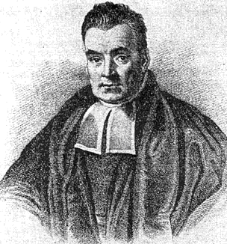
Bayes’ rule
P(E|C) P(C)
P(E|C) P(C)
P(C|E) =
=
P(E)
P(E|C) P(C) + P(E|C^{c}) P(C^{c})
More generally, if C₁,…, C_{n} partition S then
P(E|C_{i}) P(C_{i})
P(C_{i}|E) =
P(E|C₁) P(C₁) + … + P(E|C_{n}) P(C_{n})

Slide 4
Cause and effect
1
2
3
cause:
C₁
C₂
C₃
effect:
B
P(B|C_{i}) P(C_{i})
P(C_{i}|B) =
P(B|C₁) P(C₁) + P(B|C₂) P(C₂) + P(B|C₃) P(C₃)

Slide 5
Medical tests
If you are sick (S), a blood test comes out positive (P) 95% of the time.
If you are not sick, the test is positive 1% of the time.
Suppose 0.5% people in Hong Kong are sick.
You take the test and come out positive. What are the chances that you are sick?
P(P|S) P(S)
P(S|P) =
≈ 32.3%
P(P|S) P(S) + P(P|S^{c}) P(S^{c})
95% 0.5%
1% 99.5%

Slide 6
Computer science vs. nursing
Two classes take place in Lady Shaw Building.
One is a computer science class with 100 students, out of which 20% are girls.
The other is a nursing class with 10 students, out of which 80% are girls.
A girl walks out. What are the chances that she is from the computer science class?

Slide 7
Two effects
Cup one has 9 blue balls and 1 red ball.
Cup two has 9 red balls and 1 blue ball.
I choose a cup at random and draw a ball. It is blue.
I draw another ball from the same cup (without replacement). What is the probability it is blue?

Slide 8


Russian roulette
Alice
Bob
BANG
Alice and Bob take turns spinning the 6 hole cylinder and shooting at each other.
What is the probability that Alice wins (Bob dies)?

Slide 9
Russian roulette
Probability model
S = { H, MH, MMH, MMMH, MMMH, …}
E.g. MMH: Alice misses, then Bob misses, then Alice hits
A = “Alice wins” = { H, MMH, MMMMH, …}
outcomes are not equally likely!

Slide 10
Russian roulette
outcome H MH MMH MMMH MMMH
probability
1/6
5/6 ∙ 1/6
(5/6)² ∙ 1/6
(5/6)³ ∙ 1/6
(5/6)⁴ ∙ 1/6
P(A)
= 1/6 + (5/6)² ∙ 1/6 + (5/6)⁴ ∙ 1/6 + …
= 1/6 ∙ (1 + (5/6)² + (5/6)⁴ + …)
= 1/6 ∙ 1/(1 – (5/6)²)
= 6/11

Slide 11
Russian roulette
Solution using conditional probabilities:
A = “Alice wins” = { H, MMH, MMMMH, …}
A^{c} = “Bob wins” = { MH, MMMH, MMMMMH, …}
W₁ = “Alice wins in first round” = { H }
P(A) = P(A|W₁) P(W₁) + P(A|W₁^{c}) P(W₁^{c})
1
1/6
P(A^{c})
5/6
P(A) = 1 ∙ 1/6 + (1 – P(A)) ∙ 5/6
11/6 P(A) = 1
so P(A) = 6/11

Slide 12
Infinite sample spaces
Axioms of probability:
1. for every E, 0 ≤ P(E) ≤ 1
S
E
2. P(S) = 1
S
3. If EF = ∅ then
S
P(E∪F) = P(E) + P(F)
E
F
3. If E₁, E₂, … are pairwise disjoint:
P(E₁∪E₂∪…) = P(E₁) + P(E₂) + …

Slide 13
Problem for you to solve
Charlie tosses a pair of dice. Alice wins if the sum is 7. Bob wins if the sum is 8.
Charlie keeps tossing until one of them wins.
What is the probability that Alice wins?

Slide 14
Hats again
The hats of n men are exchanged at random. What is the probability that no man gets back his hat?
Solution using conditional probabilities:
N = “No man gets back his hat”
H₁ = “1 gets back his own hat”
P(N) = P(N|H₁) P(H₁) + P(N|H₁^{c}) P(H₁^{c})
0
1/n
(n-1)/n

Slide 15
Hats again
N = “No man gets back his hat”
let p_{n} = P(N)
H₁ = “1 gets back his own hat”
S₁ = “1 exchanges hats with another man”
p_{n} =
P(N) = P(N|H₁^{c})
n – 1
n
P(N|H₁^{c}) = P(NS₁|H₁^{c}) + P(NS₁^{c}|H₁^{c})
= P(S₁|H₁^{c}) P(N|S₁H₁^{c}) + P(NS₁^{c}|H₁^{c})
1/(n-1)
p_{n-2}
p_{n-1}
n – 1
1
p_{n} = p_{n-1} + p_{n-2}
n
n

Slide 16
Hats again
N = “No man gets back his hat”
p_{n} = P(N)
n – 1
1
p₁ = 0
p_{n} = p_{n-1} + p_{n-2}
n
n
1
1
p_{n} – p_{n-1} = – (p_{n-1} – p_{n-2})
p₂ =
n
2
1
1
1
1
p₃ – p₂ = – (p₂ – p₁)
= –
p₃ = –
3
3!
2
3!
1
1
1
1
1
p₄ – p₃ = – (p₃ – p₂)
=
p₄ = – +
4
4!
2
3!
4!

Slide 17
Summary of conditional probability
Conditional probabilities are used:
1
When there are causes and effects
to estimate the probability of a cause when we observe an effect
2
To calculate ordinary probabilities
Conditioning on the right event can simplify the description of the sample space

Slide 18
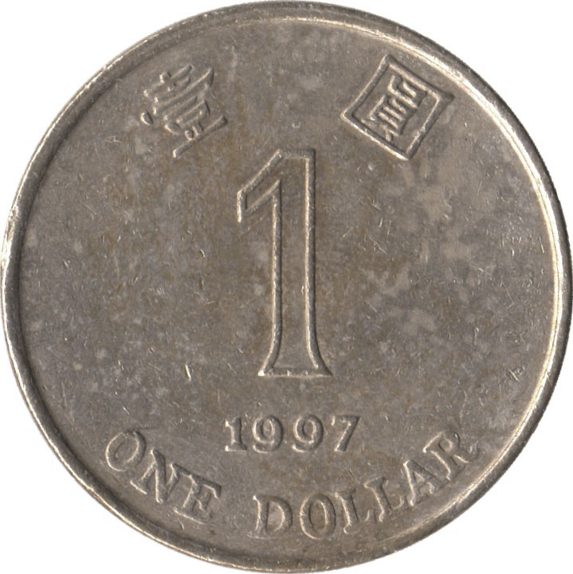
Independence of two events
Let E₁ be “first coin comes up H”
E₂ be “second coin comes up H”
Then P(E₂ | E₁) = P(E₂)
P(E₂E₁) = P(E₂)P(E₁)
Events A and B are independent if
P(A B) = P(A) P(B)

Slide 19
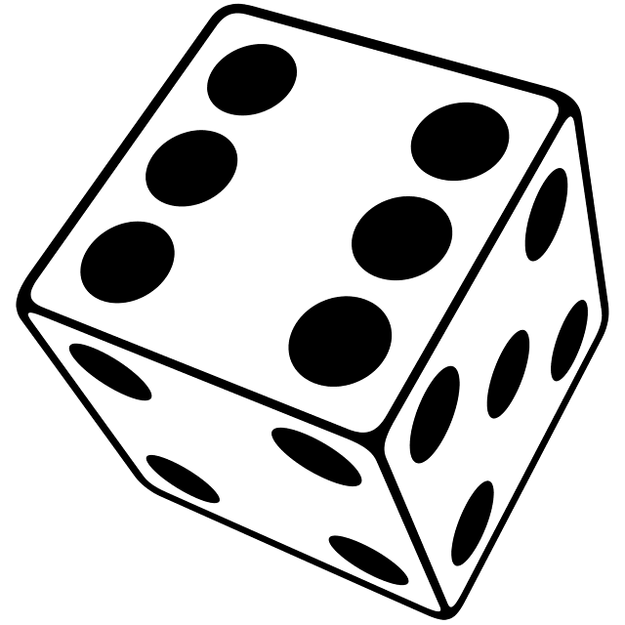
Examples of (in)dependence
Let E₁ be “first die is a 4”
S₆ be “sum of dice is a 6”
S₇ be “sum of dice is a 7”
P(E₁) =
1/6
P(E₁S₆) =
1/36
E₁, S₆ are dependent
P(S₆) =
5/36
P(S₇) =
1/6
P(E₁S₇) =
1/36
E₁, S₇ are independent
P(S₆S₇) =
0
S₆, S₇ are dependent
Notes:
0

Slide 20
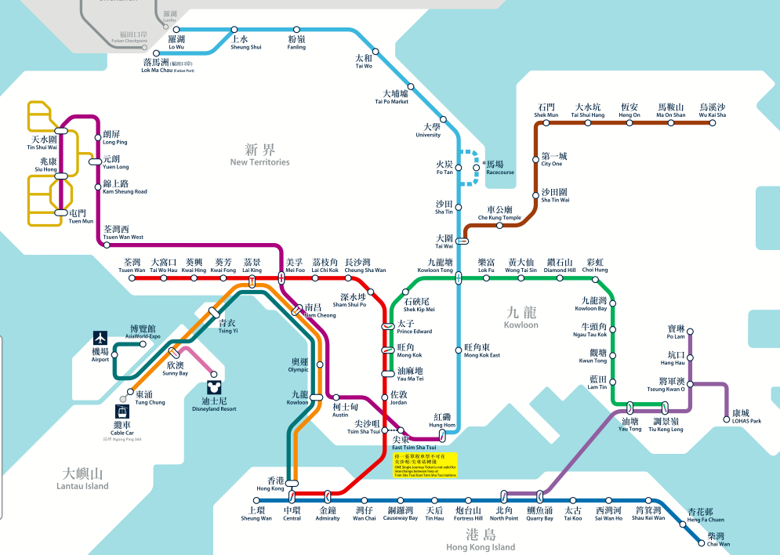
Sequential components
A: “I can get from Fanling to Ma On Shan”
ER: “East Rail Line is working”
P(ER) = 70%
MS: “Ma On Shan Line is working”
P(MS) = 98%
Assuming events E and M are independent:
P(A) = P(ER MS) = P(ER)P(MS) = 68.6%

Slide 21
Algebra of independent events
If A and B are independent, then A and B^{c} are also independent.
Proof: Assume A and B are independent.
P(AB^{c})
= P(A) – P(AB)
= P(A) – P(A)P(B)
= P(A)P(B^{c})
so B^{c} and A are independent.
Taking complements preserves independence.

Slide 22
Parallel components
B: “I can get from Lai King to Central / Hong Kong”
TW: “Tsuen Wan Line is operational”
P(TW) = 80%
TC: “Tung Chung Line is operational”
P(TC) = 85%
Assuming TW and TC
are independent:
P(B) = P(TW∪TC )
= 97%
P(B^{c}) = P(TW^{c} TC^{c})
= P(TW^{c}) P(TC^{c})
= 0.2 0.15
= 0.03

Slide 23
Independence of three events
Events A, B, and C are independent if
P(AB) = P(A) P(B)
P(BC) = P(B) P(C)
P(AC) = P(B) P(C)
and P(ABC) = P(A) P(B) P(C).
This is important!

Slide 24
(In)dependence of three events
Let E₁ be “first die is a 4”
E₂ be “second die is a 3”
S₇ be “sum of dice is a 7”
✔
P(E₁E₂) = P(E₁) P(E₂)
1/6
✔
E₁
P(E₁S₇) = P(E₁) P(S₇)
✔
P(E₂S₇) = P(E₂) P(S₇)
1/36
E₂
S₇
✗
P(E₁E₂S₇) = P(E₁) P(E₂) P(S₇)
1/6
1/6
1/36
1/6
1/6
1/6

Slide 25
Independence of many events
Events A₁, A₂, … are independent if for every subset A_{i1}, …, A_{ir} of the events
P(A_{i1}…A_{ir}) = P(A_{i1}) … P(A_{ir})
Algebra of independent events
Independence is preserved if we replace some event(s) by their complements, intersections, unions

Slide 26
Multiple components
P(ER) = 70%
P(WR) = 75%
P(TW) = 85%
P(KT) = 95%
C: “I can get from University to Mei Foo”
P(C) = P(ER WR∪ER KT TW )

Slide 27
Multiple components
P(ER) = 70%
ER
WR
KT
TW
probability
✓
✓
✓
✓
0.424
P(WR) = 75%
✓
✓
✓
✗
0.075
P(KT) = 95%
0.022
✓
✓
✗
✓
P(TW) = 85%
✓
✓
✗
✗
0.004
✓
✗
✓
✓
0.141
P(C) ≈
0.666
P(C) = P(ER WR∪ER WR^{c} KT TW )
= P(ER WR) P(ER WR^{c} KT TW )
= P(ER)P(WR) + P(ER)P(WR^{c})P(KT)P(TW)
= 0.7 0.75 + 0.7 0.25 0.95 0.85
≈ 0.666

Slide 28

Playoffs
Alice wins 60% of her ping pong matches against Bob. They meet for a 3 match playoff. What are the chances that Alice will win the playoff?
Probability model
Let W_{i} be the event Alice wins match i
We assume P(W₁) = P(W₂) = P(W₃) = 0.6
We also assume W₁, W₂, W₃ are independent

Slide 29
Playoffs
Probability model
To convince ourselves this is a probability model, let’s redo it as in Lecture 2:
S = { AAA, AAB, ABA, ABB, BAA, BAB, BBA, BBB }
the probability of AAA is P(W₁W₂W₃) = 0.6³
AAB
P(W₁W₂W₃^{c}) = 0.6² ∙ 0.4
ABA
P(W₁W₂^{c}W₃) = 0.6² ∙ 0.4
…
…
BBB
P(W₁^{c}W₂^{c}W₃^{c}) = 0.4³
The probabilities add up to one.

Slide 30
Playoffs
For Alice to win the tournament, she must win at least 2 out of 3 games. The corresponding event is
A = { AAA, AAB, ABA, BAA }
0.6³
0.6² ∙ 0.4 each
P(A) = 0.6³ + 3 ∙ 0.6² ∙ 0.4 = 0.648.
General playoff
Alice wins a p fraction of her ping pong games against Bob. What are the chances Alice beats Bob in an n match tournament (n is odd)?

Slide 31
Playoffs
Solution
Probability model similar as before.
Let A be the event “Alice wins playoff”
A_{k} be the event “Alice wins exactly k matches”
A = A_{(n+1)/2}∪…∪A_{n}
P(A) = P(A_{(n+1)/2}) + … + P(A_{n}) (they are disjoint)
P(A_{k}) = C(n, k) p^{k} (1 – p)^{n - k}
number of arrangements of k As, n – k Bs
probability of each such arrangement

Slide 32
Playoffs
P(A) = ∑ _{k = (n+1)/2}
C(n, k) p^{k} (1 – p)^{n - k}
^{n}
p = 0.6
p = 0.7
n
n
The probability that Alice wins an n game tournament

Slide 33
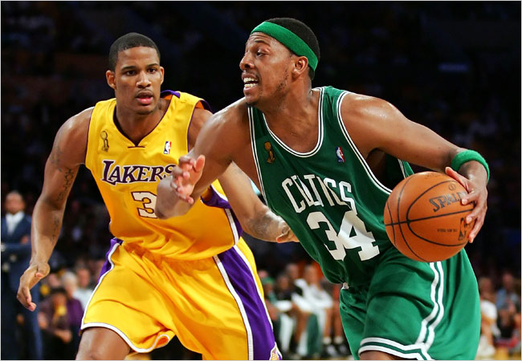
Problem for you
The Lakers and the Celtics meet for a 7-game playoff. They play until one team wins four games.
Suppose the Lakers win 60% of the time. What is the probability that all 7 games are played?

Slide 34

Gambler’s ruin
You have $100. You keep betting $1 on red at roulette.
You stop when you win $200,
or when you run out of money.
What is the probability you win $200?

Slide 35
Gambler’s ruin
Probability model
S = all infinite sequences of Reds and Others
Let R_{i} be the event of red in the ith round
(there is an R in position i)
Probabilities:
call this p
P(R₁) = P(R₂) = … = 18/37
R₁, R₂, … are independent

Slide 36
Gambler’s ruin
$n
You have $100. You stop when you win $200.
Let W be the event you win $200 and w_{n} = P(W).
w_{n} = P(W)
= P(W|R₁) P(R₁) + P(W|R₁^{c}) P(R₁^{c})
w_{n+1}
p
w_{n-1}
1-p
w_{n} = (1-p)w_{n-1} + pw_{n+1}
w₀ = 0
w₂₀₀ = 1.

Slide 37
Gambler’s ruin
w_{n} = (1-p)w_{n-1} + pw_{n+1}
w₀ = 0
w₂₀₀ = 1.
p(w_{n+1} – w_{n} ) = (1-p)(w_{n} – w_{n-1})
let λ = (1-p)/p = 19/18
w_{n+1} – w_{n} = λ (w_{n} – w_{n-1})
= λ² (w_{n-1} – w_{n-2})
= … = λ^{n} (w₁ – w₀)
w_{n+1} = w_{n} + λ^{n}w₁
= w_{n-1} + λ^{n-1}w₁ + λ^{n}w₁
= … = w₁ + λw₁ + … + λ^{n}w₁

Slide 38
Gambler’s ruin
w_{n} = (1-p)w_{n-1} + pw_{n+1}
You have $100.
w₀ = 0
w₂₀₀ = 1.
You stop when you win
$200 or run out.
λ = (1-p)/p = 19/18
The probability you win is
w_{n+1} = w₁ + … + λ^{n}w₁
w₁₀₀ ≈ 0.0045
= (λ^{n+1} – 1)/(λ – 1)w₁
w₂₀₀ = (λ²⁰⁰ – 1)/(λ – 1)w₁
λ^{n+1} – 1
w_{n+1} =
λ²⁰⁰ – 1

