Slide 1
2. Axioms of Probability part two

Slide 2
Birthdays
You have a room with n people. What is the probability that at least two of them have a birthday on the same day of the year?
Probability model
experiment outcome = birthdays of n people
The sample space consists of all sequences (b₁,…, b_{n}) where b₁,…, b_{n} are numbers between 1 and 365
S_{n} = {(b₁,…, b_{n}) : 1 ≤ b₁,…, b_{n} ≤ 365 } = {1, …, 365}^{n}

Slide 3
Birthdays
Probability model
We will assume equally likely outcomes.
This is a simplifying model which ignores some issues, for example:
Leap years have 366 not 365 days
Not all birthdays are equally represented, e.g. September is a popular month for babies
Birthdays among people in the room may be related, e.g. there may be twins inside

Slide 4
Birthdays
We are interested in the event that two birthdays are the same:
E_{n} = {(b₁,…, b_{n}) : b_{i} = b_{j} for some pair i ≠ j }
It will be easier to work with the complement of E:
E_{n}^{c} = {(b₁,…, b_{n}) : (b₁,…, b_{n}) are all distinct }
|E_{n}^{c}|
365⋅364⋅…⋅(365 – n + 1)
P(E_{n}^{c}) =
=
|S_{n}|
365^{n}
P(E_{n}) = 1 – P(E_{n}^{c})

Slide 5
Birthdays
P(E₂₂) = 0.4757…
P(E_{n})
P(E₂₃) = 0.5073…
n
Among 23 people, two have the same birthday
with probability about 50%.

Slide 6
Interpretation of probability
The probability of an event should equal the fraction of times that it occurs when the experiment is performed many times under the same conditions.
Let’s do the birthday experiment many times and see if this is true.

Slide 7
Simulation of birthday experiment
# perform t simulations of the birthday experiment for n people
# output a vector indicating the times event E_n occurred
def simulate_birthdays(n, t):
days = 365
occurred = []
for time in range(t):
# choose random birthdays for everyone
birthdays = []
for i in range(n):
birthdays.append(randint(1, days))
# record the occurrence of event E_n
occurred.append(same_birthday(birthdays))
return occurred
# check if event E_n occurs (two people have the same birthday)
def same_birthday(birthdays):
for i in range(len(birthdays)):
for j in range(i):
if birthdays[i] == birthdays[j]:
return True
return False
randint(a,b)
Choose a random integer in a range

Slide 8
Interpretation of probability
n = 23
P(E₂₃) = 0.5073…
t experiments
Fraction of times two people have the
same birthday in the first t experiments

Slide 9
Problem for you to solve
You drop 3 blue balls and 3 red balls into 5 bins at random. What is the probability that some bin gets two (or more) balls of the same color?

Slide 10
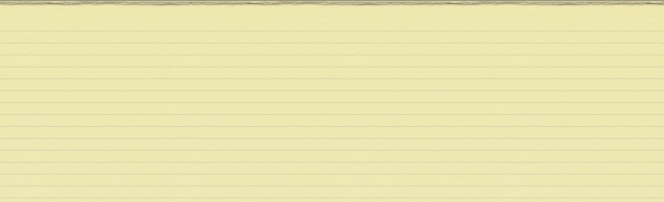
Generalized inclusion exclusion
P(E₁ ∪ E₂) = P(E₁) + P(E₂) – P(E₁E₂)
P(E₁ ∪ E₂ ∪ E₃) = P(E₁) + P(E₂ ∪ E₃) – P(E₁ (E₂ ∪ E₃))
P(E₂ ∪ E₃) = P(E₂) + P(E₃) – P(E₂E₃)
P(E₁ (E₂ ∪ E₃)) = P(E₁E₂ ∪ E₁E₃)
= P(E₁E₂) + P(E₁E₃) – P(E₁E₂E₃)
P(E₁ ∪ E₂ ∪ E₃) =
P(E₁) + P(E₂) + P(E₃)
– P(E₁E₂) – P(E₂E₃) – P(E₁E₃)
+ P(E₁E₂E₃)

Slide 11
Generalized inclusion exclusion
P(E₁ ∪ E₂ ∪…∪E_{n}) = ∑_{1 ≤ i ≤ n} P(E_{i})
– ∑_{1 ≤ i ≤ j ≤ n} P(E_{i}E_{j})
+ ∑_{1 ≤ i ≤ j ≤ k ≤ n} P(E_{i}E_{j}E_{k})
…
+ if n is odd,
– if n is even
+ or – P(E₁E₂…E_{n})
(-1)^{n+1}

Slide 12
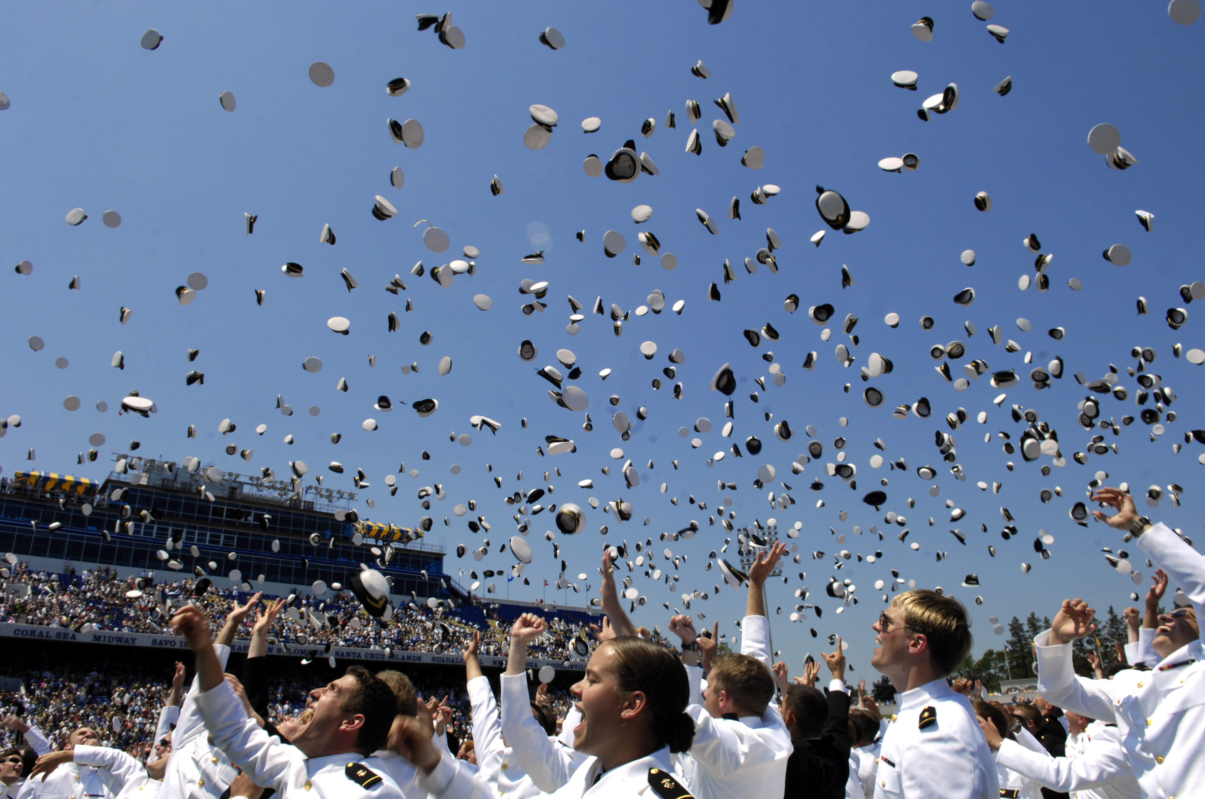
Each of n men throws his hat. The hats are mixed up and randomly reassigned, one to each person. What is the probability that at least someone gets their own hat?

Slide 13
Hats
Probability model
outcome = assignment of n hats to n people
let’s do n = 4: 1342 means
1 gets 1’s hat
3 gets 4’s hat
2 gets 3’s hat
4 gets 2’s hat
The sample space S consists of all permutations
p₁p₂p₃p₄ of the numbers 1, 2, 3, 4

Slide 14
Hats
S = {
1234, 1243, 1324, 1342, 1423, 1432,
2134, 2143, 2314, 2341, 2413, 2431,
3124, 3142, 3214, 3241, 3412, 3421,
4123, 4132, 4213, 4231, 4312, 4321 }
H: “at least someone gets their own hat”
|H|
15
P(H) =
=
|S|
24
Now let’s calculate in a different way.

Slide 15
Hats
Event H “at least someone gets their own hat”
H = H₁ ∪ H₂ ∪ H₃ ∪ H₄
H_{i} is the event “person i gets their own hat”.
H₁ = {p₁p₂p₃p₄ : permutations such that p₁ = 1}
and so on.

Slide 16
Hats
We will calculate P(H) by inclusion-exclusion:
P(H₁ ∪ H₂ ∪ H₃ ∪ H₄)
= P(H₁) + P(H₂) + P(H₃) + P(H₄)
– P(H₁H₂) – P(H₁H₃) – P(H₁H₄) – P(H₂H₃) – P(H₂H₄) – P(H₃H₄)
+ P(H₁H₂H₃) + P(H₁H₂H₄) + P(H₁H₃H₄) + P(H₂H₃H₄)
– P(H₁H₂H₃H₄).
|E|
|E|
P(E) =
Under equally likely outcomes,
=
|S|
4!

Slide 17
Hats
H₁ = { p₁p₂p₃p₄ : permutations such that p₁ = 1}
|H₁|
= number of permutations of {2, 3, 4} = 3!
H₂ = { p₁p₂p₃p₄ : permutations such that p₂ = 2}
|H₂|
= number of permutations of {1, 3, 4} = 3!
similarly |H₃| = |H₄| = 3!
P(H₁) = P(H₂) = P(H₃) = P(H₄) = 3!/4!

Slide 18
Hats
H₁ = { p₁p₂p₃p₄ : permutations such that p₁ = 1}
H₂ = { p₁p₂p₃p₄ : permutations such that p₂ = 2}
H₁H₂ = { p₁p₂p₃p₄ : permutations s.t. p₁ = 1 and p₂ = 2}
|H₁H₂|
= number of permutations of {3, 4} = 2!
similarly |H₁H₃| = |H₁H₄| = … = |H₃H₄| = 2!
P(H₁H₂) = … = P(H₃H₄) = 2!/4!

Slide 19
Hats
P(H₁ ∪ H₂ ∪ H₃ ∪ H₄)
= P(H₁) + P(H₂) + P(H₃) + P(H₄)
– P(H₁H₂) – P(H₁H₃) – P(H₁H₄) – P(H₂H₃) – P(H₂H₄) – P(H₃H₄)
+ P(H₁H₂H₃) + P(H₁H₂H₄) + P(H₁H₃H₄) + P(H₂H₃H₄)
– P(H₁H₂H₃H₄).
value
3!/4!
2!/4!
1!/4!
0!/4!
×
–
×
+
×
–
×
number of
terms
C(4, 1)
C(4, 2)
C(4, 3)
C(4, 4)

Slide 20
Hats
It remains to evaluate
3!/4!
2!/4!
1!/4!
0!/4!
P(H) =
×
–
×
+
×
–
×
C(4, 1)
C(4, 2)
C(4, 3)
C(4, 4)
Each term has the form
(4 – k)!
4!
(4 – k)!
1
C(4, k)
=
×
=
4!
k! (4 – k)!
4!
k!
1
1
1
1
15
so P(H) =
–
+
–
=
1!
2!
3!
4!
24

Slide 21
Hats
General formula for n men:
Let E_{n} = “at least someone gets their own hat”
1
1
1
1
P(E_{n}) =
–
+
– … + (-1)^{n+1}
1!
2!
3!
n!
assuming equally likely outcomes.

Slide 22
Hats
0.63212…
P(E_{n})
n

Slide 23
Hats
Remember from calculus
x²
x³
e^{x} = 1 + x +
+
+ …
2!
3!
1
1
1
1
P(E_{n}) =
–
+
– … + (-1)^{n+1}
1!
2!
3!
n!
so P(E_{n}) → 1 – e⁻¹ ≈ 0.63212 as n → ∞

Slide 24
Circular arrangements
In how many ways can n people sit at a round table?
We do not distinguish between seatings that differ by a rotation of the table.
2
2
3
3
4
4
1
3
1
4
1
2
1
4
1
2
1
3
4
3
4
2
3
2
Once the first person has sat down, the others can be arranged in (n – 1)! ways relative to his position.
(n – 1)!

Slide 25
Round table
10 husband-wife couples are seated at random at a round table. What is the probability that no wife sits next to her husband?
Probability model
The sample space S consists of all circular arrangements of {H₁, W₁, …, H₁₀, W₁₀}
|S| = (n – 1)!
We assume equally likely outcomes.

Slide 26
Round table
The event N of interest is that no husband and wife are adjacent. Let A₁, …, A₁₀ be the events
A_{i} = “The husband-wife pair H_{i}, W_{i} is adjacent”
so
P(N) = 1 – P(N^{c}) = 1 – P(A₁ ∪ … ∪ A₁₀)
We calculate this using inclusion-exclusion.

Slide 27
Round table
The inclusion exclusion formula involves expressions like P(A₁), P(A₂A₅), P(A₃A₄A₇A₉).
Let’s start with P(A₁), so we want H₁ and W₁ adjacent.
We need to calculate |A₁|, the number of circular arrangements in which H₁ and W₁ are adjacent.

Slide 28
Round table
We use the basic principle of counting.
W₁
W₁
H₂
H₂
W₂
W₂
H₁
H₂
H₁
W₂
H₁
W₁
H₁
W₂
H₁
W₁
H₁
H₂
W₂
H₂
W₂
W₁
H₂
W₁
Treating the couple H₁, W₁ as a single unordered item, we get 18! circular arrangements
For each of this arrangements, the couple can sit in the order H₁W₁ or W₁H₁ --- 2 possibilities so
|A₁| = 2 × 18!
P(A₁) = 2 × 18! / 19!

Slide 29
Round table
In general, the events in the inclusion-exclusion formula are indexed by some set C of couples.
E.g. if A₃A₄A₇A₉ then C = {3, 4, 7, 9}.
In how many ways can we arrange the couples so that those in C are adjacent?
Treating the couples in C as single unordered items, we get (19 – |C|)! arrangements.
For each such arrangement, we can order the C couples in 2^{|C|} possible ways.
2^{|C|}(19 – |C|)!

Slide 30
Round table
P(A₁ ∪ A₂ ∪…∪A₁₀)
value
#terms
= ∑_{1 ≤ i ≤ 10} P(A_{i})
2 × 18! / 19!
×
10
– ∑_{1 ≤ i ≤ j ≤ 10} P(A_{i}A_{j})
2² × 17! / 19!
×
C(10, 2)
+ ∑_{1 ≤ i ≤ j ≤ k ≤ 10} P(A_{i}A_{j}A_{k})
2³ × 16! / 19!
×
C(10, 3)
…
– P(A₁A₂…A₁₀)
2¹⁰ × 9! / 19!
×
1
0.6605…
so P(N) = 1 – 0.6605… = 0.3395…

Slide 31
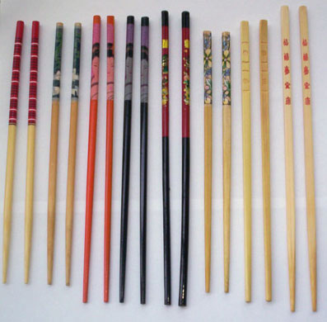
Problem for you to solve
You have 8 different chopstick pairs and you randomly give them to 8 guests.
What is the probability that no guest gets a matching pair?

