Slide 1
1. Combinatorial Analysis

Slide 2



Example
Alice
Bob
Range of signal

Slide 3
Example
Alice
Bob
Some relay antennas may be defective

Slide 4
Example
Alice
Bob

Slide 5
Example
Alice
Bob
No connection

Slide 6
Example
Can Alice and Bob make a connection?
Assumptions
1. Each antenna is defective half the time
2. Antenna defects are independent of one
another

Slide 7
Solution
1. Connection can be made if
no two consecutive antennas are defective
Let’s call such configurations good
2. By our assumption there are 16 possible
configurations, all equally likely

Slide 8
Solution
Alice and Bob can communicate
8/16 = 50% of the time

Slide 9
Counting
To solve a probability problem, we
often need to count the number of
possible outcomes.
In example we saw, the solution was
number of good antenna configurations
number of all possible antenna configurations

Slide 10
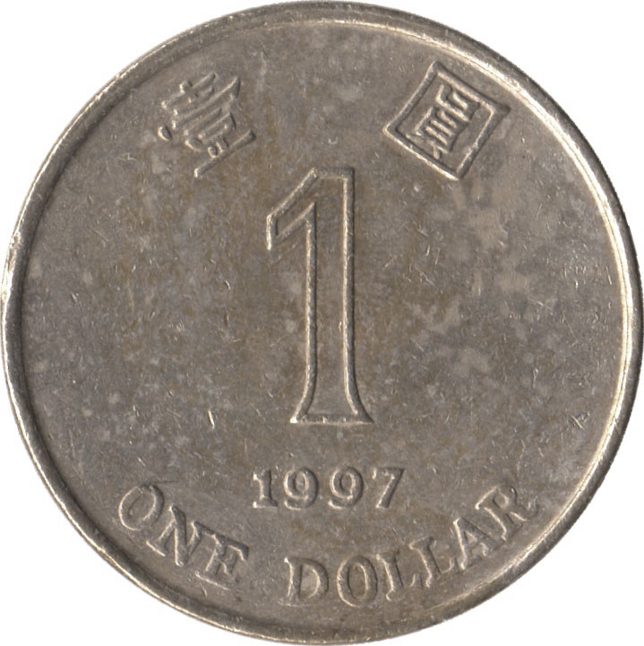

Sample spaces
A sample space is a set of possible outcomes.
Examples
outcomes = {H, T}
outcomes = {1, 2, 3, 4, 5, 6}

Slide 11
Sample spaces
Examples
outcomes = { HH, HT, TH, TT }
a pair of coins
outcomes = { 11, 12, 13, 14, 15, 16,
21, 22, 23, 24, 25, 26,
31, 32, 33, 34, 35, 36,
41, 42, 43, 44, 45, 46,
51, 52, 53, 54, 55, 56,
61, 62, 63, 64, 65, 66 }
a pair of dice

Slide 12
Basic principle of counting
You perform two experiments.
Experiment 1 has n possible outcomes.
For each such outcome,
experiment 2 has m possible outcomes.
Then together there are nm possible outcomes.
Examples
Tossing two coins: 2×2 = 4 outcomes.
Tossing two dice: 6×6 = 36 outcomes.
Tossing a die and a coin: 6×2 = 12 outcomes.

Slide 13
Basic principle of counting
You perform r experiments.
Experiment 1 has n₁ possible outcomes.
For each outcome of experiment 1,
experiment 2 has n₂ possible outcomes.
For each outcome of experiments 1 and 2,
experiment 3 has n₃ possible outcomes
…
Then together there are n₁n₂…n_{r} outcomes

Slide 14
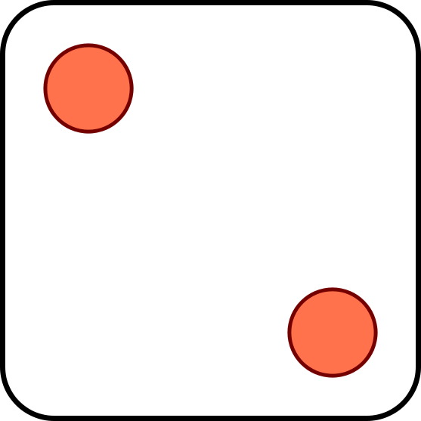
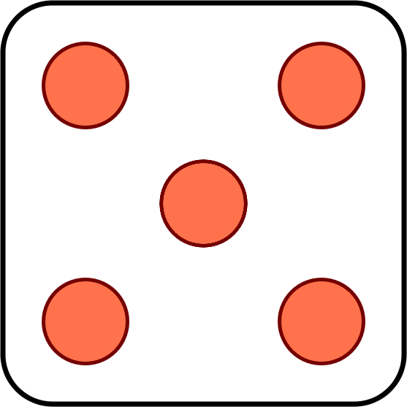
Quiz
You toss two dice. How many ways are there for
the two dice to come out different?
A
B
C
15 ways
25 ways
30 ways

Slide 15
Quiz
Solution 1:
11, 12, 13, 14, 15, 16,
21, 22, 23, 24, 25, 26,
31, 32, 33, 34, 35, 36,
41, 42, 43, 44, 45, 46,
51, 52, 53, 54, 55, 56,
61, 62, 63, 64, 65, 66
C
30 ways
Solution 2:
First die has 6 possible outcomes.
For each one of them,
second die has 5 possible outcomes
Together there are 6×5 = 30 outcomes.

Slide 16

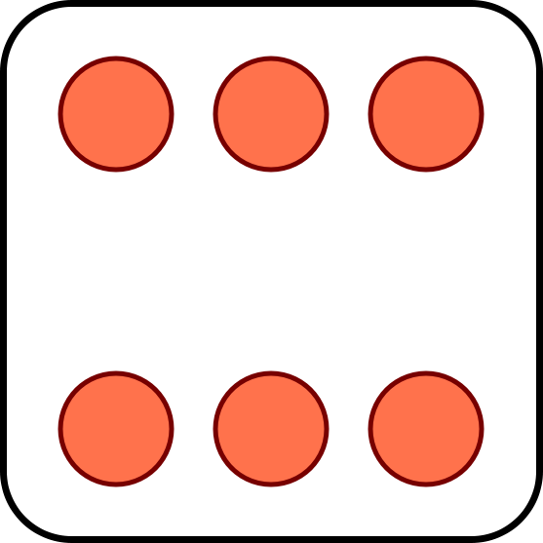
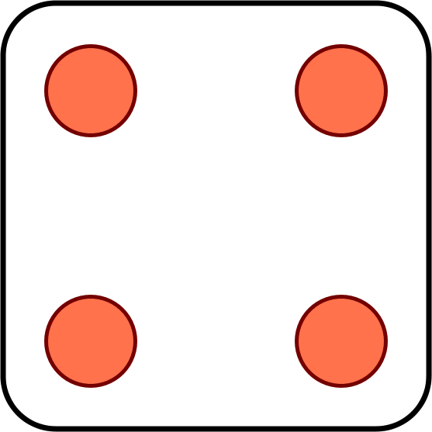
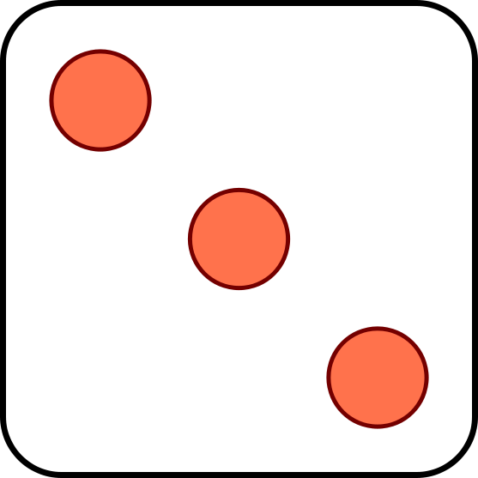
Permutations
You toss six dice. How many ways are there for
all six dice to come out different?
Answer: 6×5×4×3×2×1 = 720
In general, the number of permutations (ordered arrangements) of n different objects is
n × (n − 1) × … × 1 = n!

Slide 17
Equally likely outcomes
If we toss k dice, there are 6^{k} possible outcomes
Let’s assume all outcomes are equally likely
For two dice, the chance both come out different is
6×5
≈ 83%
6×6
For six dice, the chance they all come out different is
6!
≈ 1.5%
6⁶

Slide 18
Problems for you to solve
Toss two dice. Assuming equally likely outcomes, what are the chances that
(a) The second one is bigger?
(b) The sum is equal to 7?
(c) The sum is even?

Slide 19



Problem for you to solve
There are 3 brothers. Assuming equally likely outcomes, what are the chances that their birthdays are
(a) All on the same day of the week?
M T W T F S S
(b) All on different days of the week?
M T W T F S S

Slide 20
Arrangements
You have r red balls and b blue balls
Balls of same color are identical
How many possible arrangements of the balls?
Example:
r = 3, b = 2
outcomes = { RRRBB, RRBRB, RRBBR, RBRRB,
RBRBR, RBBRR, BRRRB, BRRBR,
BRBRR, BBRRR }

Slide 21
How to count arrangements
Let’s first pretend all balls are different
R₁, R₂, R₃, B₁, B₂
They can be arranged in 5! possible ways.

Slide 22
How to count arrangements
Now any arrangement of the actual balls, e.g.
RRRBB
could arise from
R₁R₂R₃B₁B₂
R₁R₂R₃B₂B₁
R₂R₁R₃B₁B₂
R₂R₁R₃B₂B₁
R₁R₃R₂B₁B₂
R₁R₃R₂B₂B₁
R₂R₃R₁B₁B₂
R₂R₃R₁B₂B₁
R₃R₁R₂B₁B₂
R₃R₁R₂B₂B₁
R₃R₂R₁B₁B₂
R₃R₂R₁B₂B₁
There are 3! arrangements of the Rs
For each of them, 2! arrangement of the Bs
By counting principle, 2! 3! possibilities

Slide 23
How to count arrangements
# arrangements for
identical balls
# arrangements for different balls
=
# ways to get each arrangement
5!
=
=
10
3! 2!
In general for r red balls and b blue balls the number
of arrangements is (r + b)! / (r! b!)
If there are k different ball colors and n_{i} identical
balls of color i the number of arrangements is
(n₁ + … + n_{k})!
n₁! n₂! … n_{k}!

Slide 24
Problems for you to solve
In how many ways can you arrange 10 red and 10 blue balls?
In how many ways can you arrange 10 red and 10 blue balls so the first two balls are of the same color?
Assuming equally likely outcomes, what are the chances that among 10 red and 10 blue balls, the first two balls are of the same color?

Slide 25
Combinations
In how many ways can you choose 3 numbers out of
5 numbers {1, 2, 3, 4, 5}?
Take 3 red balls, 2 blue balls. In an arrangement, the 3 numbers are described by the red ball positions:
1
2
3
4
5
So we have 5! / (3! 2!) ways to choose the 3 objects.
In general, k objects out of n can be chosen in
(
n
)
n!
=
ways.
k
k! (n - k)!

Slide 26
Problems for you to solve
There are 10 students and you need to choose two committees with 3 students in each.
(a) In how many ways can you choose?
(b) … so that the committees do not overlap?
(c) … with at least one person in both?
(d) … with exactly one person in both?

Slide 27
Example
There are r red balls and b blue balls. No two red balls should be consecutive. In how many ways can they be arranged?
Solution
The r red balls can occupy any of the b + 1 dashed slots
(
)
b + 1
This can be done in ways
r

Slide 28
Answer check
from itertools import *
def no_consecutive_reds(red, blue):
total = 0
bad = 0
for arrangement in combinations(range(red + blue), red):
total = total + 1
for i in range(red - 1):
# if the i-th and (i+1)-st red balls are consecutive
if arrangement[i + 1] - arrangement[i] == 1:
# this outcome is bad
bad = bad + 1
break
good = total - bad
return good
>>> no_consecutive_reds(5, 8)
126
(
)
8 + 1
= 126
5
http://docs.python.org/2/library/itertools.html

Slide 29
Number of integer solutions
In how many ways can you distribute 8 identical $1 coins to Alice, Bob, Charlie, and David?
A
B
C
D
A
B
C
D

Slide 30
Number of integer solutions
In how many ways can you distribute 8 identical $1 coins to Alice, Bob, Charlie, and David?
Answer
= # arrangements of 8 and 3
= (8 + 3)! / 8! 3!
= 165.

Slide 31
Problem for you to solve
Assuming equally likely outcomes, what are the chances that...
(a) everyone gets $2?
(b) everyone gets at least $1?

