Slide 1
8. Multiple Continuous
Random Variables
ENGG 2760A / ESTR 2018: Probability for Engineers
Fall 2020

Slide 2
One random variable review
PMF f(x)
PDF f(x)
P(X ≤ a)
∑_{x ≤ a} f(x)
∫_{x ≤ a} f(x)dx
E[X]
∑_{x} x f(x)
∫_{x} x f(x)dx
E[X²]
∑_{x} x² f(x)
∫_{x} x² f(x)dx
Var[X]
E[(X – E[X])²] = E[X²] – E[X]²

Slide 3
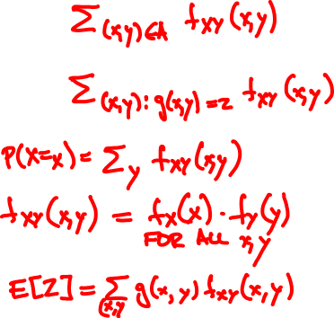
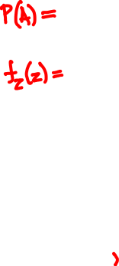
Discrete two variables review
joint PMF f_{XY}(x, y) = P(X = x, Y = y)
Probability of A
Derived RV Z = g(X, Y)
Marginals
Independence
Expectation

Slide 4
Continuous random variables
A pair of continuous random variables X, Y can be specified either by their joint c.d.f.
F_{XY}(x, y) = P(X ≤ x, Y ≤ y)
or by their joint p.d.f.
∂
∂
f_{XY}(x, y)
=
F_{XY}(x, y)
∂x
∂y
P(x < X ≤ x + ε, y < Y ≤ y + δ)
=
lim
ε, δ → 0
εδ

Slide 5

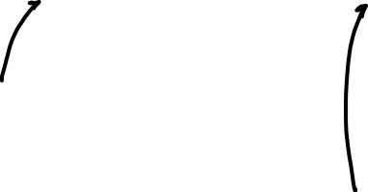
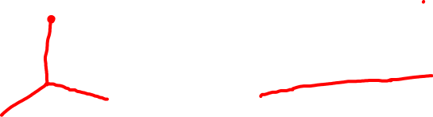
Rain drops at a rate of 1 drop/sec. Let X and Y be the arrival times of the first and second raindrop.
X
Y
F(x, y) = P(X ≤ x, Y ≤ y)
f(x, y)
=
∂
∂
F(x, y)
∂x
∂y

Slide 6
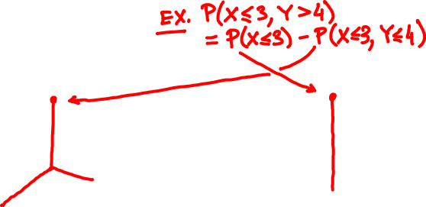
Continuous marginals
Joint CDF F_{XY}(x, y) = P(X ≤ x, Y ≤ y)
Marginal CDF:
F_{X}(x) = P(X ≤ x)
P(X ≤ x)
Exponential(1)

Slide 7

the continuous cheat sheet
X, Y continuous with joint p.d.f. f_{XY}(x, y)
Probability of A
P(A) = ∫∫_{A} f_{XY} (x, y) dxdy
Derived RV Z = g(X, Y)
f_{Z}(z) = ∫_{(x, y): g(x, y) = z} f_{XY}(x, y) dxdy
Marginals
∞
f_{X}(x) = ∫_{-∞} f_{XY}(x, y) dy
Independence
f_{XY}(x, y) = f_{X}(x) f_{Y}(y) for all x, y
Expectation
E[Z] = ∫∫ g(x, y) f_{XY}(x, y) dxdy

Slide 8
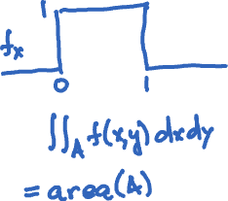
Independent uniform random variables
Let X, Y be independent Uniform(0, 1).
1
if 0 < x, y < 1
f_{XY}(x, y) = f_{X}(x) f_{Y}(y) =
0
if not
f_{XY}(x, y)
P(A) =

Slide 9
Romeo and Juliet have a date between 9 and 10.
The first to arrive will wait for 15 minutes and leave if the other isn’t there.
What is the probability they meet?

Slide 10
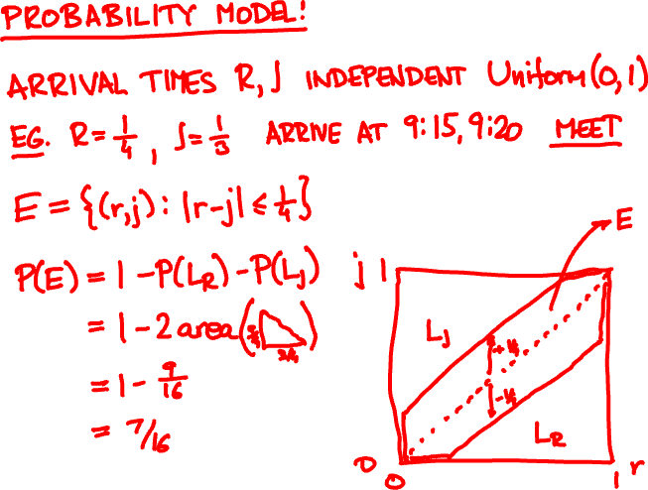

Slide 11
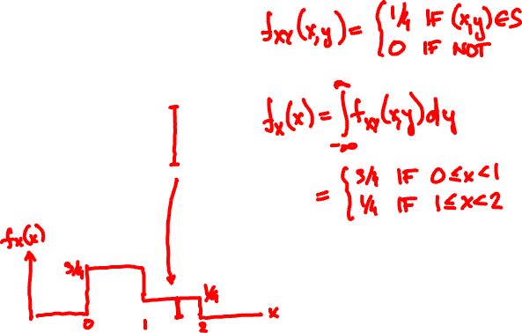
Joint PDF of X, Y is uniform over S.
What are the marginals?
y
3
2
S
1
0
x
0
1
2

Slide 12
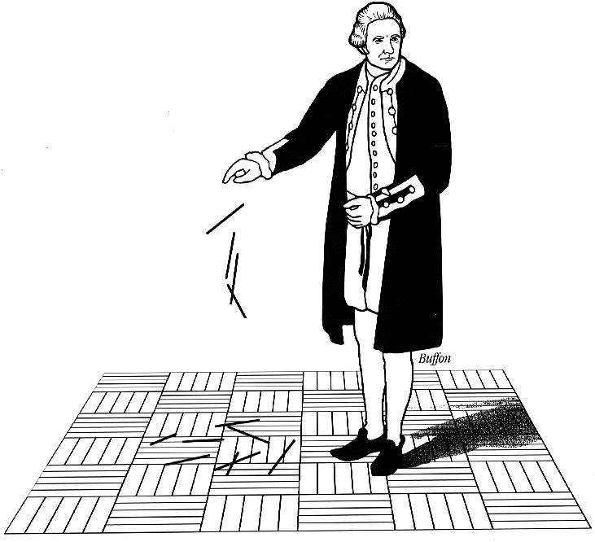
Buffon’s needle
A needle of length l is randomly dropped on a ruled sheet.
What is the probability that the needle hits one of the lines?

Slide 13
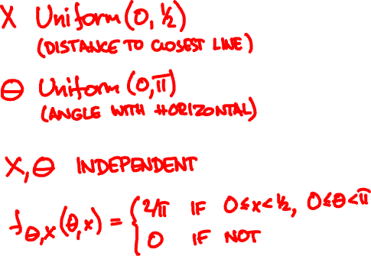
Probability model
X
Θ
1

Slide 14
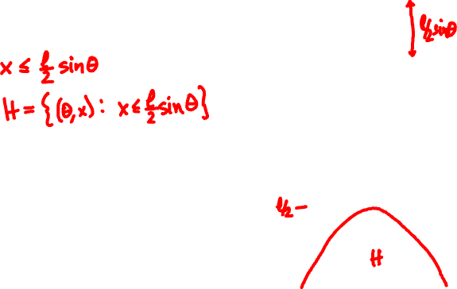
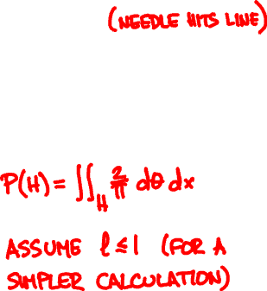
Buffon’s needle
l/2
Event H :
X
Θ
1
½
x
0
0
θ
π

Slide 15
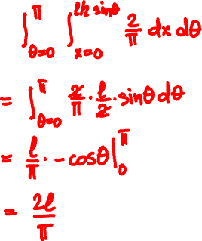
Buffon’s needle
Assume l ≤ 1 (short needle)
P(H) =

Slide 16
Conditioning
Y
discrete
continuous
X
P(X = x, Y = y)
discrete
P(X = x | Y = y) =
P(Y = y)
continuous

Slide 17
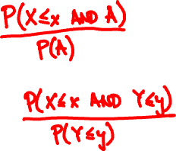
Conditioning
Y
discrete
continuous
X
discrete
P(X ≤ x | A) =
P(X ≤ x | Y ≤ y) =
continuous

Slide 18
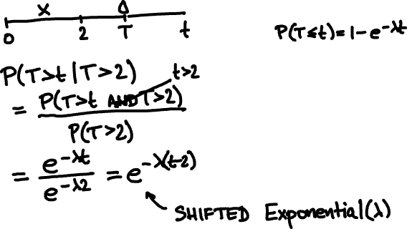
Rain drops at a rate λ = 1/sec.
You walk for 2 sec, no drop yet.
What is the arrival time of first drop?
Exponential(λ) CDF

Slide 19
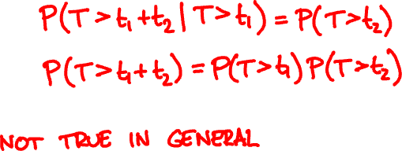
T
Memorylessness of Exponential(λ):

Slide 20
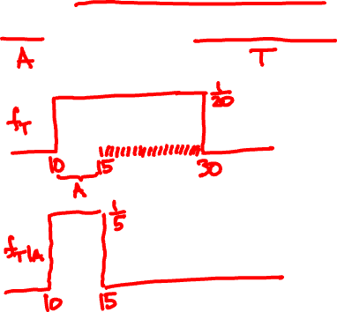
Alice arrives 8.10 - 8.30.
2430A
Given she caught the first bus, what is her arrival time?
8.15 AM
8.30 AM

Slide 21
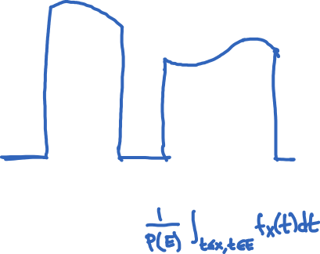
Conditioning a continuous RV on an event
f_{X}(x)
PDF:
f_{X | E} (x) =
when x ∈ E
P(E)
f_{X}(x)
x
E
CDF:
P(X ≤ x | E) =

Slide 22
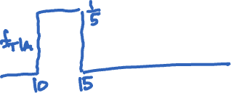
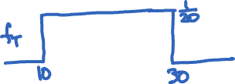
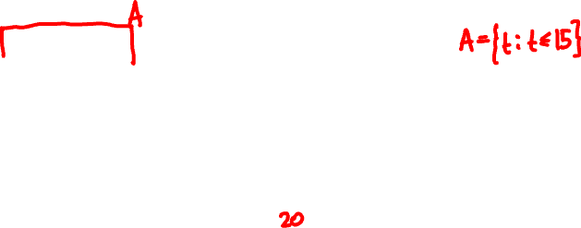

Arrival time is Uniform(10, 30)
2430A
Conditional arrival time PDF:
8.15 AM
8.30 AM

Slide 23
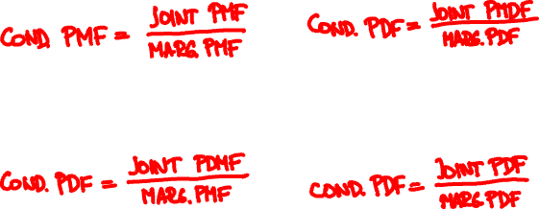
Conditioning
X
discrete
continuous
Y
discrete
f_{XY}(x, y)
f_{Y|X}(y | x) =
f_{X}(x)
continuous

Slide 24
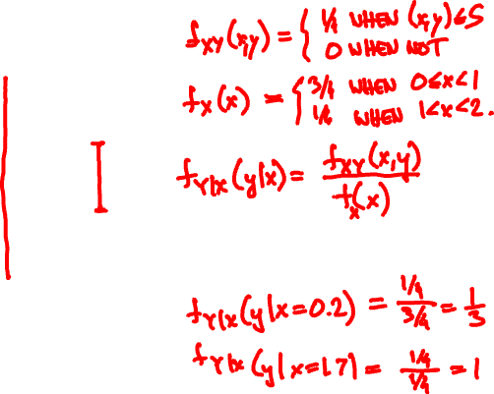
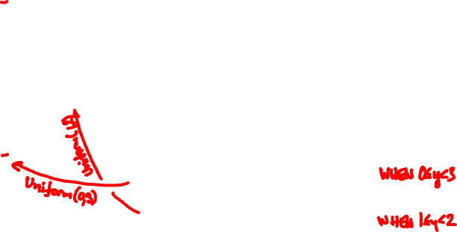
Joint PDF of X, Y is uniform over S.
What are the conditional PDFs?
y
3
2
S
1
0
x
0
1
2

Slide 25
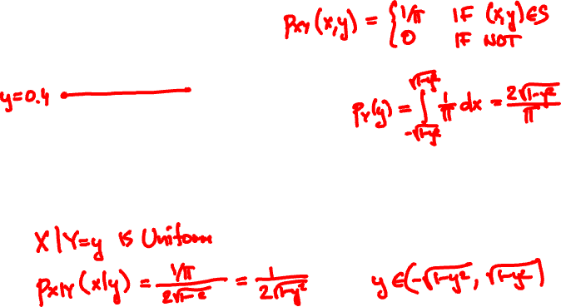

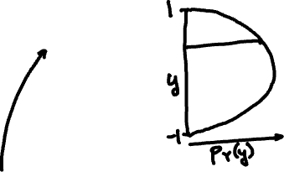

Joint PDF of X, Y is uniform over S.
What are the marginal and conditional PDFs?
S

Slide 26
Total probability theorem:
f_{X}(x) = ∑_{y} f_{X|Y}(x | y) f_{Y}(y)
Y discrete
f_{X}(x) = ∫ f_{X|Y}(x | y) f_{Y}(y) dy
Y continuous
Total expectation theorem:
E[X] = ∑_{y} E[X | Y = y] f_{Y}(y)
Y discrete
E[X] = ∫ E[X | Y = y] f_{Y}(y) dy
Y continuous

Slide 27
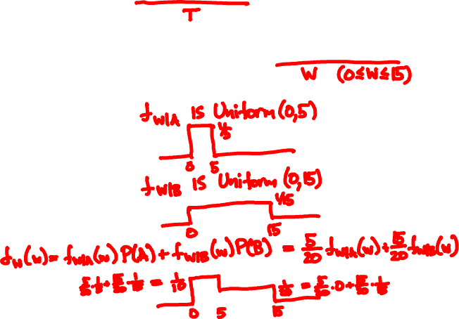
Arrival time is Uniform(10, 30)
2430A
Unconditional waiting time PDF:
8.15 AM
8.30 AM

Slide 28
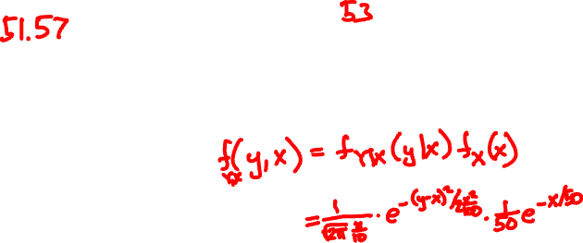

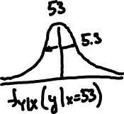
👮‍♂️
50
🚙
Y = Normal(X, X/10)
X = Exponential(1/50)
E[Y] =

Slide 29
Independence
X and Y are independent if
f_{XY}(x, y) = f_{X}(x) f_{Y}(y) for all x, y
if and only if
E[g(X)h(Y)] = E[g(X)]E[h(Y)] for all g, h

Slide 30
Independent Normals
X, Y are Normal(0, 1)

Slide 31
Independent Normals
X is Normal(μ, σ), Y is Normal(μ’, σ’)

Slide 32
Continuous Bayes’ rule
f_{X|Y}(x | y) f_{Y}(y)
f_{Y | X}(y | x) =
f_{X}(x)

Slide 33


X = 1 or -1
Y = X + N
P(X = 1 | Y = y) =

Slide 34
Rain falls at Poisson(Λ) drops/sec
Λ itself is Exponential(1)
You’re hit by 2 drops. What is your guess for Λ?

