Slide 1

Introduction to PHYS3710
Physics, CUHK
http://www.phy.cuhk.edu.hk/djwang/teachlab/index.html

Slide 2
Outline
About this course
The special schedule
Some detailed requirements: lab notebook, data analysis, report writing
Assessment scheme
Lab safety reminder

Slide 3
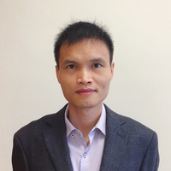

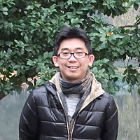
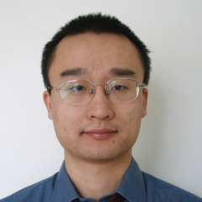
Teaching team
Professors:
Yilin Wu, Dajun Wang
Swee-Kuan Goh, Lei Xu
Technician: Gary Lai
TAs:
Ruoqi Ai, Zhen Chen, Guanghua Chen, Xinxin Xia, Mucan Jin, and Jianyu Xie

Slide 4
Background
Physics is an experimental science, but there were only two lab courses in our old curriculum.
Previous teaching lab courses (Lab I and II) provides only basic skills but didn’t prepare our students for real scientific research and work.
No independent experimental project learning opportunities for students in the old physics curriculum.

Slide 5
Purpose
Provide an opportunity for students to experience the whole process of scientific research.
Skills to pick up:
Independent learning,
reading skill (to read some references at the beginning),
time-management skill (keep track of the progress in taking data),
honesty and organization (honest and organized to the data taken),
data analysis,
drawing conclusions from data,
communication skills (scientific writing or/and oral reporting, discussions with instructors),
Eventually, a systemic way of working on a new scientific problem.

Slide 6
Basic structure
  1-unit; compulsory for year-3 students;
  It is offered in the 1st term and the 2nd semesters;
  One short experimental project to finish independently, which illustrates modern physics and/or experimental technique;
  For each project, a student should plan to work in the lab for at least 5 days, but no more than 10 days
  Prerequisite: PHYS1712 and 2711; special permission of the instructor otherwise.

Slide 7
Projects
 | 1 | 2 | 3 | 4 | 5 | 6 | 7 | 8
 | Special rel. | C60 | Radiometer | Rutherford | Muon | Cavity | NMR | High Tc YBCO
 | Nuclear detector | Coupled Osc. | Soliton | Heat engine | Cu-Ni alloy | Diodes | CCD | Brownian
Modern physics and nuclear physics:
special relativity, Rutherford scattering, nuclear detector, muon lifetime
Solid state physics:
C60, High Tc Superconductor YBCO, magnetic properties of Cu-Ni alloy
Optics and electronics:
optical cavity, ccd, diodes, Brownian
Other:
radiometer, NMR, water soliton, coupled osc., heat engine, saturation spectroscopy

Slide 8
Outline
About this course
The special schedule
Some detailed requirements: lab notebook, data analysis, report writing
Assessment scheme
Lab safety reminder

Slide 9
The schedule: a very difficult situation
We are allowed to have face-to-face teaching, with special permission from the university.
However, no lab sessions are allowed in September.

Slide 10
Schedule: this week
Each project will be offered 3 times (except some with time conflicts due to instruments sharing);
One person per slot;
Make your choice before end of this Friday and mark your name in room 216 (need to come in person).

Slide 11
Choose a project slot within this week

Slide 12
Schedule: September
Reference reading and remote discussion
Find out the TA and professor in charge of your project.
Contact the Mr. Gai for the lab manual and references (E-copy).
After studying the documents, make an appointment and discuss with the professor in charge of your project within this month.
During the discussion, you should show your understanding and plan including your working schedule of the selected project.
Can’t start the experimental part without the Prof’s approval.
Zoom links will be sent to you only after receiving the appointment request.

Slide 13
Teaching team duty distribution

Slide 14
Schedule: Lab sessions
Lab sessions start from October 5: each group should finish the project, including preparation, data taking and analyzing within 2 weeks starting from the designated date
Another one weeks for report writing. The professors offer a proof-reading opportunity for your draft report if the report is submitted 3 days before the due date.

Slide 15
Schedule: note to lab sessions
You need to follow your planned schedule: otherwise no one can follow and help you.
Try to get things done with maximum independence: think hard enough before asking for help, but don’t hesitate to ask for help.
TAs, technician and professors are available, but you need to make appointments in advance.
Running experiment after 5:30 pm alone is not allowed: university rule. In special cases, you need to make arrangement with TAs in advance.

Slide 16
Outline
About this course
The special schedule
Some detailed requirements: lab notebook, data analysis, report writing
Assessment scheme
Lab safety reminder

Slide 17
Lab notebook
It is one of the most important part of this course
It should be in a detailed, organized, dairy style and reflect the real-time progress of the project
It should include, but not limited to these: physics understanding of the project in your own words, overall procedure, experimental schematics, records of experimental parameters, plots of raw data, details of your analysis, results and conclusions
All contents on the notebook should be permanent, including mistakes (marked by strikethrough lines)
Handwriting should be legible (to you and to others)
It should be submitted together with your report
Ask Mr. Gary Lai for the notebook itself when choosing your project

Slide 18
Data analysis
One of the most important parts of scientific research: in many cases, data analysis takes more time than data taking!
One common mistake: show lots of raw data without any analysis!
Others: errors misrepresented, units missing

Slide 19
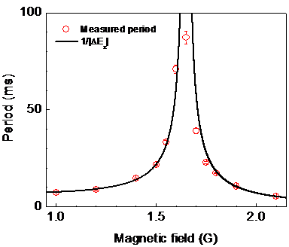

Slide 20
Lab report
Journal format: Physics Review (A,B,C,D)
Latex is suggested (visit www.sharelatex.com); Word is ok but harder to work with for journal papers. We can provide help for first time users.
Organization: not fixed, just an example
Title:
Author and affiliation:
Abstract:
Main text in sections (just an example!):
Introduction
Theory
Experiment
Results and discussions
Conclusion
Acknowledgements

Slide 21
Lab report: common mistakes
Wrong format: harder to follow Physical Review format without using Latex
Abstract: duplication of the first and last sentences of the main text!
References: not in place
Figures: without post-processing, without clear labels (with units) and marks
Figures: too many. A series of measurements with only one changing variables should be compiled together to form one figure, if you want to show them.
Figures: captions too simple. Everything shown should be explained clearly.

Slide 22
Outline
About this course
The special schedule
Some detailed requirements: lab notebook, data analysis, report writing
Assessment scheme
Lab safety reminder

Slide 23
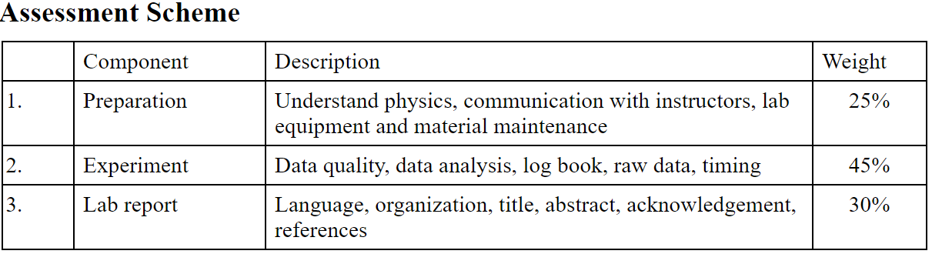
Assessment scheme
Submit the lab report, the raw data and the lab notebook to the
professor in charge of your project.
Submit in person or by email!
Don’t use the box in the 2nd floor!
Not only the report

Slide 24
Assessment scheme: more details
We have 4
professors now.
To make sure the
grading is more
uniform, we will
use a more detailed
marking scheme.

Slide 25
Assessment scheme: criterion referencing
Grade Descriptors
A : Demonstrate thorough mastery of the subject (of the project or seminar) required for attaining all the course learning outcomes. Demonstrate evidence of original thoughts and the ability of critical use of data or results to draw insightful conclusions, in a manner that would surpass the normal expectation at this level and standards that may be required at higher levels of study or research. Has the ability to express the knowledge and synthesis of ideas in a clear and cogent manner.
A- : Demonstrate substantial command of the subject (of the project or seminar) required for attaining almost all the course learning outcomes. Demonstrate the ability of critical use of data or results to draw meaningful conclusions, in a manner that is logical and comprehensive. Has the ability to express the knowledge or application with clarity and accuracy.
B : Demonstrate general and sufficient command of the subject (of the project or seminar) required for attaining most of the course learning outcomes. Demonstrate the ability of the use of data or results to draw mostly correct conclusions, in a manner that is logical and persuasive. Has the ability to express the knowledge or application in a satisfactory and unambiguous way.
C : Demonstrate general command of the subject (of the project or seminar) required for attaining some of the course learning outcomes. Demonstrate the ability of the use of data or results to draw conclusions, but with occasional errors. Has the ability to express the separate pieces of knowledge in an unambiguous way.
D : Demonstrate partial command the subject (of the project or seminar) required for attaining some of the course learning outcomes. Has limited ability to use data or results to draw conclusions. Has the ability to state the knowledge in simple terms.
F : Demonstrate little or no evidence of command of subject (of the project or seminar) required for attaining the course learning outcomes, OR failure to meet specified assessment requirements.

Slide 26
Outline
About this course
The special schedule
Some detailed requirements: lab notebook, data analysis, report writing
Assessment scheme
Lab safety reminder

Slide 27
Last but not the least: Lab safety issues
Extremely hazardous radiation: Nuclear, x-ray
Chemicals: some solvents
Electromagnetic radiation: lasers, radio and microwave frequency
Low temperature: LN2, He
High temperature: furnace
HV and UHV Vacuum
Make sure you understand the standard operation
procedure in dealing with these;
If you feel uncertain about any thing of these: stop and ask for help

Slide 28
Thanks!

